Slide 1
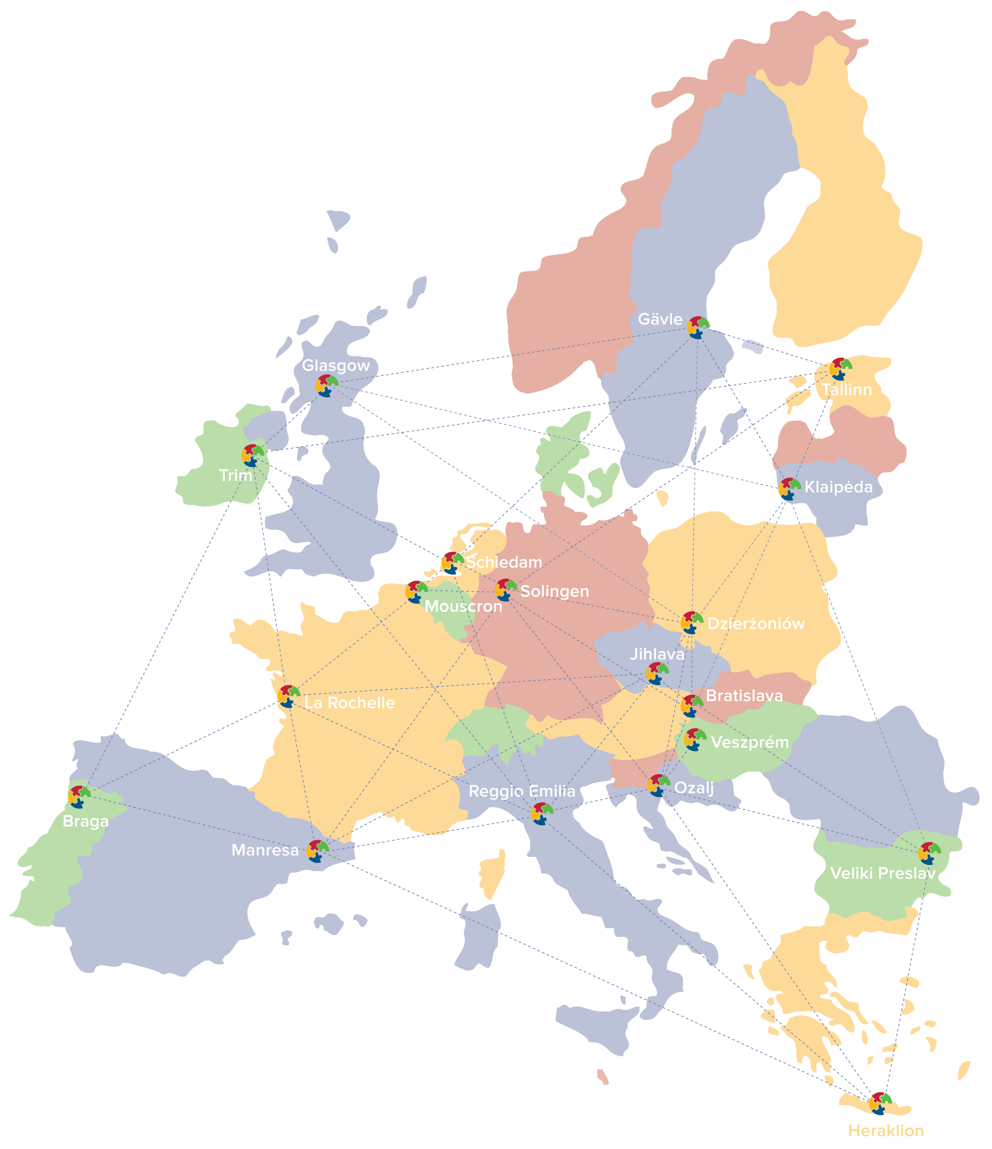
An URBACT
pilot network
on localising the
UN Sustainable Development Goals

Slide 2
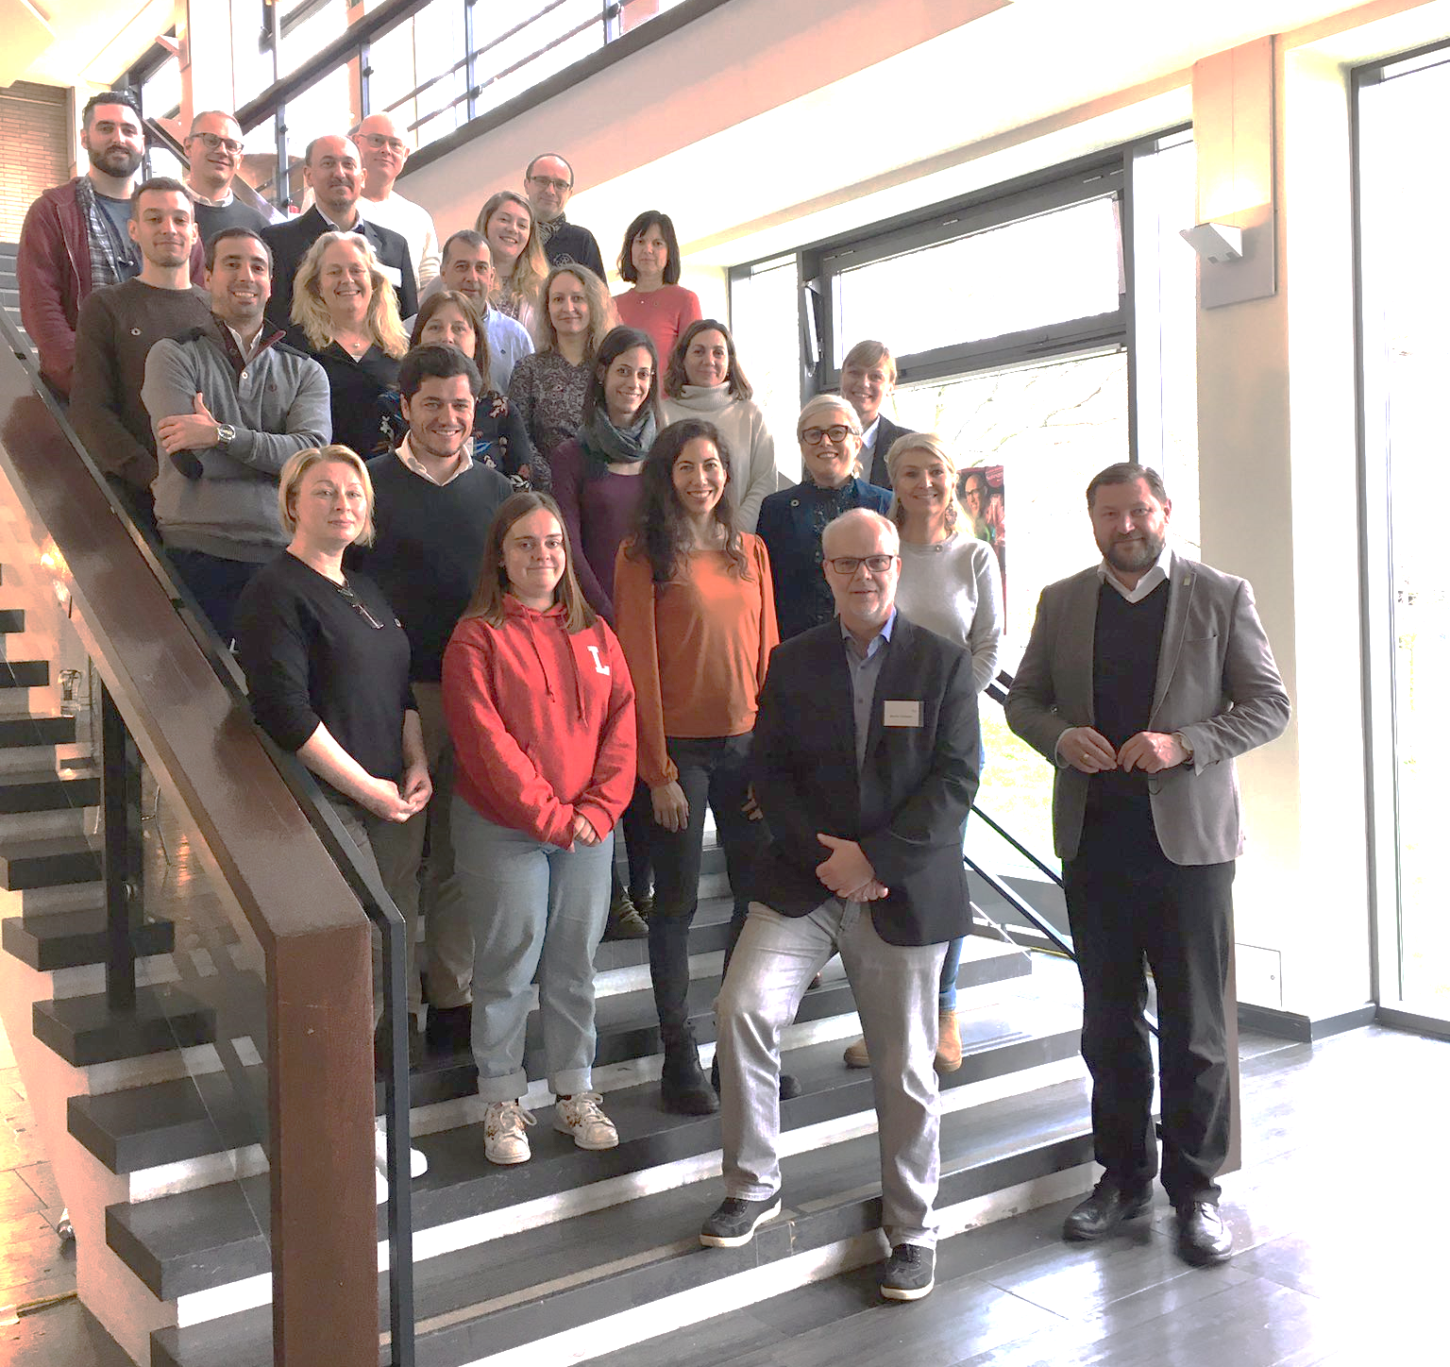
19 partner cities from all over Europe
6 000+ - 600 000+ inhabitants
Tallinn (Estonia) as lead partner

Slide 3
“Global Goals for Cities”
is a pilot network of cities and strategic
Partnership aimed at accelerating progress
Towards achieving the Sustainable Development
Goals in 19 cities in the EU, through peer learning
and integrated action planning.
The partnership is funded by the European Regional Development Fund and the
Member and Partner States, in the framework of the URBACT III European Territorial Cooperation programme.

Slide 4
Scope of the network
An URBACT pilot network
to support a group of EU cities to exchange, build capacities and develop tools to localise the SDGs
following the URBACT method incl. networking, action peer-learning, integrated and participatory approach
In the end of the project, all partners will have produced an Integrated Action Plan for localizing the SDGs in their context
In partnership with CEMR
using the Reference Framework for Sustainable Cities (RFSC) self-assessment tool
open to international cooperation and peer-learning between cities worldwide, beyond EU

Slide 5
Localising the SDGs
The process of taking into account subnational contexts in the achievement of the 2030 Agenda, from the setting of goals and targets, to determining the means of implementation and using indicators to measure and monitor progress” – UCLG definition
17 Goals
169 Targets
232 Global indicators

Slide 6
An integrated approach
The 2030 Agenda is organised around 5 dimensions « 5Ps »: Planet, People, Prosperity, Peace and Partnership
The 5 Ps and the 17 SDGs are interconnected and interdependent
The 2030 Agenda 2030 is universal: all 193 Member States have agreed on the 17 goals and 169 targets.

Slide 7
Action Planning journey in 5 key phases
March 2021
December 2022
Diagnosis
Visioning
Planning Actions
Fixing Indicators
Finale
SDG Priorities and Gaps analysis
SDG Stories
Awareness-raising and citizen engagement
Co-creation of Integrated Action Plans for localising
the SDGs
Participation and co-creation
Lessons learned and good practices
Spreading knowledge

Slide 8
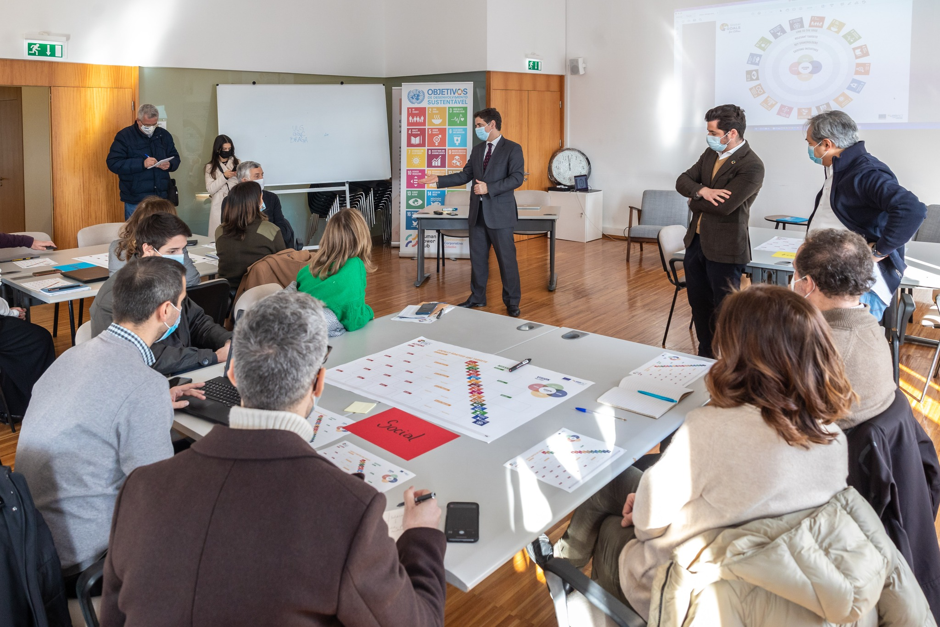
An participatory approach:
The URBACT Local Group
Every partner sets up an URBACT Local Group with different stakeholders from the city
Together, they co-create the Integrated Action Plan using the Action Planning tools proposed in the international exchanges
This helps to make sure that the plan reflects the needs of the city

Slide 9
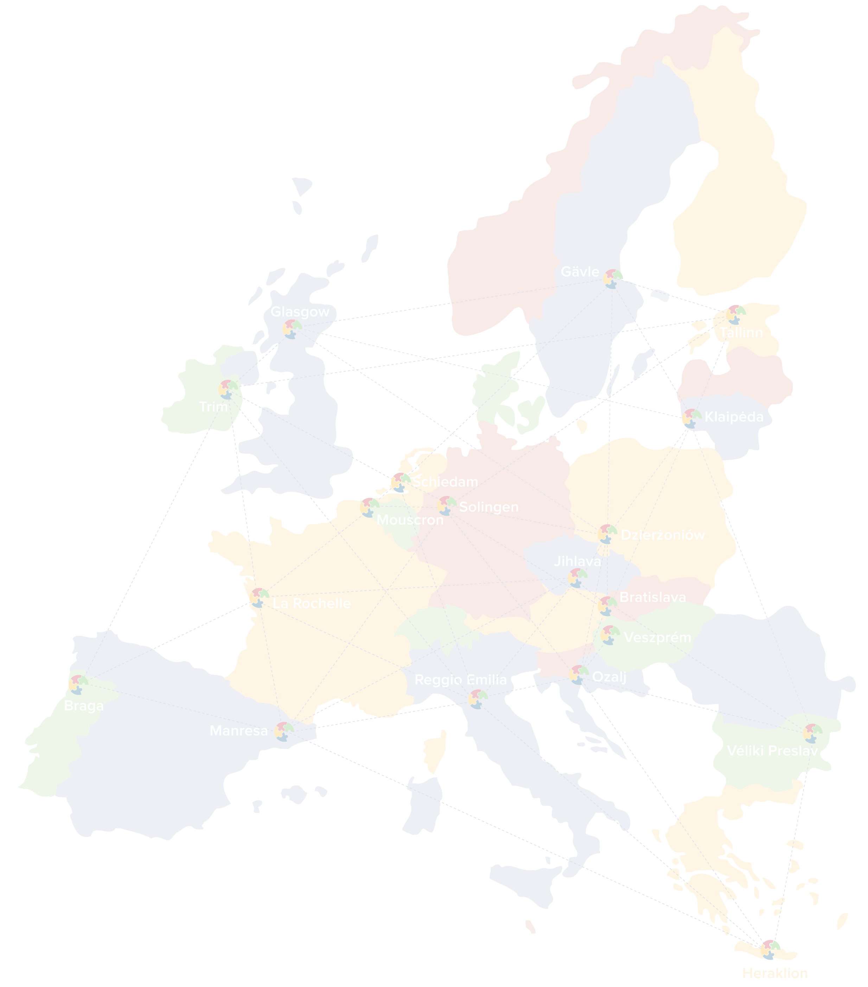
Diagnosis Phase

Slide 10
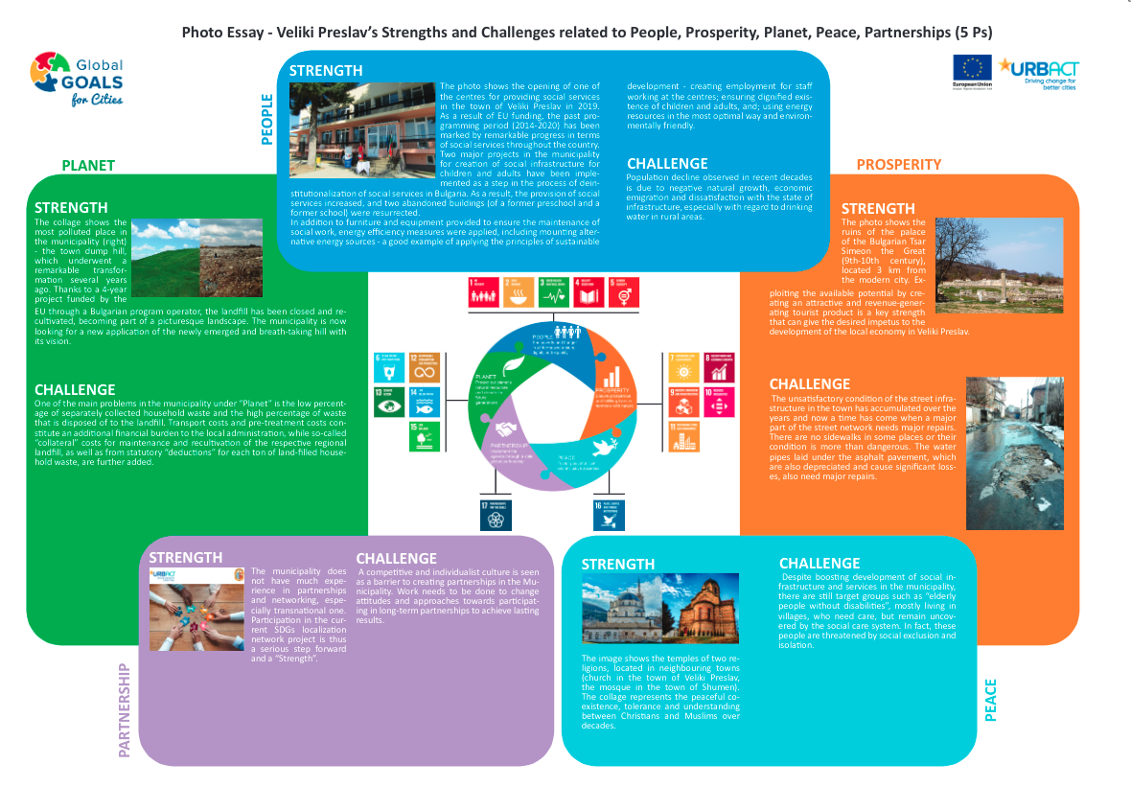
Diagnosis
Highlighting Strengths and Challenges

Slide 11
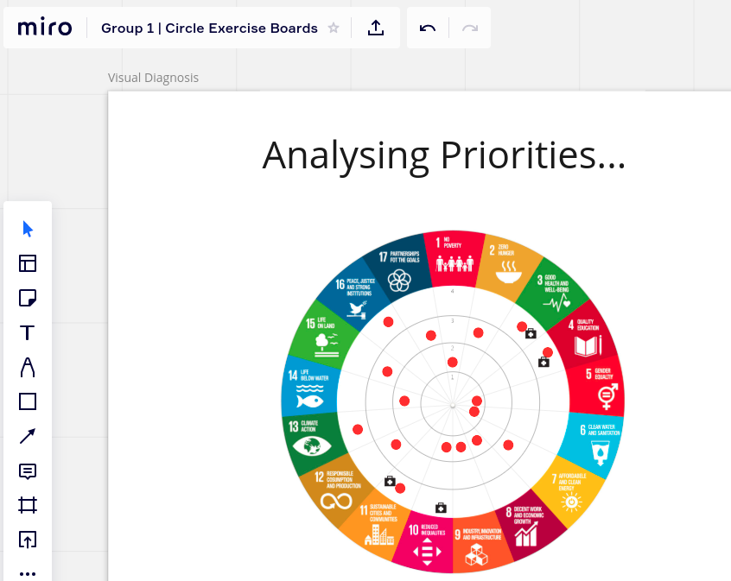
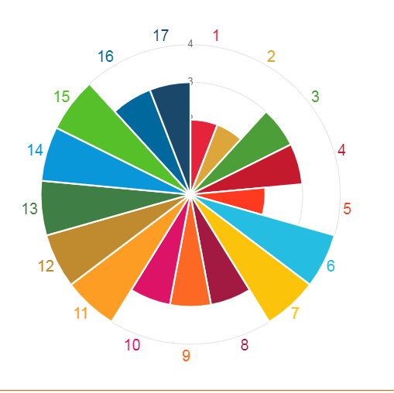
Diagnosis
Using the RFCS tool – www.rfsc.eu
Identifying Gaps

Slide 12
Visioning Phase

Slide 13
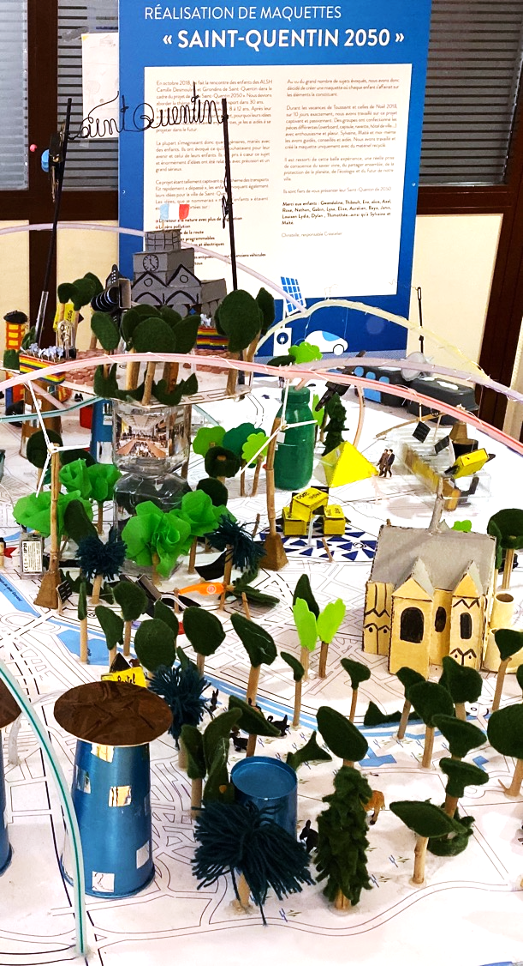
Why a vision?
"Too often, cities elaborate sustainability action plans with hundred of actions… but with no vision for their city. It's not clear what they want their city to actually become in the future."
Erwin Riclet, French Ministry
of Sustainable Development

Slide 14
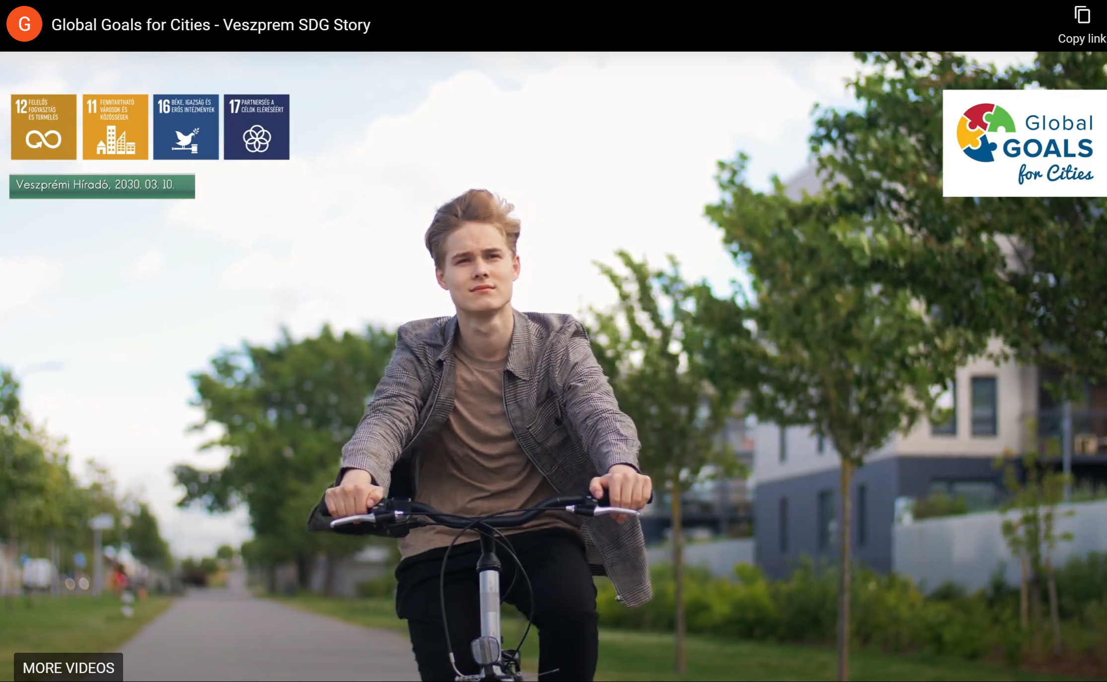
SDG Stories
Veszprém’s #SDGstory includes the vision of transforming the mobility of the city to become a “cyclist paradise” by 2030, in collaboration with local residents

Slide 15
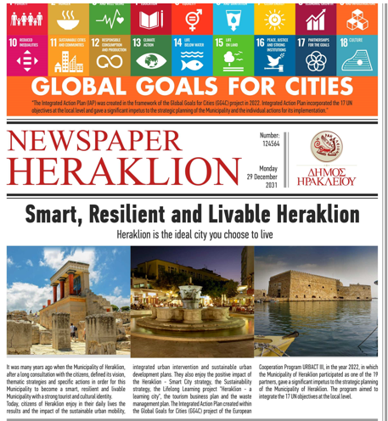
SDG Stories

Slide 16
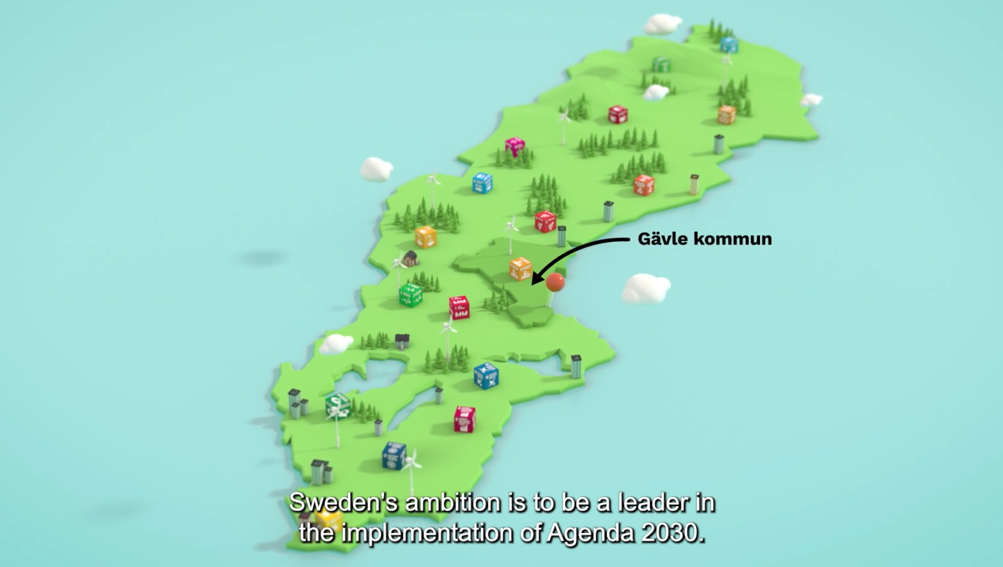
SDG Stories
Gävle’s (Sweden) highlights that for the #Agenda2030 to become a reality everyone must contribute - #municipality, #businesses, #associations and #residents. #GlobalGoals are global, but they are realized by individuals!

Slide 17
Planning of Actions Phase

Slide 18
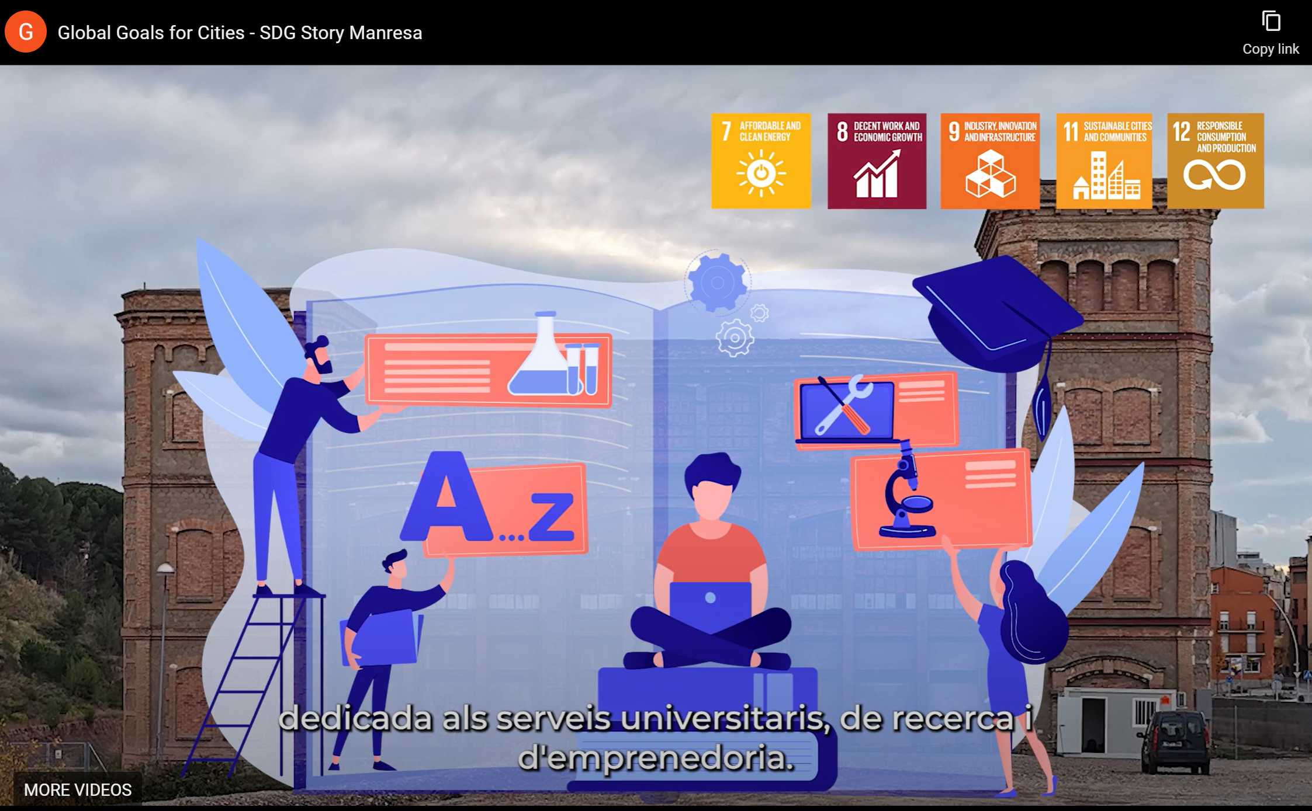
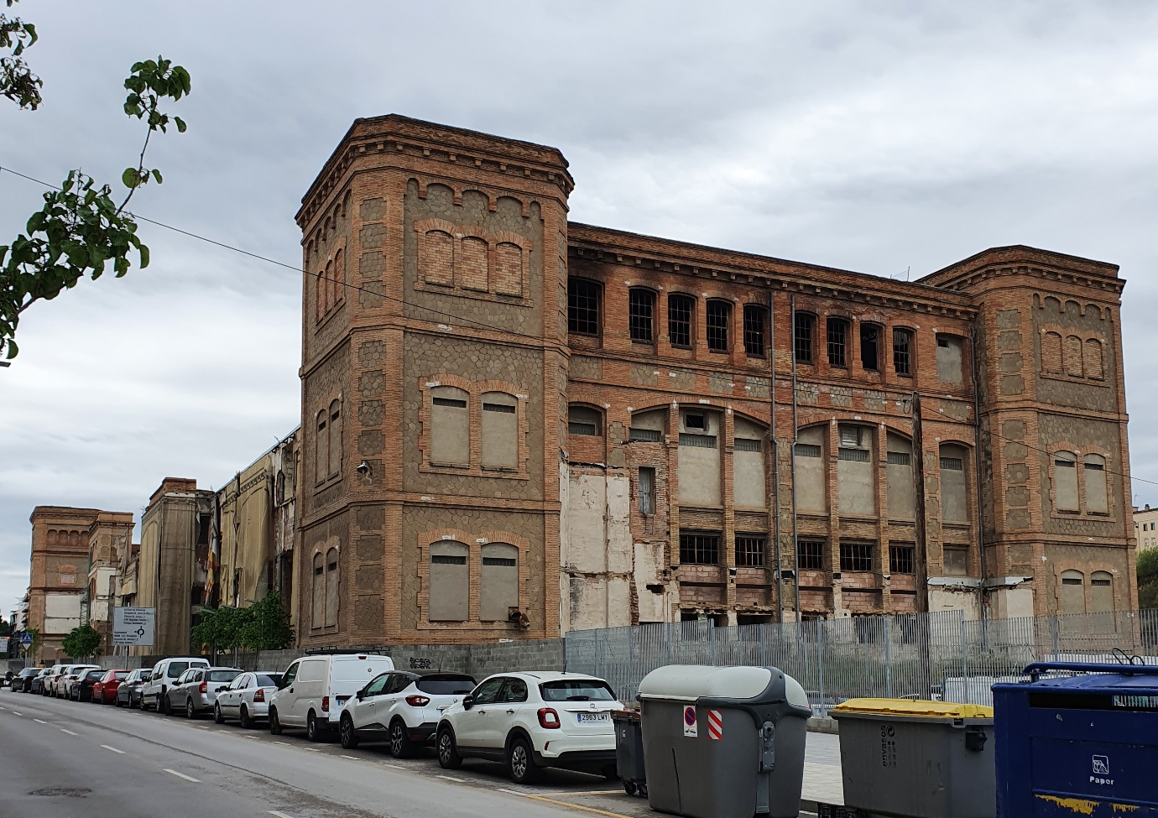
From Vision to Missions to Action!
Mission:
By 2030, we will have a competitive and sustainable local economy, thanks to technological innovation, the use of clean energy, circular production systems and a better articulation of the territory.
Action: Sustainable Rehabilitation of the Fàbrica Nova
Manresa, Spain

Slide 19
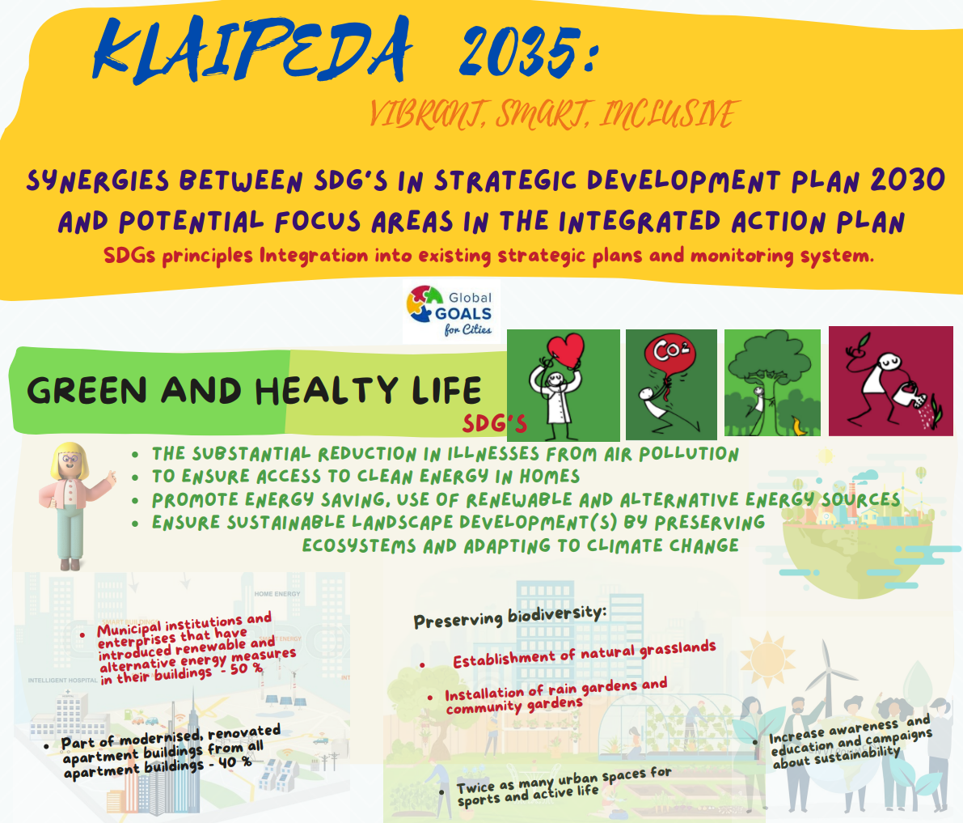
From Vision to Missions to Action!

Slide 20
Fixing Indicators phase (ongoing)

Slide 21
Setting targets and monitoring progress

Slide 22
SDG targets “as Specific Objectives”
Locally adapted SDG targets
SDG 13, target 13.2 Reduce the municipality's carbon footprint by integrating climate change measures into local policies, strategies and plans
SDG 7, target 7.3 By 2030, double the local rate of improvement in energy efficiency in all municipal buildings

Slide 23
Adding intended results
Locally adapted SDG targets
Intended result
SDG 7, target 7.3 By 2030, double the local rate of improvement in energy efficiency in all municipal buildings
100% increase in energy efficiency in all municipal buildings by 2030
Results indicator
Energy consumption per m2 in municipal buildings
Baseline: 300 kWh per m2 in 2021
Target: 150 kWh per m2 in 2030

Slide 24
Coming up

Slide 25
Upcoming activities
3 Transnational meetings (out of 10 in total)
10 Podcast episodes releases
19 Integrated Action Plans focussing on the SDGs
1 Final Event in Tallinn (Estonia) – January 2023
Follow us on Twitter (@Local_SDGs), LinkedIn (Global Goals for Cities) and https://urbact.eu/global-goals-cities

Slide 26
Thank you!

