Slide 1


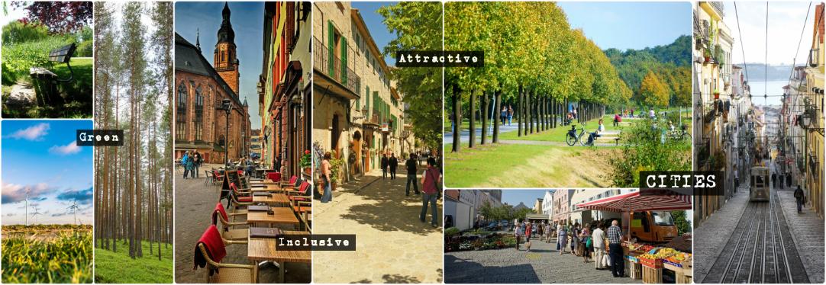



Slide 2

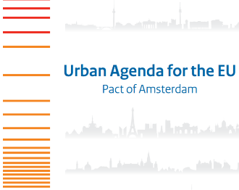











FROM THE LEIPZIG CHARTER TO THE SDGS
Leipzig Charter on Sustainable European Cities
Common principles for urban development
Toledo Declaration
Validation of the prototype of the RFSC
Dissemination of the RFSC
Financial support of the European Commission
RFSC tool updated
Including the Sustainable Development Goals
RFSC tool to localise the SDGs
19 cities from different countries
2007
2008
2010
2011
2012
2014
2015
2016
2021
Marseille Declaration
Decision to develop a tool to implement the principles of the Leipzig Charter
Testing phase
66 cities from different countries and with different sizes
2030 Agenda for Sustainable Development
www.rfsc.eu
@rfsc_eu
info@rfsc.eu

Slide 3
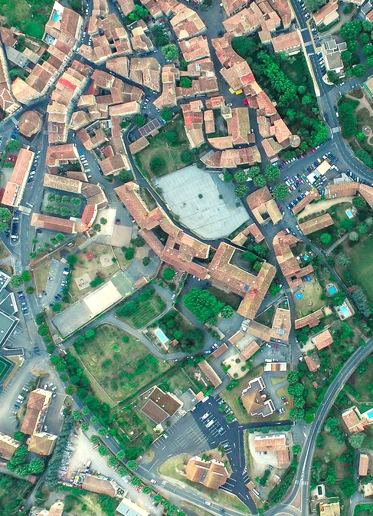
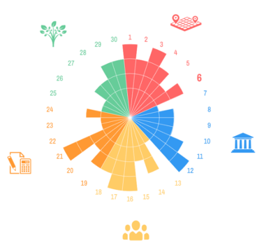

THE AND ITS WEBTOOL
GUIDE CITIES OF ALL SIZES TO
DESIGN, IMPLEMENT AND MONITOR
INTEGRATED SUSTAINABLE URBAN DEVELOPMENT
THE EUROPEAN VISION OF SUSTAINABLE CITIES
The RFSC
THE 2030 AGENDA AND THE SDGs
The SDGs
Notes:
To guide cities of all sizes design, implement and monitor their projects and strategies

Slide 4


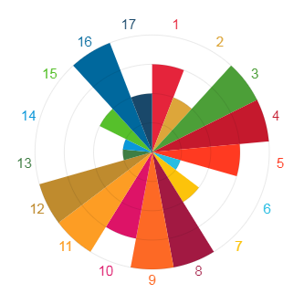
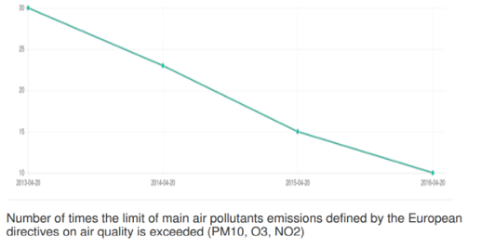
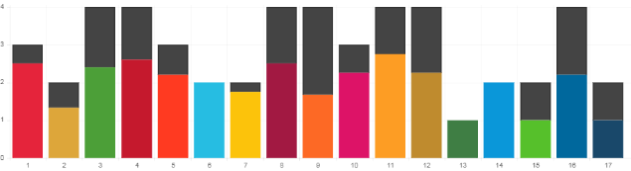






HOW TO USE THE TOOL?
3 STEP PROCESS
SELECT FRAMEWORK
ASSESS YOUR STRATEGY OR PLAN
CHECK YOUR
ACTIONS
MONITOR PROGRESS
EUROPEAN FRAMEWORK FOR SUSTAINABLE CITIES
AND/OR
17 SUSTAINABLE DEVELOPMENT GOALS
The RFSC reveals the sustainability profile of your strategy or action plan
The RFSC helps you visualise potential gaps to improve your actions
Select indicators online to monitor progress of your strategy or plan over time
www.rfsc.eu
@rfsc_eu
info@rfsc.eu

Slide 5


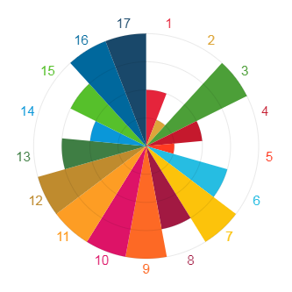


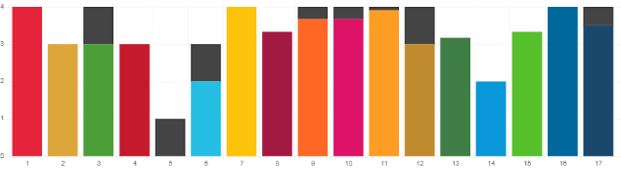
PEER LEARNING & KNOWLEDGE SHARING
COMPARING LOCAL STRATEGIC OBJECTIVES
ACTIONS BEING IMPLEMENTED TO ACHIEVE THE SDGs
OBJECTIVES
ACTIONS
www.rfsc.eu
@rfsc_eu
info@rfsc.eu

Slide 7
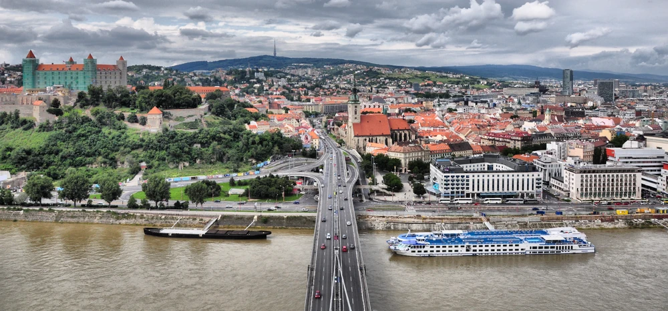
BRATISLAVA
PROFILE
Bratislava’s priority ranking of the goals conducted according to the following criteria:
Whether the city has a strategic or conceptual document on the particular topic of the SDG;
Whether there any activities or measures implemented for the particular topic of the SDG;
Whether the topic of the SDG formulated as one of the Mayor's priorities.
BRATISLAVA 2021-2030
BRATISLAVA, SLOVAKIA
MAIN OBJECTIVE
PREPARE FOR A NEW CITY STRATEGY – BRATISLAVA 2021-2030
THE RFSC TOOL WAS USED TO ASSESS THE PRIORITY RANKING OF THE BRATISLAVA 2030 AGENDA
ACTIONS
www.rfsc.eu
@rfsc_eu
info@rfsc.eu

Slide 8
BRATISLAVA (SK)
VESZPRÉM (HU)
REGGIO EMILIA (IT)
OTHER EXAMPLES FROM CITIES USING THE RFSC

Slide 9
BRATISLAVA
PROFILE
Bratislava’s priority ranking of the goals conducted according to the following criteria:
Whether the city has a strategic or conceptual document on the particular topic of the SDG;
Whether there any activities or measures implemented for the particular topic of the SDG;
Whether the topic of the SDG formulated as one of the Mayor's priorities.
BRATISLAVA 2021-2030
BRATISLAVA, SLOVAKIA
MAIN OBJECTIVE
PREPARE FOR A NEW CITY STRATEGY – BRATISLAVA 2021-2030
THE RFSC TOOL WAS USED TO ASSESS THE PRIORITY RANKING OF THE BRATISLAVA 2030 AGENDA
ACTIONS
www.rfsc.eu
@rfsc_eu
info@rfsc.eu

Slide 10
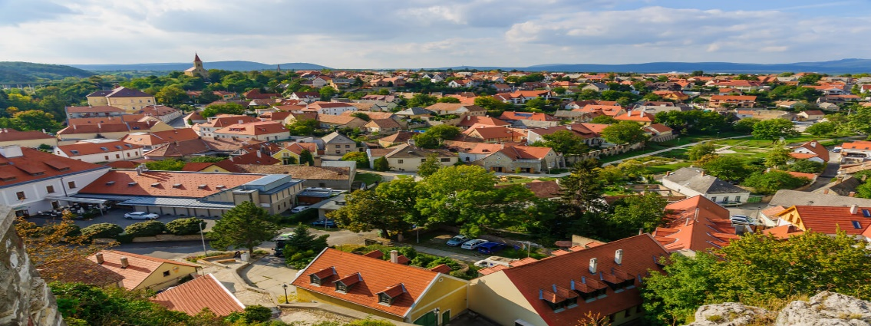
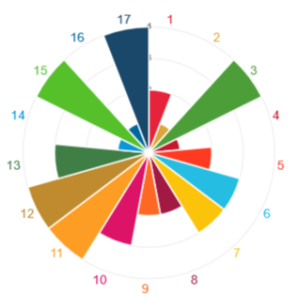
VESZPRÉM
PROFILE
THE ANALYSIS HAS COMFORTED THE MUNICIPALITY TO USE A CROSS-SECTORAL APPROACH IN THE DESIGN AND PLANNING OF ITS INTEGRATED ACTION PLAN
A 2030 AGENDA FOR VESZPRÉM
VESZPRÉM, HUNGARY
MAIN OBJECTIVE
TAKE A LEADING ROLE IN LOCALISING SDGs IN HUNGARY
THE RFSC WAS USED TO HIGHLIGHT A FEW INSIGHTS TO BE TAKEN FORWARD IN THE DEVELOPMENT OF THE FUTURE IAP FOR VESZPRÉM
ACTIONS
www.rfsc.eu
@rfsc_eu
info@rfsc.eu

Slide 11
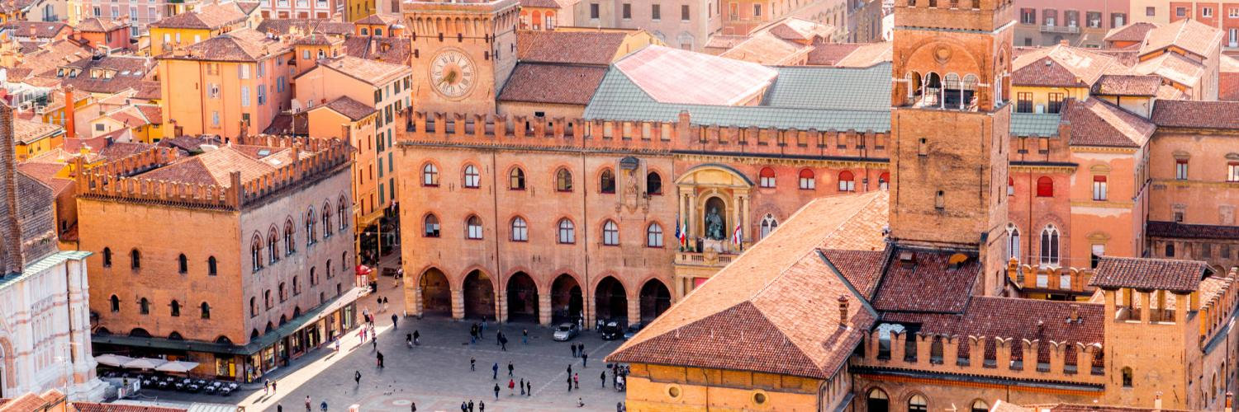
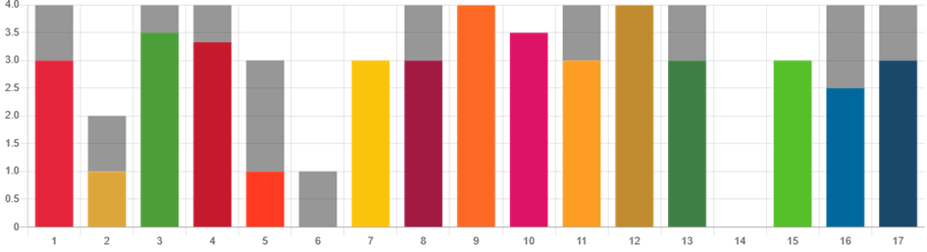
REGGIO EMILIA
PROFILE
The narrative surrounding the RFSC assessment allowed to give some explanations behind the results. Indeed, the Municipality of Reggio Emilia organized a training course, which was helpful in identifying the main priorities and challenges to work on (SDGs 3, 4, 8, 10, 11).
A 2030 AGENDA FOR REGGIO EMILIA
REGGIO EMILIA, ITALY
MAIN OBJECTIVE
The overall results of the RFSC self-assessment, correspond to the key challenges and strengths of the city. Moreover, these results are supported by several indicators and data related to the local context.
ACTIONS
www.rfsc.eu
@rfsc_eu
info@rfsc.eu

Slide 12

JOIN US AT THE 11TH WORLD URBAN FORUM IN KATOWICE, POLAND
28 JUNE – 09:00-10:30
“DESIGNING INTEGRATED URBAN STRATEGIES AND LOCALISING THE SDGS: EXPERIENCES FROM CITIES USING THE RFSC TOOL”, PART OF THE “VOICES FROM CITIES” PROGRAMME
FOLLOW UP:
RFSC TRAININGS FOR POLISH CITIES
www.rfsc.eu
@rfsc_eu
info@rfsc.eu

Slide 13
www.rfsc.eu
Thank you!
@rfsc_eu
info@rfsc.eu

