Slide 1
Better Governance, Planning and Services in Local Self-Governments in Poland
Key findings and recommendations
Janos Bertok
Deputy Director, Directorate for Public Governance, OECD

Slide 2
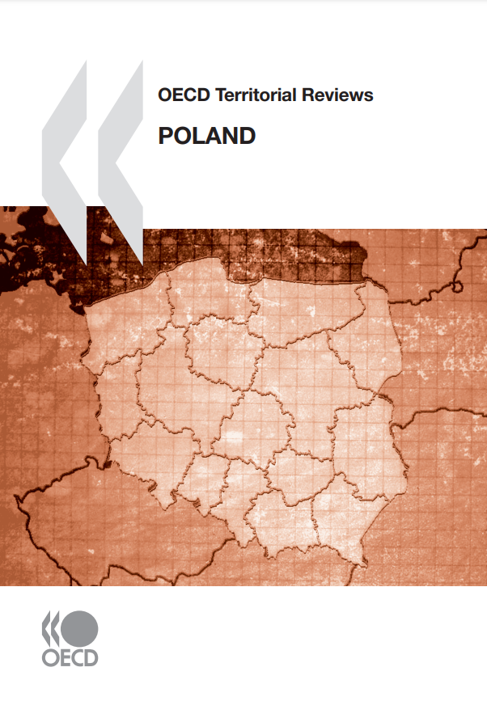
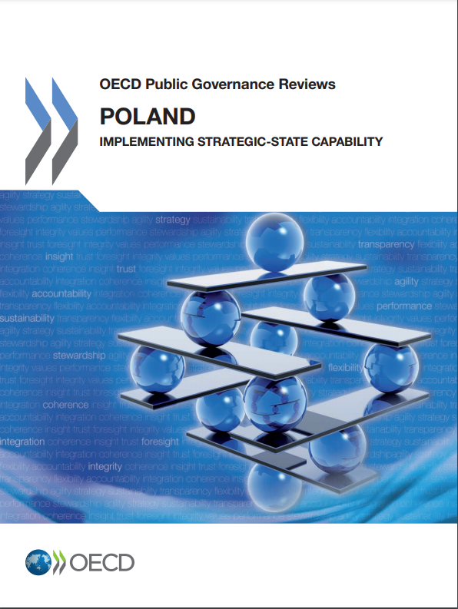
Overview: A comprehensive and targeted report
Objective: Strengthen the capacity of subnational governments across Poland to pursue integrated local development planning in fulfilment of good-governance principles by:
Assessing subnational policy and practice in key thematic areas of public governance and territorial development and presenting recommendations for reforms.
Accompanying Polish cities and municipalities in strengthening their capacity to set and implement Development Plans through the design and use of a municipal public-governance self-assessment tool.
The report was prepared in cooperation with the Association of Polish Cities (APC) and the Polish Ministry of Development Funds & Regional Policy (MDFRP) and published in June 2021.
The report was financed under the Norway/EEA grant scheme.
Based on a solid evidence base with 4 fact-finding missions and questionnaire responses from 70+ institutions at 3 levels of government.

Slide 3
Covering 8 key dimensions of public governance & territorial development
1. Open government
8. Strategic and effective workforce
2. Administrative burden reduction and simplification of public procurement
7. Use of evidence in strategic decision-making
The report covers 8 themes relating to public governance and territorial development at the local level
3. Coordination across administrative units and policy sectors within local self-governments
6. Multi-level governance and investment capacity
4. Strategic planning
5. Budgeting

Slide 4
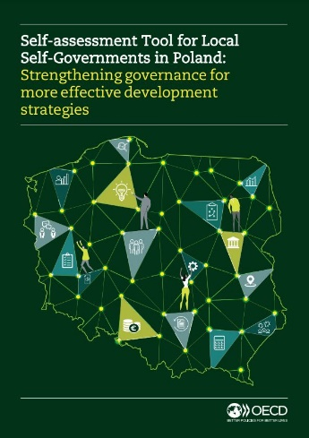
Targeted advice & self-assessment tool
In addition to the report, the OECD provided:
3 synthesis assessments with more granular assessment for 3 different types of municipalities
9 profiles of individual municipalities
A self-assessment tool (SAT) for local self-governments to assess strengths and weaknesses on public governance and local development practices.
oe.cd/poland-local
oe.cd/il/poland-sat

Slide 5
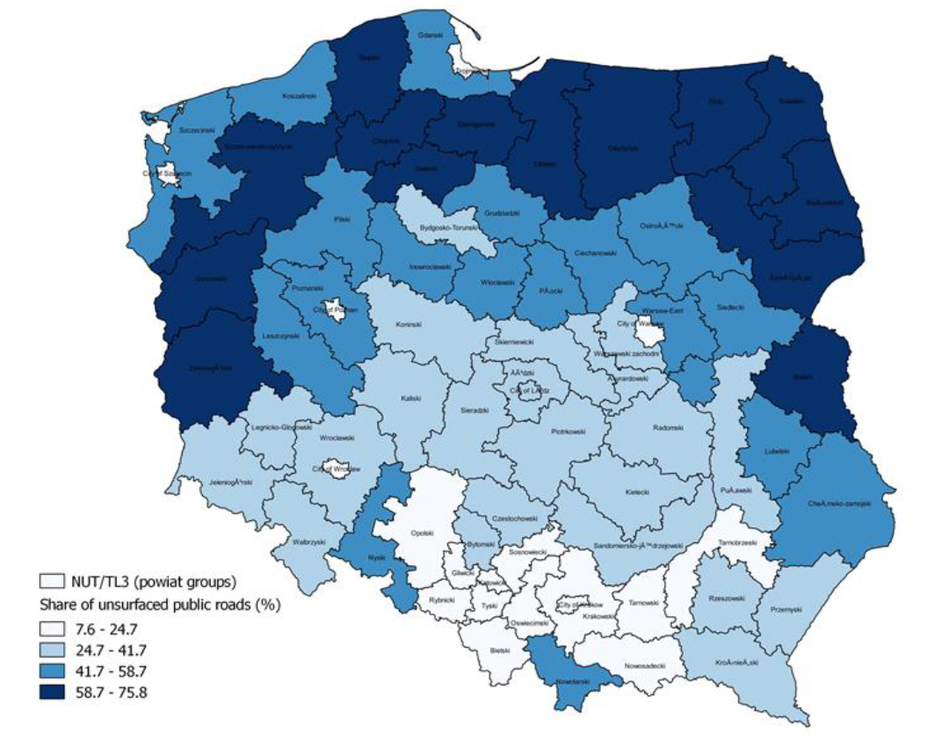
Room for improvement: regional well-being
Strengths and challenges of territorial development
Share of unsurfaced public roads in TL3 regions, Poland, 2018
Regional inequalities: Metropolitan regions benefit from a greater income increase than others
Several well-being areas below OECD averages: housing, civic engagement, life satisfaction, health and income
Education, road and ICT infrastructure disparities
How can Poland achieve a place-based and functional approach to address these territorial development challenges?

Slide 6
Put in place a well-functioning multi-level governance system with better cooperation for better investment
Multi-level governance and investment capacity
The report’s advice to local self-governments:
Inter-municipal cooperation
Subnational public spending increased from 23% in 1995 to 34% in 2018.
However, local self-government unit revenue is falling short of needs, and they have limited fiscal autonomy.
Provide resources and incentives for municipalities to develop joint projects or shared services.
Strengthen local capacities to develop collaboration schemes, in particular for the new supra-local development strategies and territorial agreements.
Inter-governmental collaboration and co-ordination
Use territorial contracts and the new territorial agreements to address regional and local investment needs.
Make the most of the policy planning process to align regional and local development objectives and investment priorities with the national strategic frameworks.
What is important is not the level of decentralisation, but how decentralisation is designed and implemented.

Slide 7
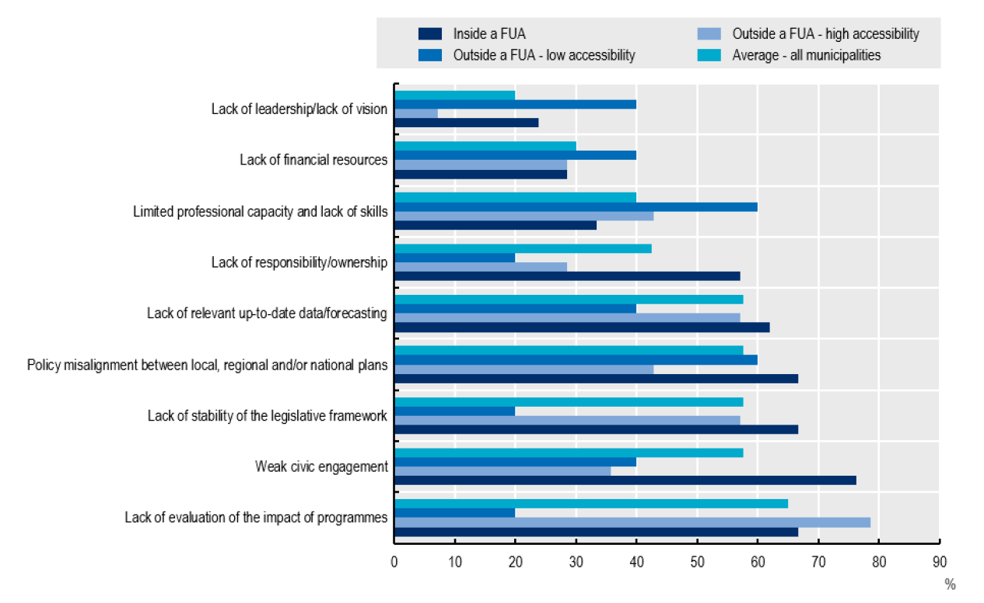
Effective design and implementation of Local Development Strategies
Strategic planning
Main challenges to designing a Local Development Strategy, by municipality type
The report’s advice to local self-governments:
The report’s advice to local self-governments:
Reinforce capacities of local self-governments for strategic planning
Improve the quality of data used in the planning process
Foster private investment for local development
Engage more effectively with citizens
Eventually make the adoption of a Local Development Strategy compulsory
Different types of municipalities highlighted different obstacles in strategic planning
N=40

Slide 8
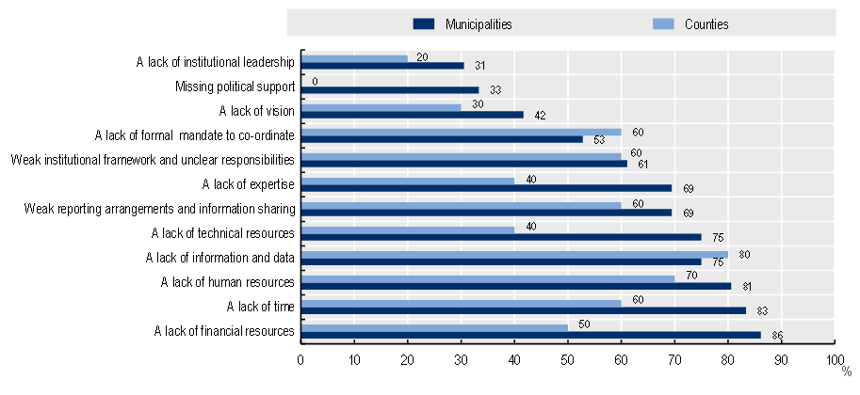
Multidimensional policy responses require effective co-ordination across administrative units and policy silos
Co-ordination within local self-governments
The report’s advice to local self-governments:
Ensure institutional responsibility for co-ordination through clear mandates, reporting arrangements and strategic use of policy documents.
Foster co-ordination through institutional mechanisms and partnerships such as task forces, joint planning and information/document sharing.
Develop capacity and resources for co-ordination.
Main challenges for effective co‑ordination across administrative units and policy sectors in local self-governments

Slide 9
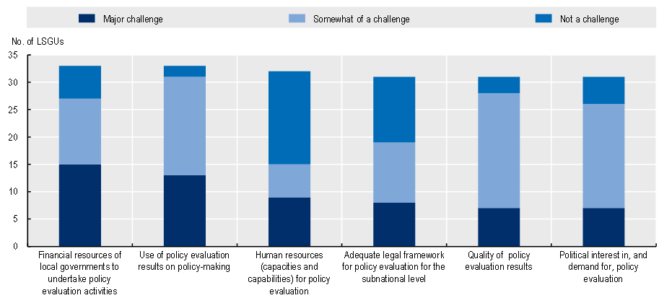
Challenges regarding data availability, resource constraints and limited awareness of the potential benefits of M&E
The use of evidence in decision-making
The report’s advice to local self-governments:
Monitor local development strategies and strengthen capacities to promote the quality of monitoring.
Promote the systematic evaluation of municipal interventions and ensure sufficient resources and capacity are available for evaluation.
Promote use of evidence for strategic decision-making at the municipal level.
Perceived challenges to promote M&E policies at the local level

Slide 10
Need to align budgeting more effectively with strategic priorities at the local level
Budgeting in local self-governments
The report’s advice to local self-governments:
Undertake efforts toward increasing revenue shares and revenue certainty in relation to national government transfers and shared national taxes.
Scrutinise public spending efficiency on a systematic basis by means of spending reviews and systematic performance benchmarking.
Strengthen the medium-term budgeting perspective to support a better link between budgets and strategic priorities in a comprehensive way and beyond the annual cycle.
Strengthen the use of performance budgeting frameworks.
Ensure a participative approach to budgeting by setting up more formalised opportunities for citizen involvement & reinforce the use of participatory budgeting.

Slide 11
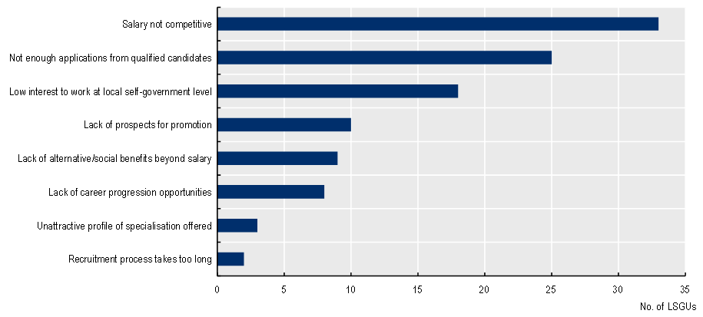
Need to attract, develop and retain people with the right skills and motivation
Toward a more strategic and effective local self-government workforce
LSGUs in Poland employed close to 255 000 people in 2018
The report’s advice to local self-governments:
Support leaders and managers to ensure they have the autonomy, tools and accountability to effectively use their leadership capabilities.
Focus on the attraction and development of transversal skills and competences.
Review the effectiveness of human resource management practices and invest in strategic workforce management capabilities.
Challenges affecting attraction in Polish local self-governments

Slide 12
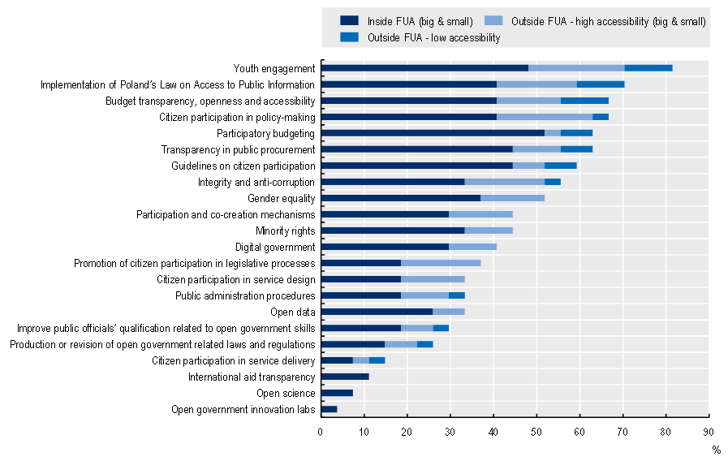
Scattered open government initiatives at the local level to promote transparency, integrity, accountability & stakeholder participation
Open Government
Open government initiatives implemented by Polish municipalities
The report’s advice to local self-governments:
Improve existing open government initiatives and foster stakeholder participation.
Take a more strategic approach to open government by consolidating initiatives.
Create an open government culture in municipalities by increasing open government literacy, raising awareness and providing adequate human and financial resources.

Slide 13
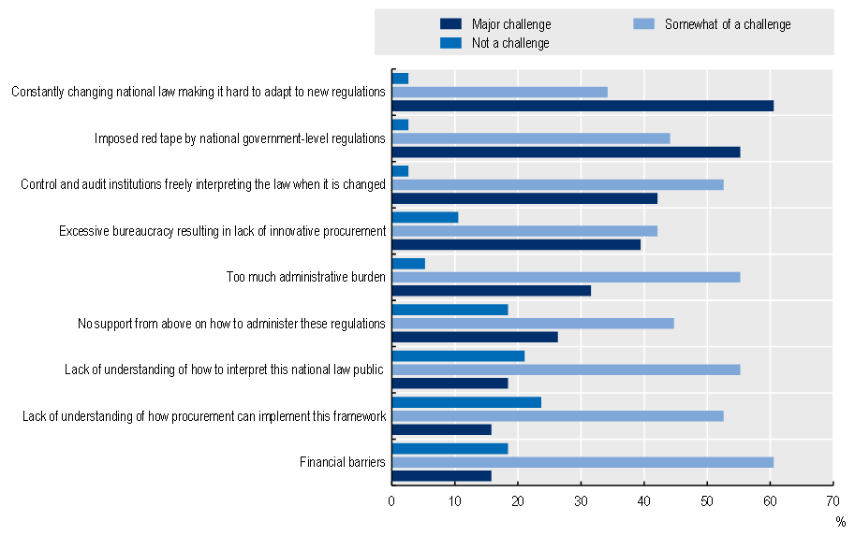
Challenges when administering public procurement at the local level
Reducing administrative burden & simplifying public procurement
Challenges identified by municipalities when administering public procurement at the local level through the national Public Procurement Law
The report’s advice to local self-governments:
Assess the burden generated by administrative red tape.
Increase transparency in the interactions with stakeholders.
Make use of digital tools for simplification of procurement.
Strengthen collaboration among LSGUs to shape and adopt public procurement reforms.
Simplify procurement practices.

Slide 14
Concrete impact of the project to date
All 54 cities participating in the 2nd phase of the Local Development Programme conducted the self-assessment using the OECD tool. The results influenced the preparation of their development plans.
The remaining 29 cities in the programme will conduct the self-assessment for a second time in 2 years time.
The 29 cities participating in the 3rd phase of the Local Development Programme plan on average to implement 14 OECD recommendations each (in addition to 13 recommendations already implemented).

Slide 15
Thank you!
Janos Bertok (Janos.Bertok@oecd.org)

