Slide 1
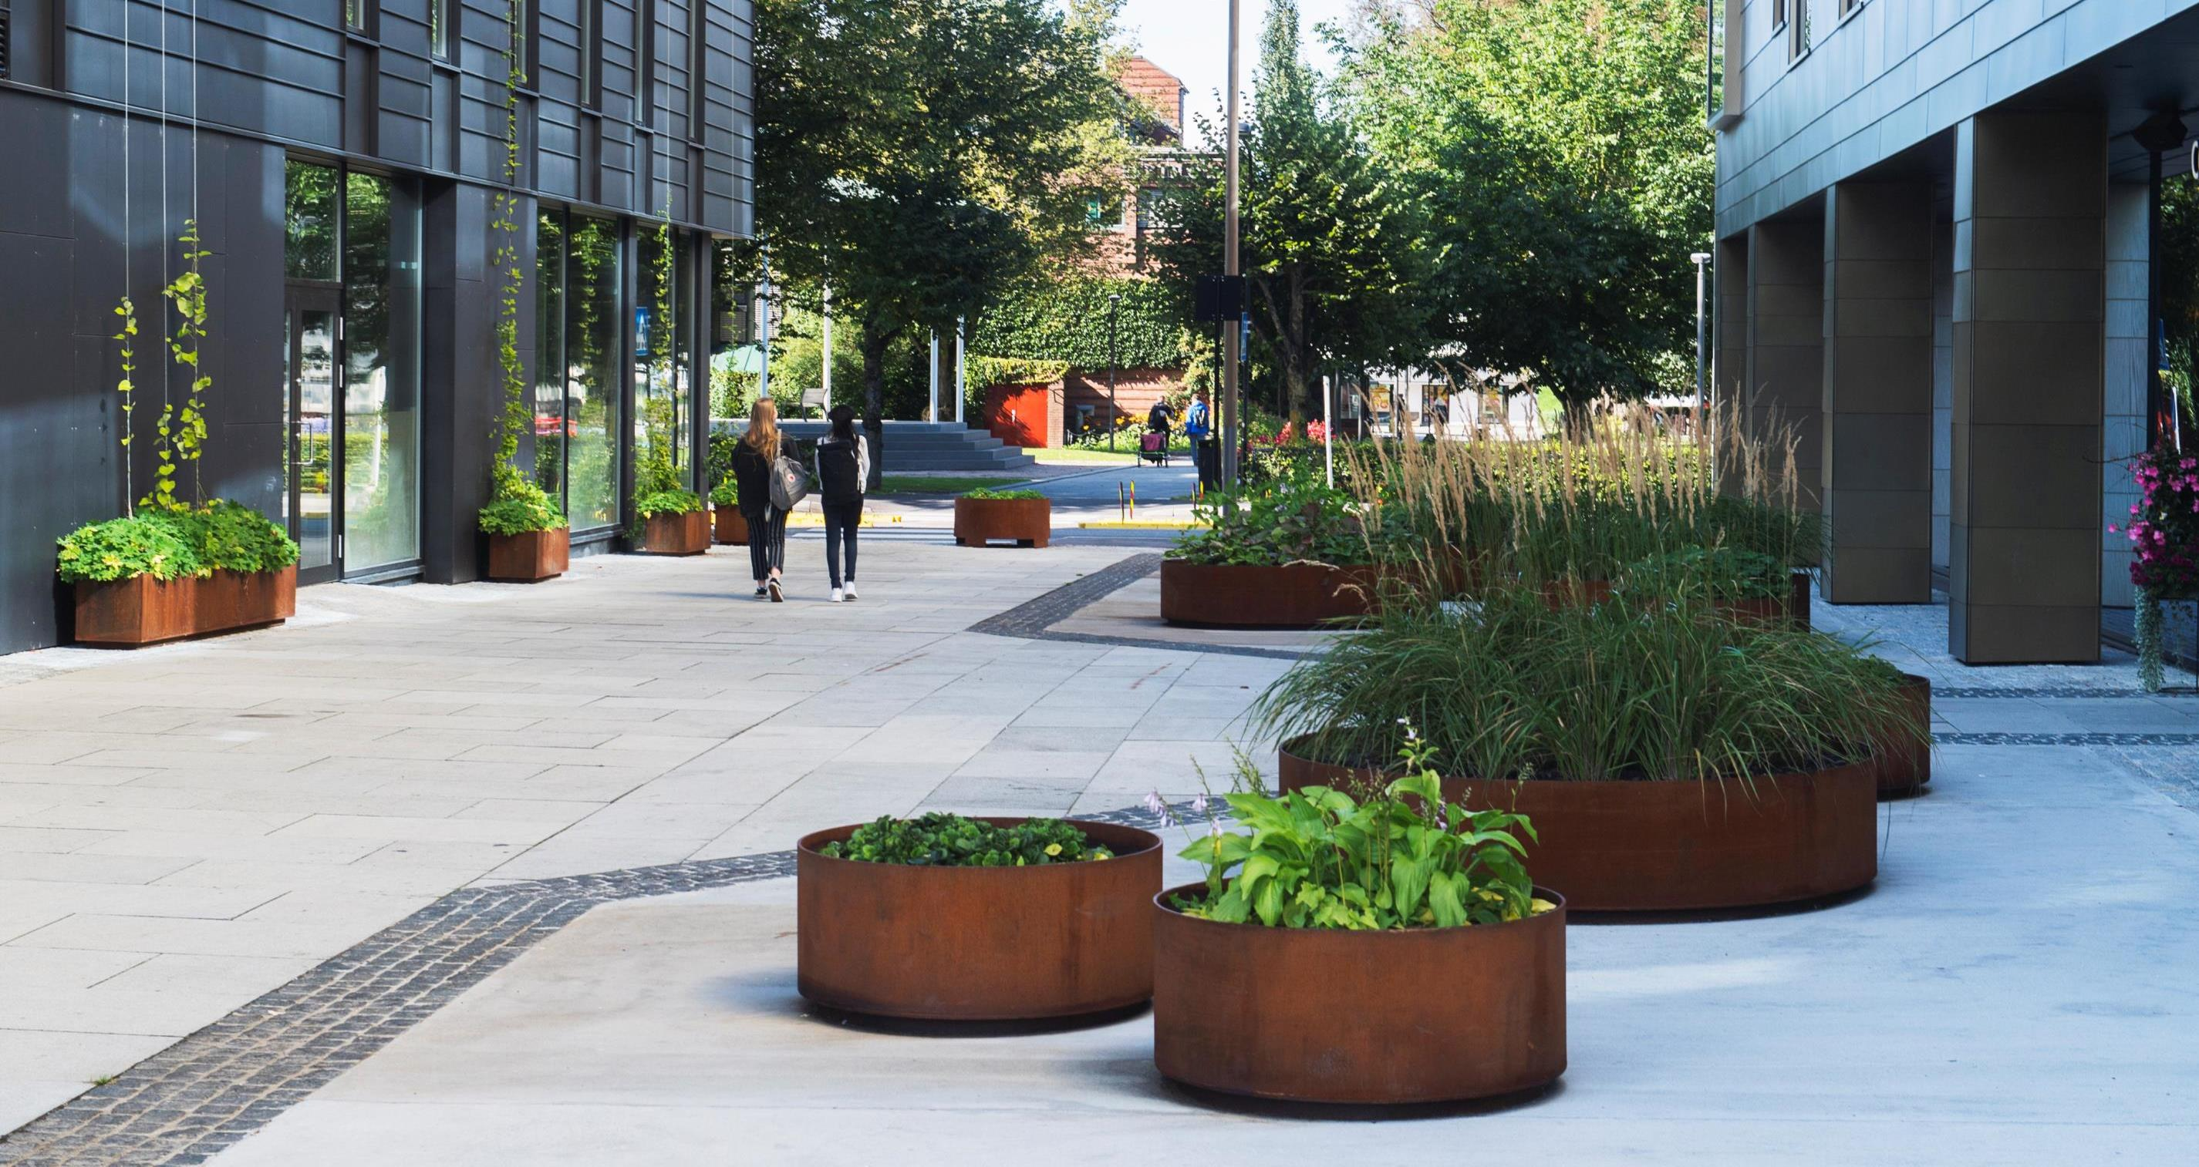
The Norwegian Planning System
Presentation on 30 September 2020 Ebba Friis Eriksen, Head of Urban Development, Porsgrunn municipality
Foto: Dag Jenssen

Slide 2
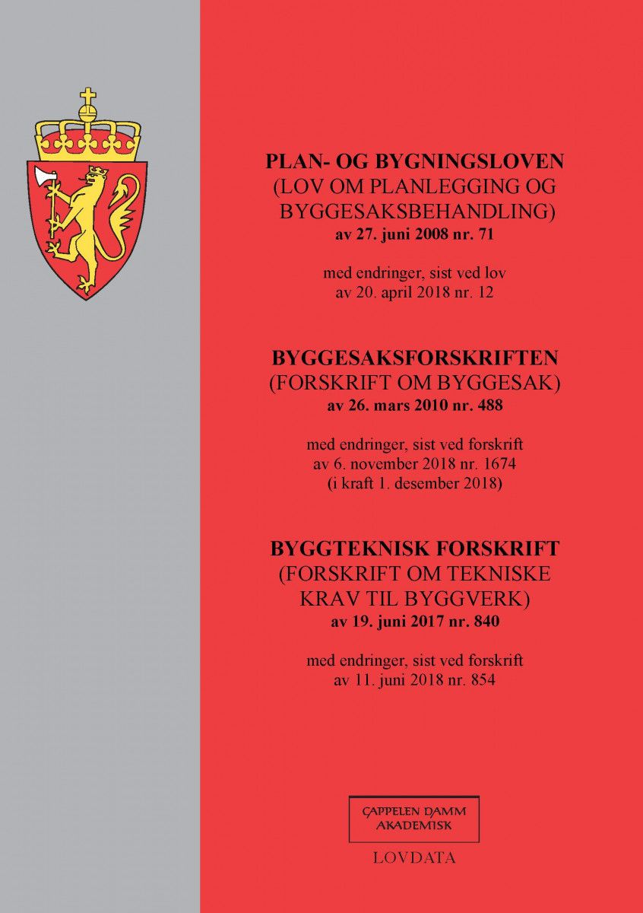
Main principles of the planning system
Plans are politically adopted
Most legally binding plans are adopted at the local level
Participation in the planning process
- To ensure transparency
- Participation by different authorities at the regional and national level, by interest organisations and other stakeholders, such as neighbours
Notes:
Planning in Norway shall contribute to coordination of state, regional and municipal tasks. At the same time it shall provide the basis for decisions on the use and protection of resources. The Norwegian planning system is defined in the Planning and Building Act.
The Planning and Building Act is a tool for safeguarding the public interest and land management. It also specifies three main principles of Norwegian planning system.
Elected council:
This means that it is political authorities who make all planning decisions.
Decentralized decision-making authority:
This means that the majority of concrete and binding planning decisions are mostly made at the local level, within the framework given by the higher authority.
Participatory planning:
Planning has to ensure that there is transparency and various authorities, organisations and other individuals have a right to participate in planning process.

Slide 3
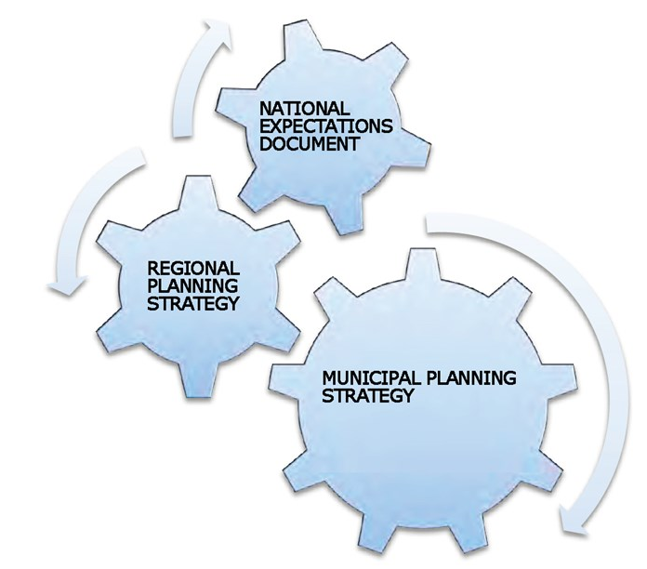
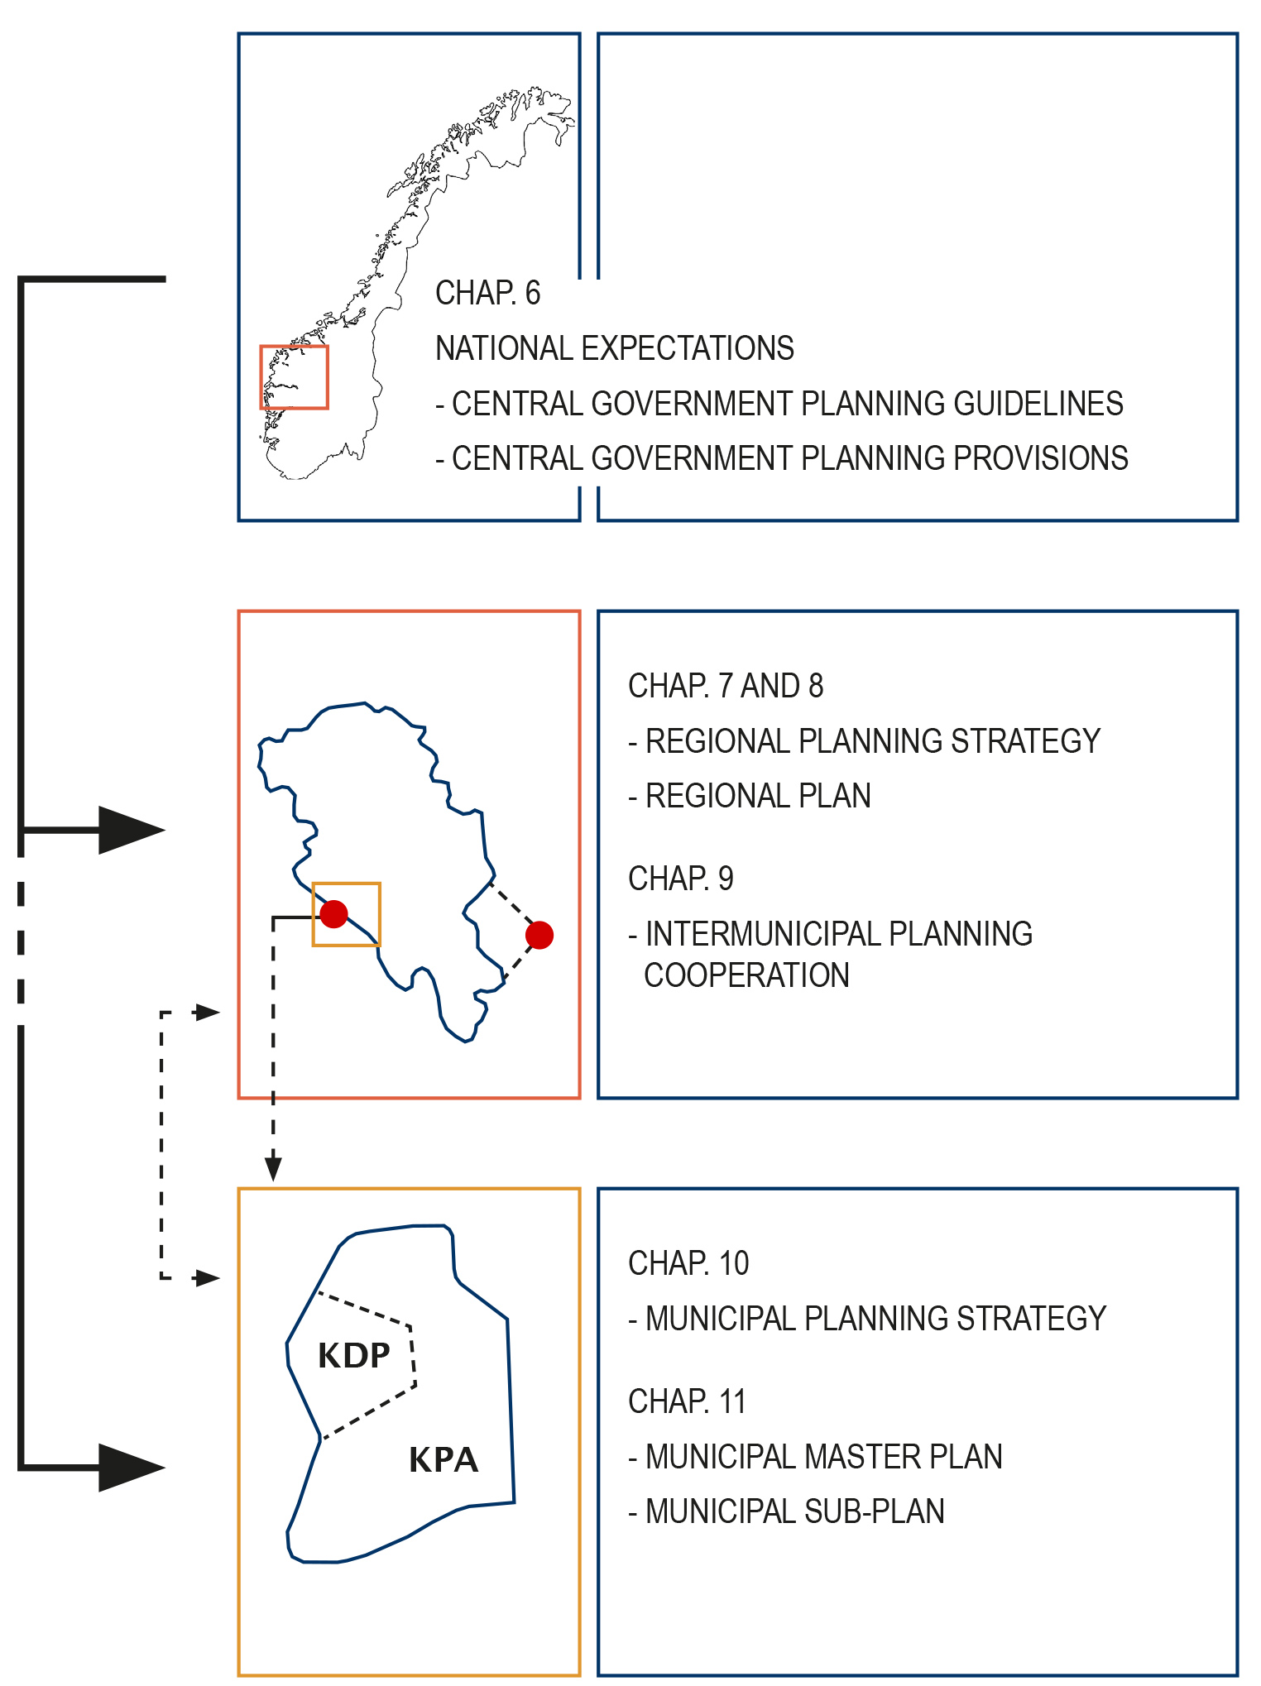
Division of planning tasks
National
- framework and guidelines for planning at regional and municipal level
Regional
regional planning strategy
regional plan
regional planning provision
Municipal
municipal master plan
legally binding zoning plans
Image source: adapted from regjeringen.no
Notes:
Responsibility for planning and adopting plans in accordance to the Planning and Building Act rests with the government, the county councils and the municipal councils.
Each governing level has different planning tasks.
At the national level the government provides frameworks and guidelines for planning at regional and municipal level based on national goals.
Regional planning strategy, regional plan and regional planning provision are prepared at the regional level.
At the municipal level municipal master plan and zoning plans are adopted. At the municipal level planning shapes the physical environment and provides both quality and opportunity for development based on local conditions and characteristics.

Slide 4
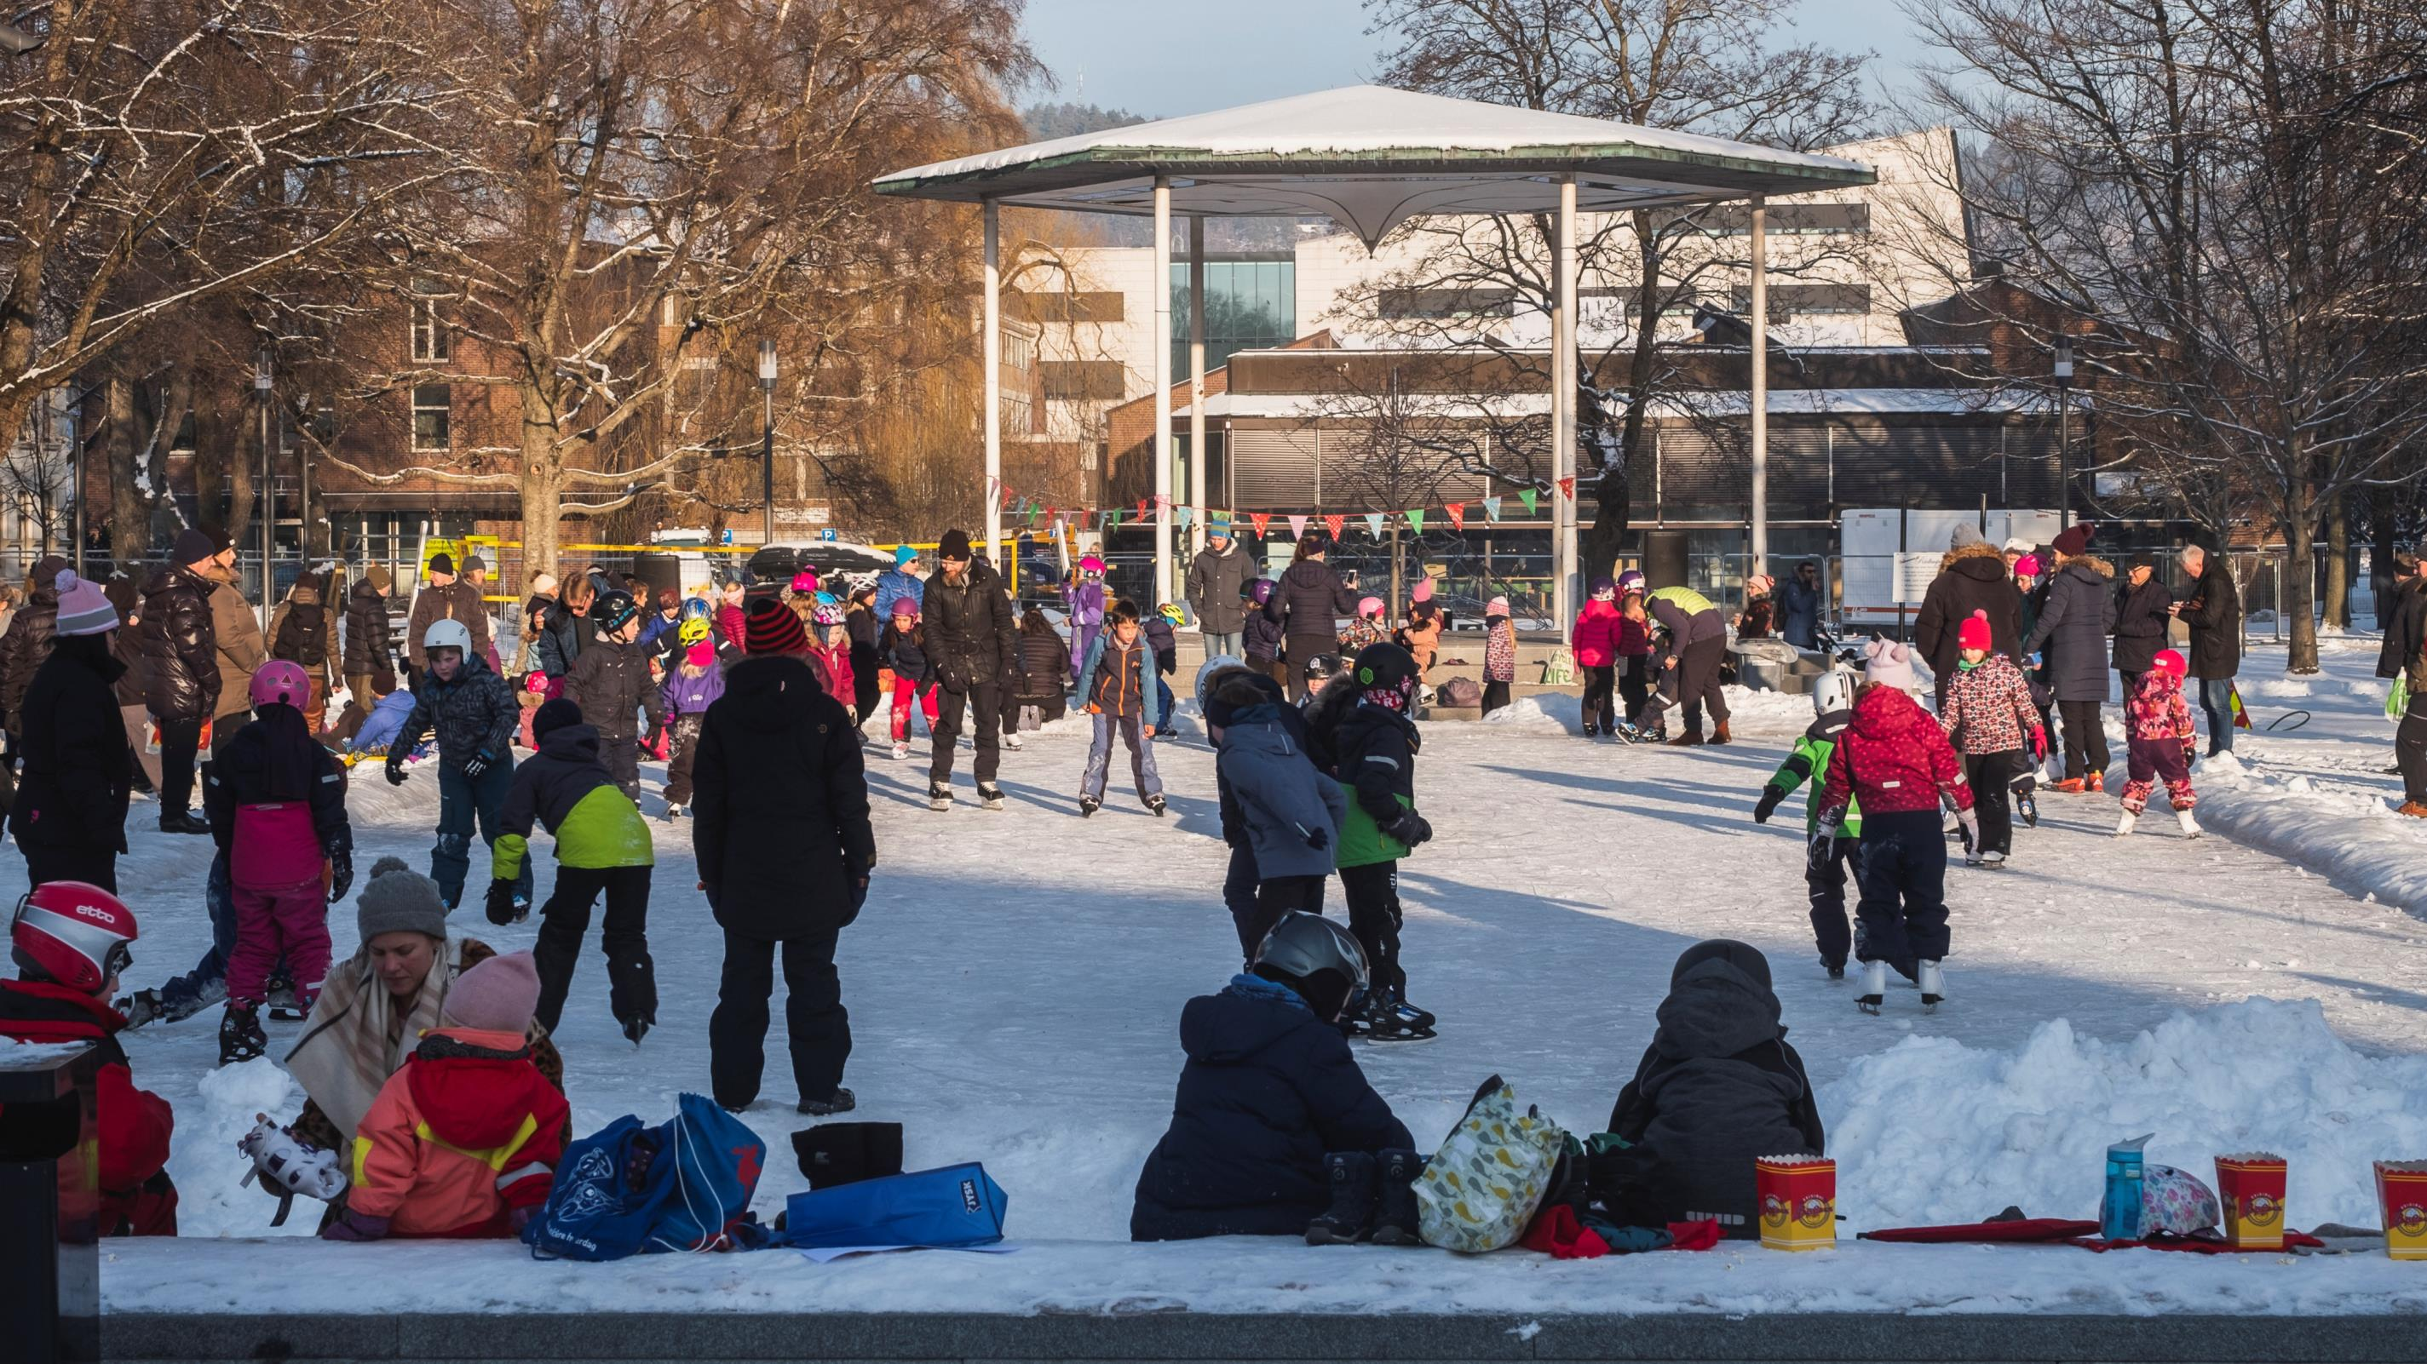
Municipal planning
Foto: Dag Jenssen

Slide 5
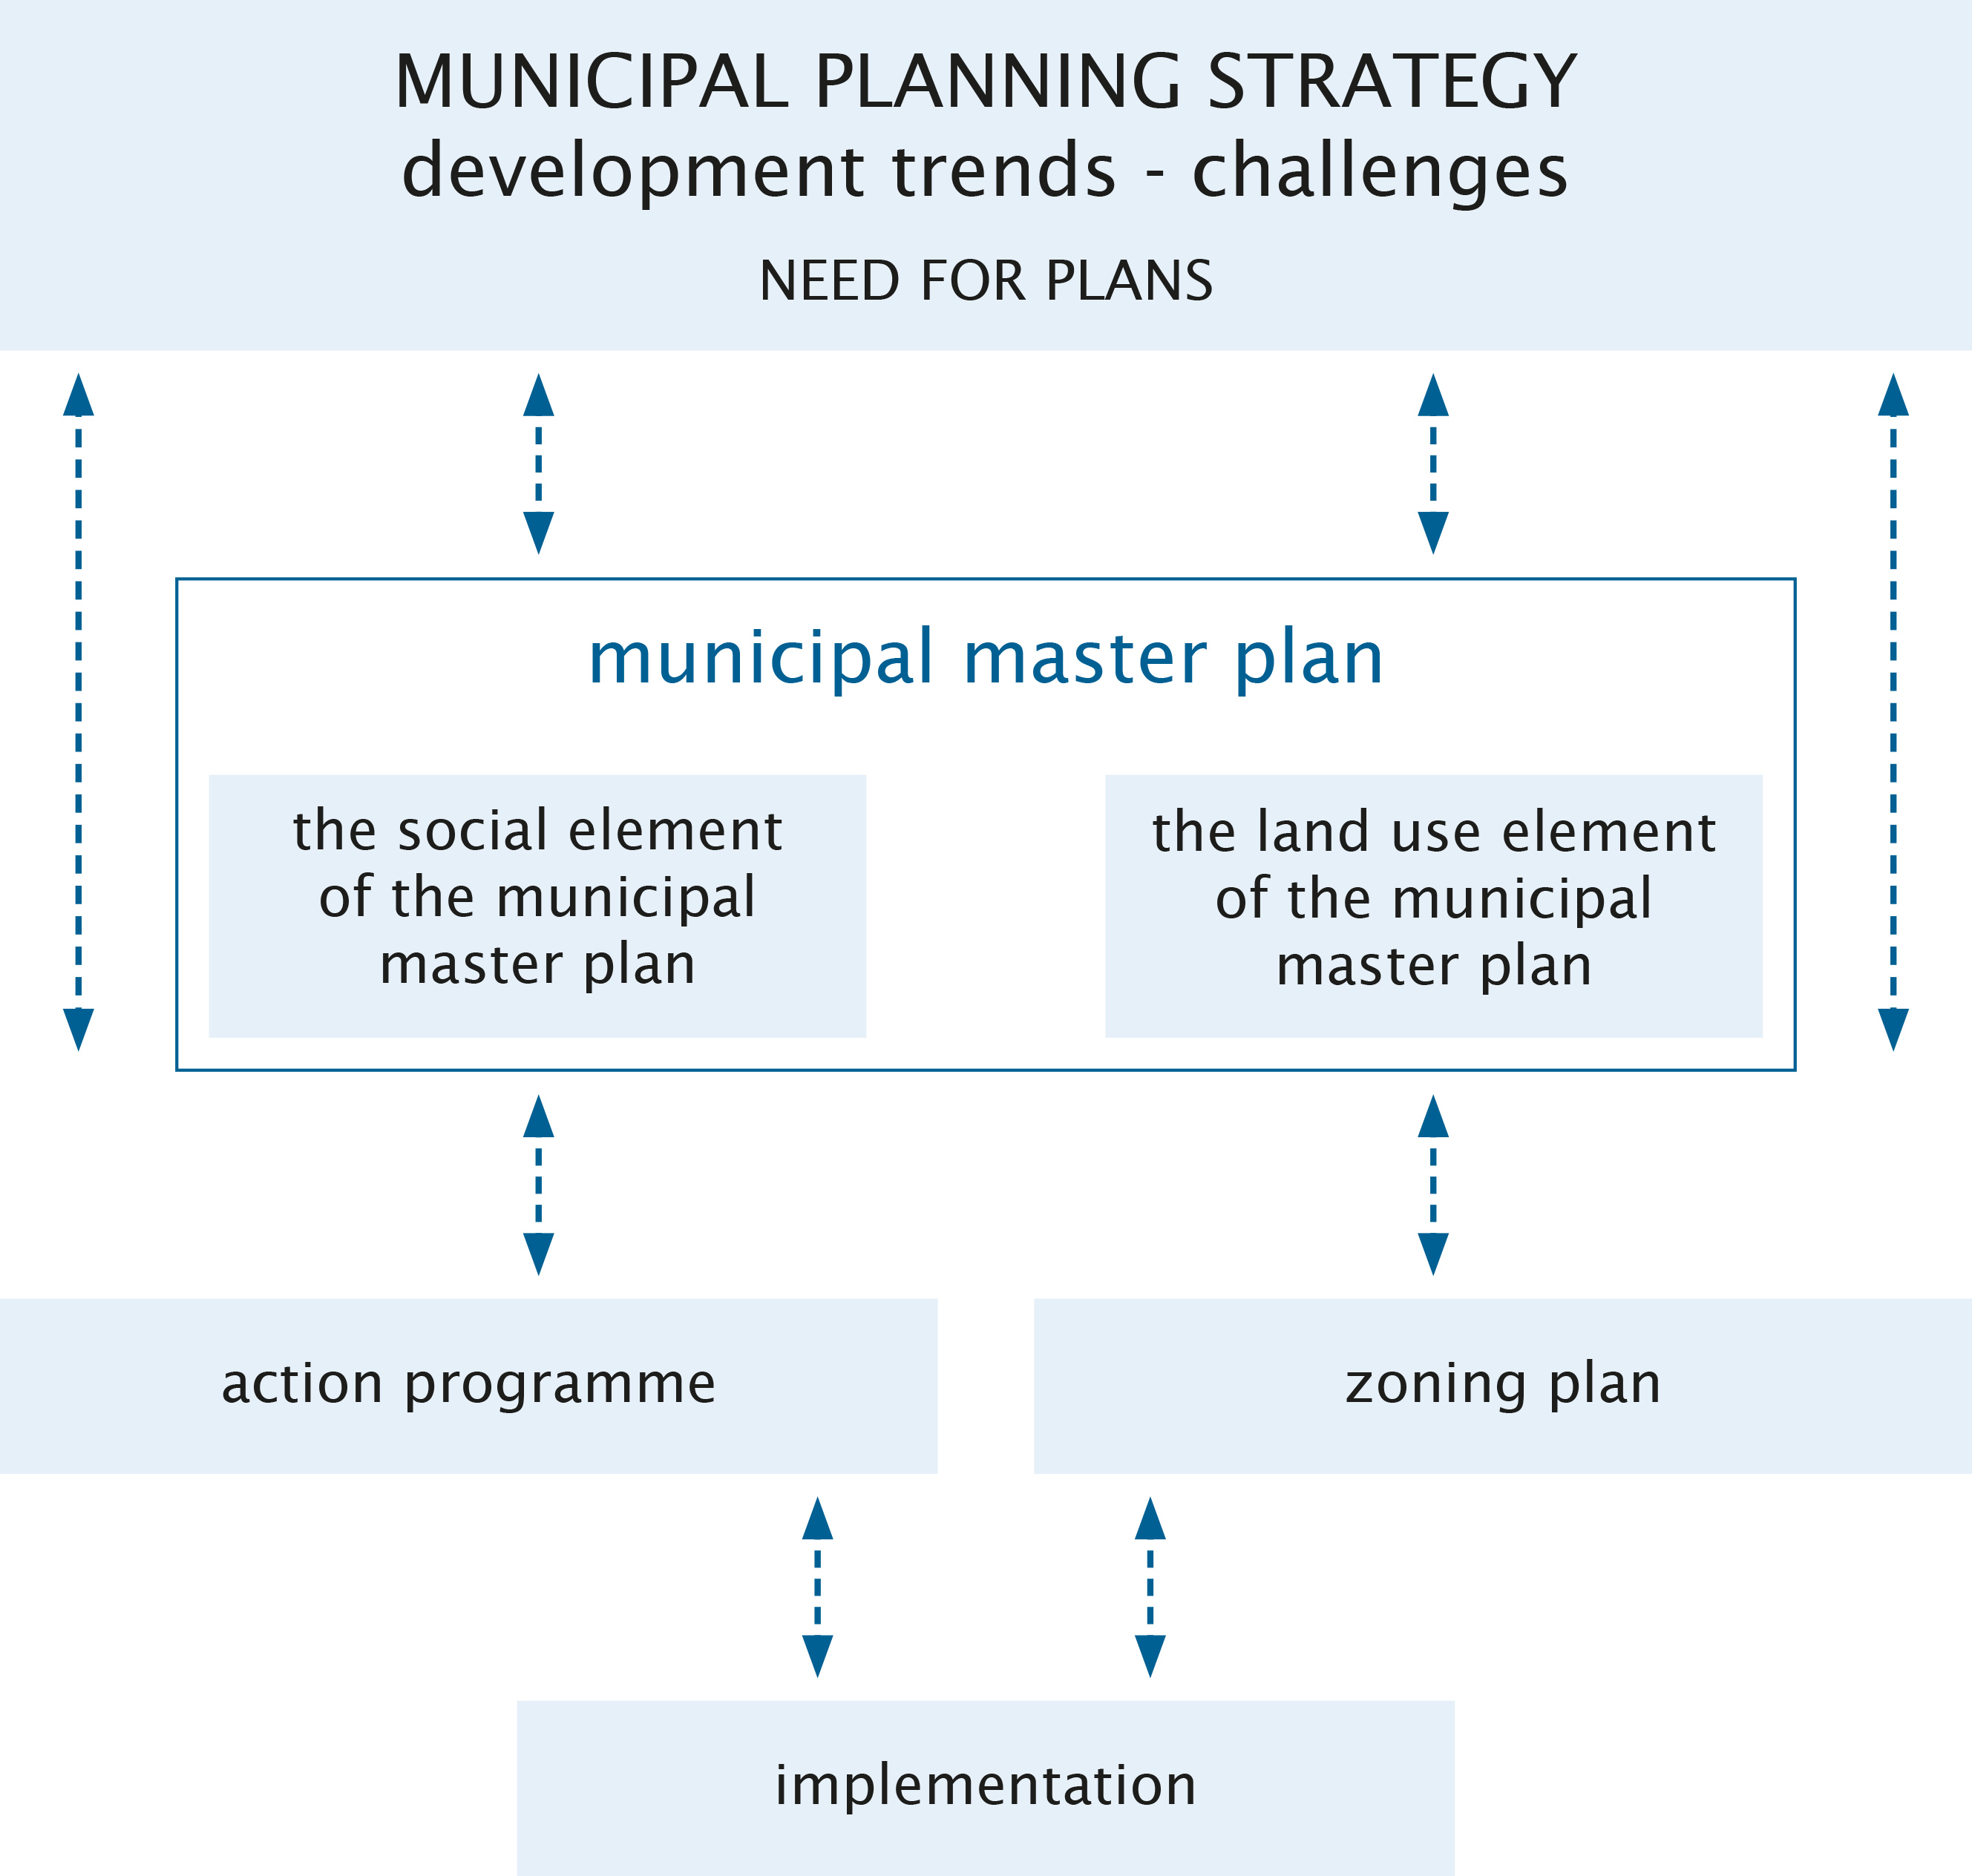
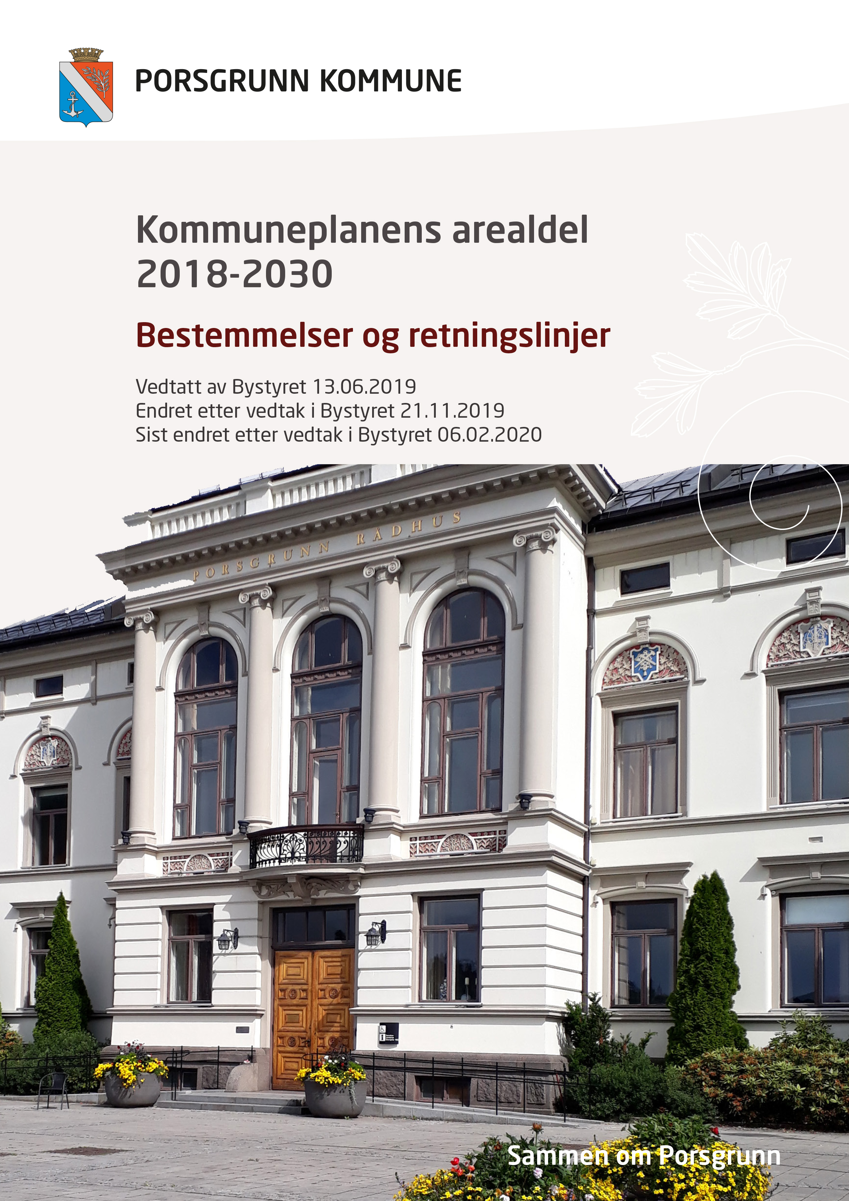
Image source: adapted from regjeringen.no Porsgrunn kommune
Notes:
During the first year of new electoral term the municipal council shall prepare a municipal planning strategy that concerns strategic choices relating to the development of the municipality and the need for future plans. One of the main questions in the planning strategy is also about revision of the municipal master plan.
The planning strategy should include a discussion of the municipality's strategic choices related to community development, including long-term land use, environmental challenges, sector’s activities and an assessment of the municipality's planning needs during the electoral term.
The main governing document at municipal level is municipal master plan. In Norwegian: kommuneplan. It consists of two parts: the social element and the land use element of the municipal master plan.
The social element shall concern long-term challenges relating to the environment and goals and strategies for the municipal community and the municipality as an organisation, and the sectors and select target groups.
The land use element shows a connection between future societal development and land use. It is a map with written provisions for the use, protection and design of areas and physical surroundings in the whole municipality.

Slide 6
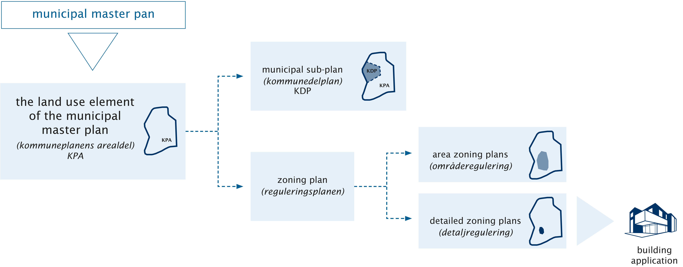
Image source: adapted from regjeringen.no
Notes:
We focus for a moment on the land use element of the municipal master plan.
The land use element of the municipal master plan, in Norwegian: kommuneplanens arealdel, shows where in the municipality physical development can take place.
In addition the municipality may, if required, prepare a municipal sub-plan. In Norwegian: kommunedelplan. Municipal sub-plan can be prepared for specific areas, themes or business areas. Porsgrunn is currently working with a municipal sub-plan for green structure within municipality.
Important elements of municipal planning are also zoning plans. In Norwegian they are called reguleringsplanen.
Zoning plan is a detailed land use plan with associated provisions. And there are two types of zoning plans:
area zoning plans, in Norwegian it is called områderegulering and
detailed zoning plans, in Norwegian detaljregulering

Slide 7
The land-use element of the municipal master plan
The municipal master plan is the municipality’s overriding governing document. It provides the framework for the development of the municipal community and management of the land use resources.
Notes:
The municipal master plan is the municipality’s overriding governing document. It provides the framework for the development of the municipal community and management of the land use resources.
Municipal planning shall promote municipal, regional and national goals, interests and functions. It consists of a land use element and a social element with an implementation element.

Slide 8
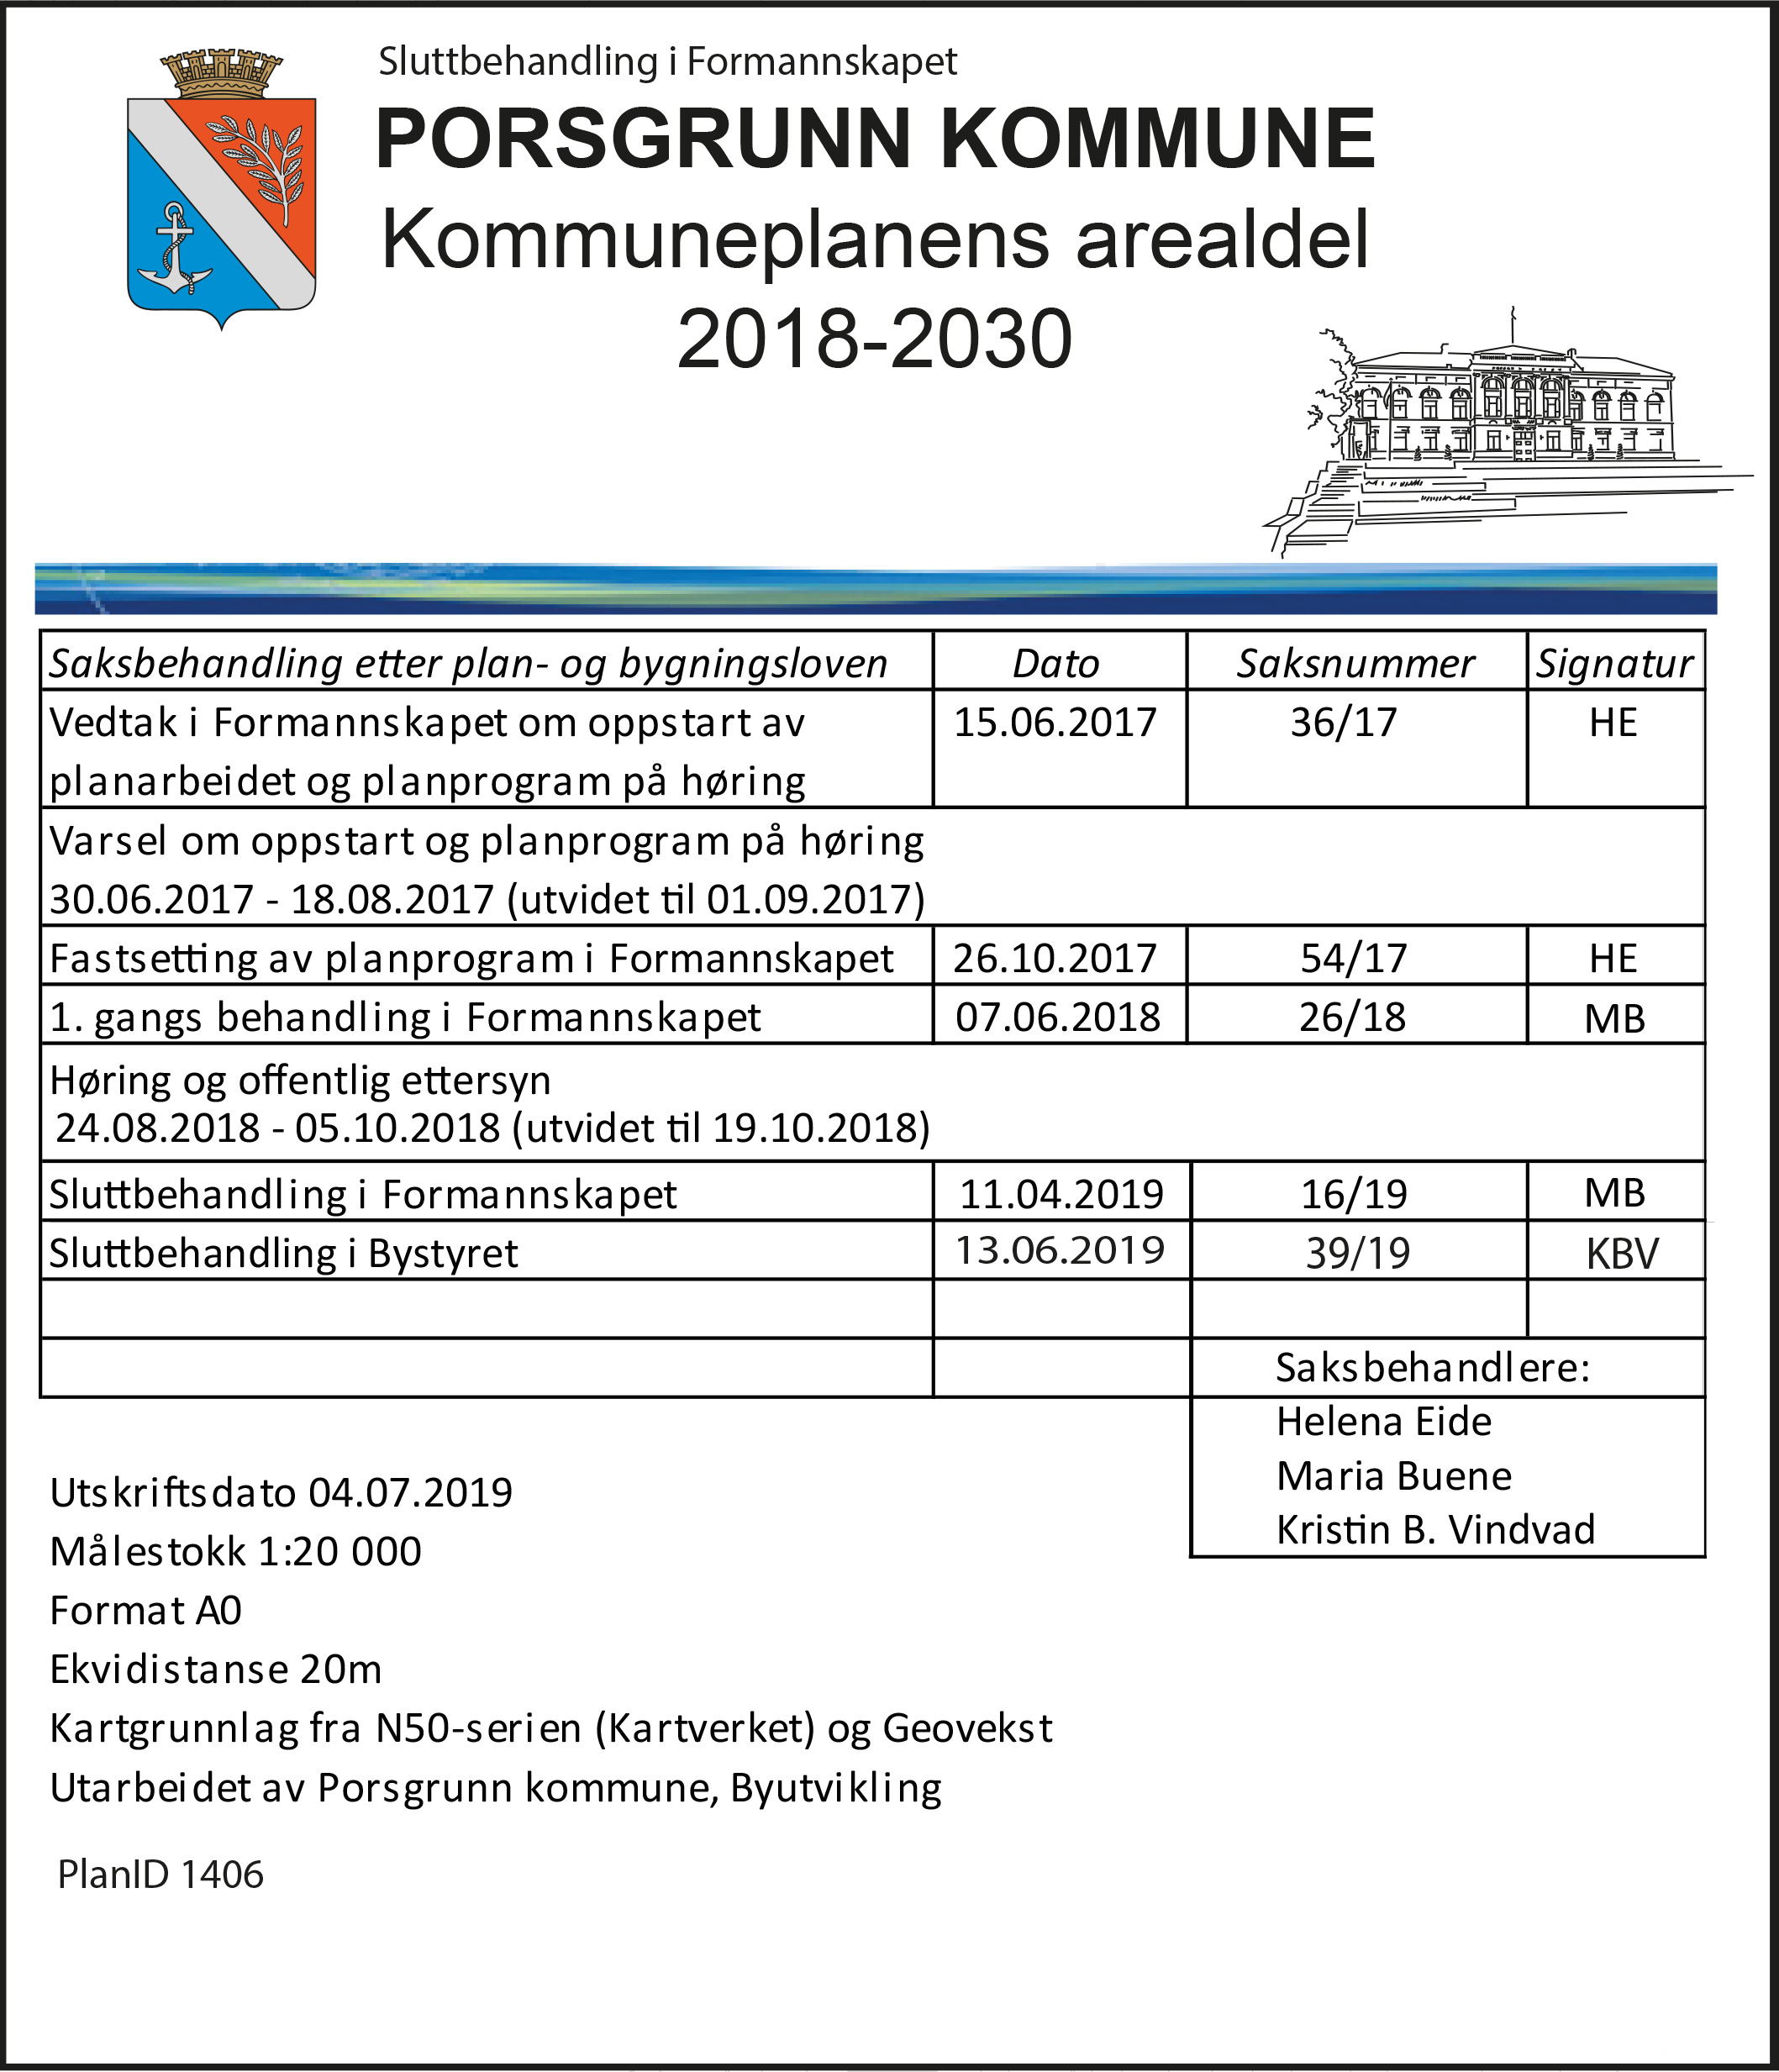
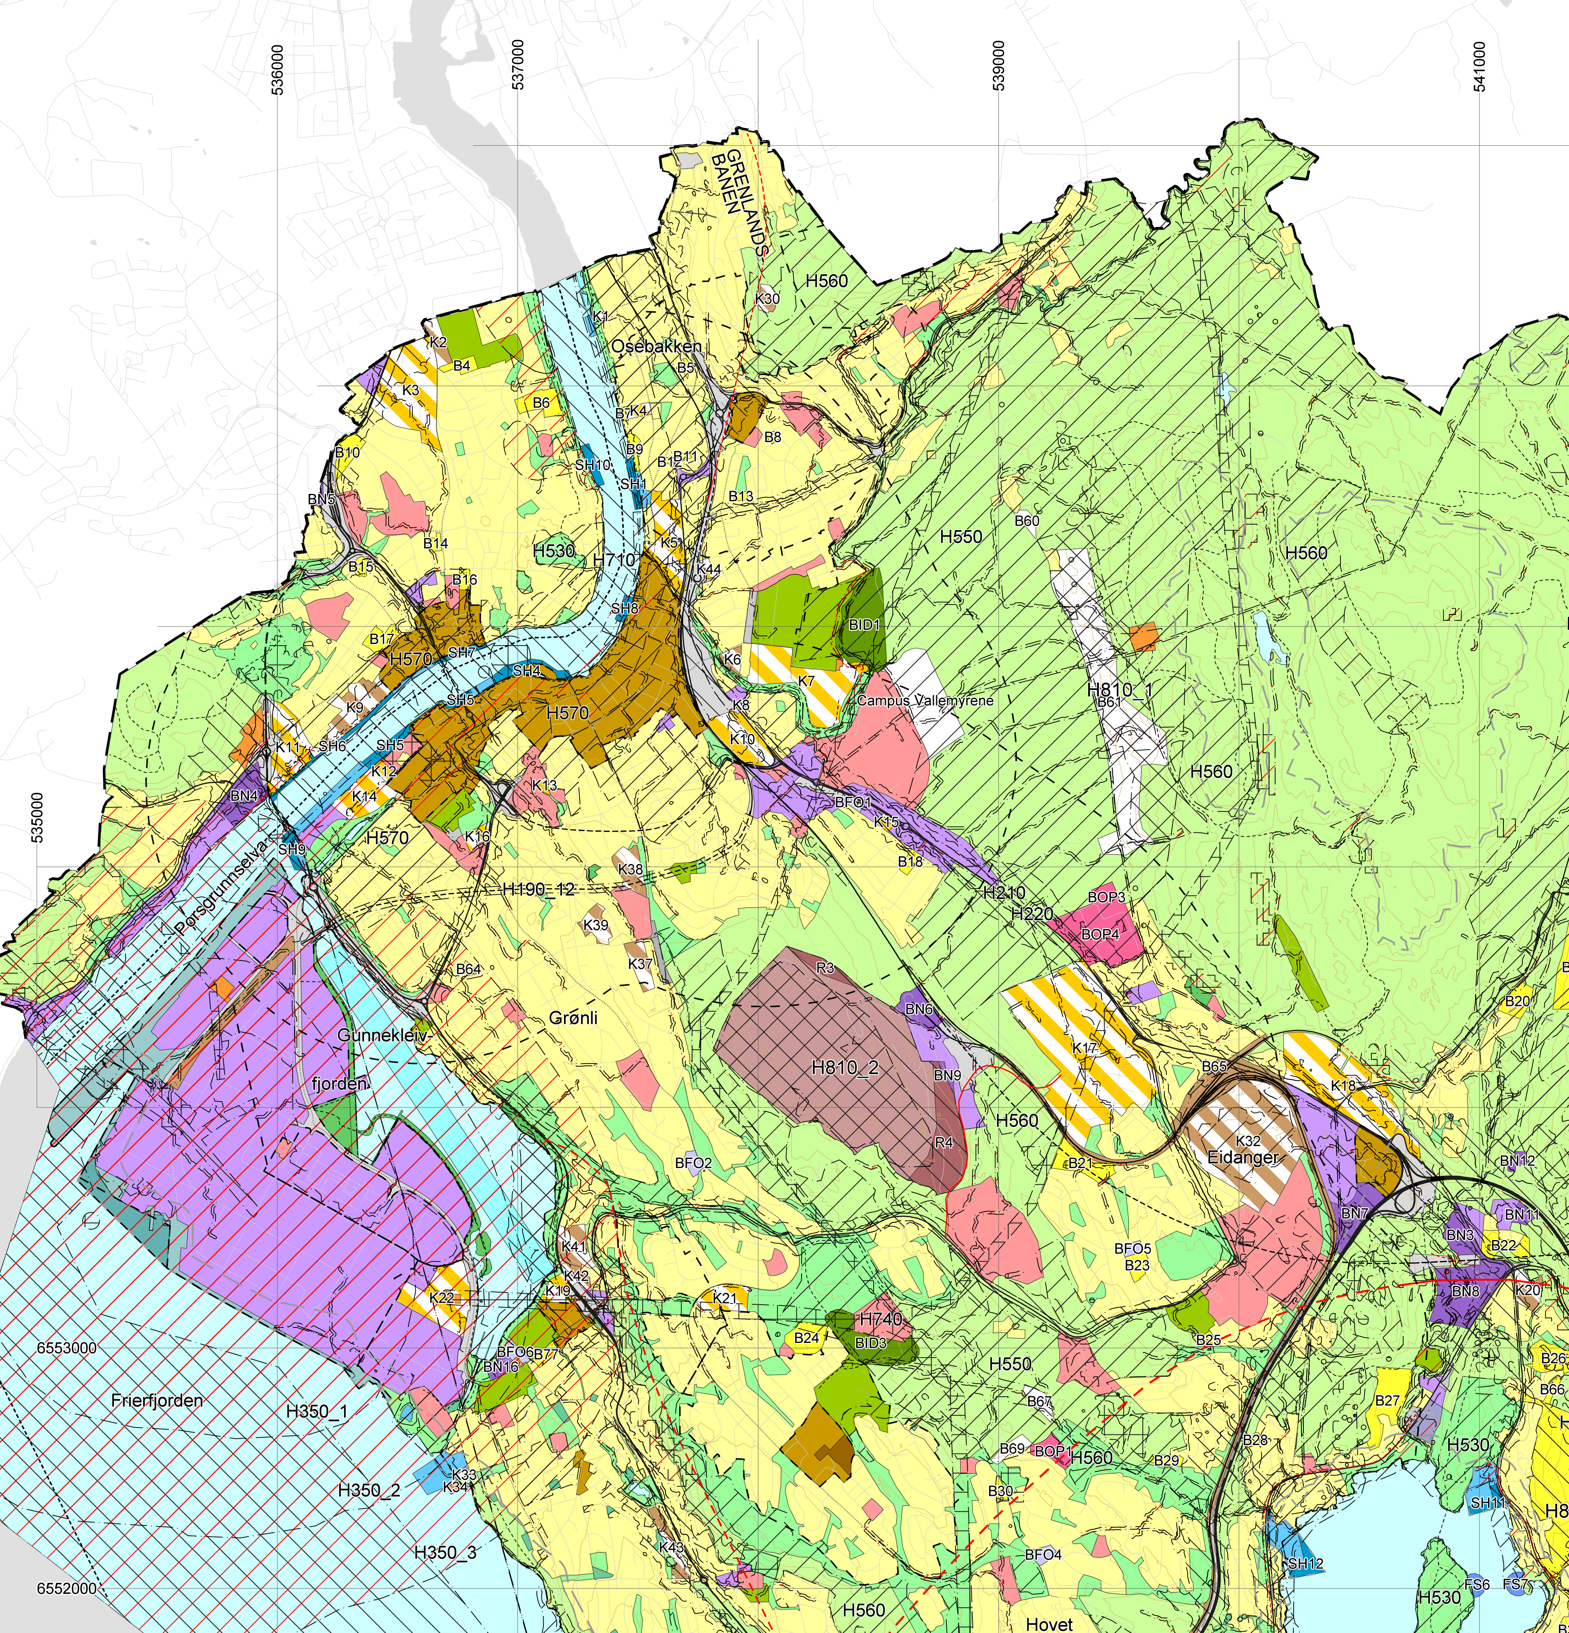
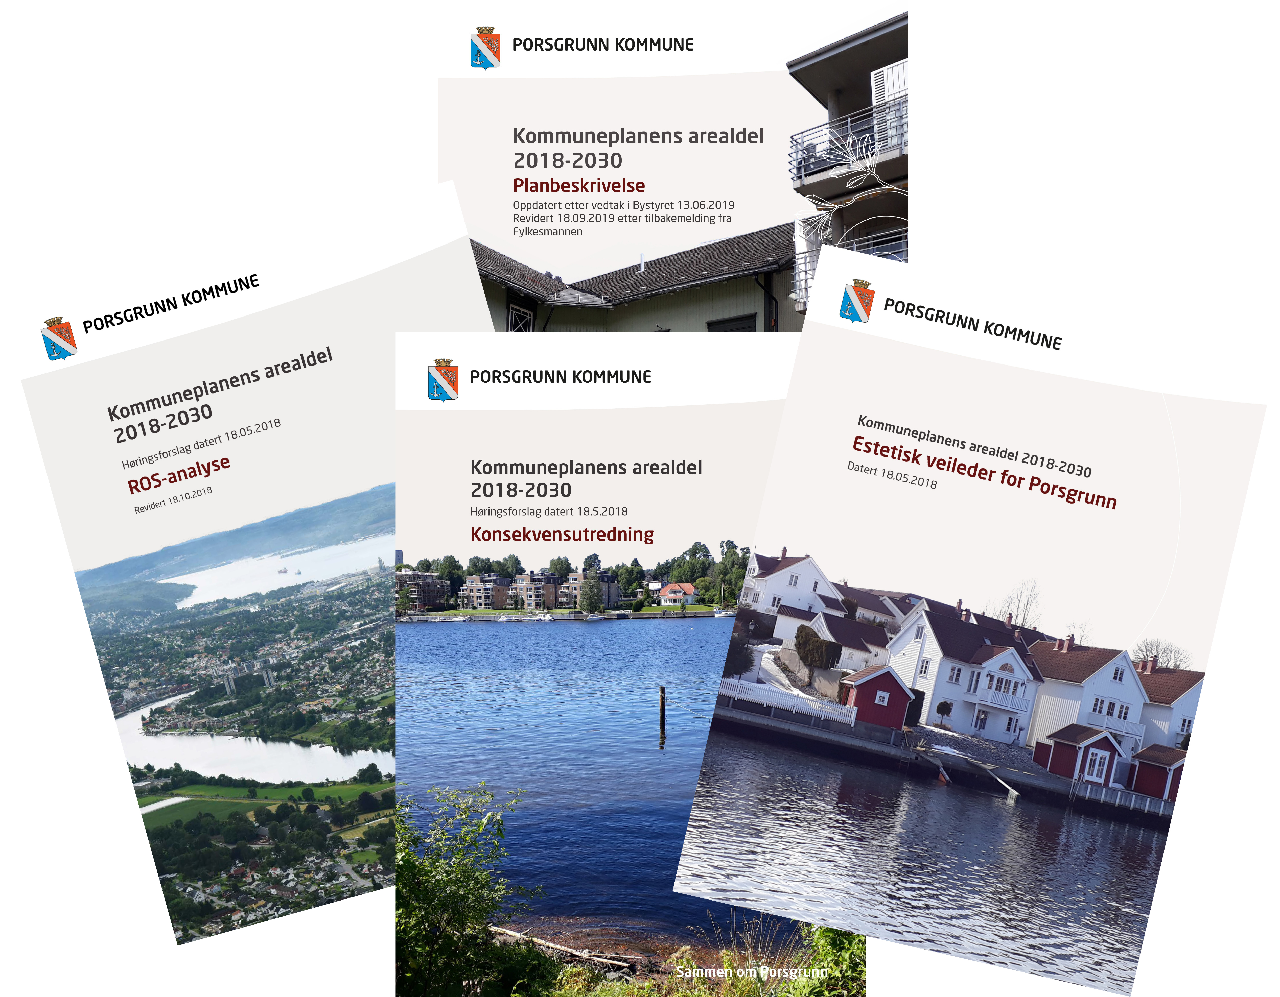
Image source: Porsgrunn kommune
Notes:
All municipalities are required to have a municipal master plan. It provides the framework for the development of the municipal community and management of the land resources. It states conditions under which new measures can be implemented, as well important factors that have to be considered.
The municipal master plan includes maps, provisions and plan descriptions which state how national goals and guidelines, and overall plans for land use, are taken care of.

Slide 9
Zoning plan
Zoning plan is a detailed land use plan with associated provisions that regulate the use and protection of land, watercourses, sea areas, buildings and the external environment in specific areas in the municipality.
Notes:
Zoning plan is a detailed land use plan with associated provisions for the use, protection and design of areas and physical surroundings within the borders of the municipality. Zoning plans shall be adopted by the municipal council and it is afterwards legally binding for all measures within the planning area. Zoning plans may be prepared by both public and private proposer.

Slide 10
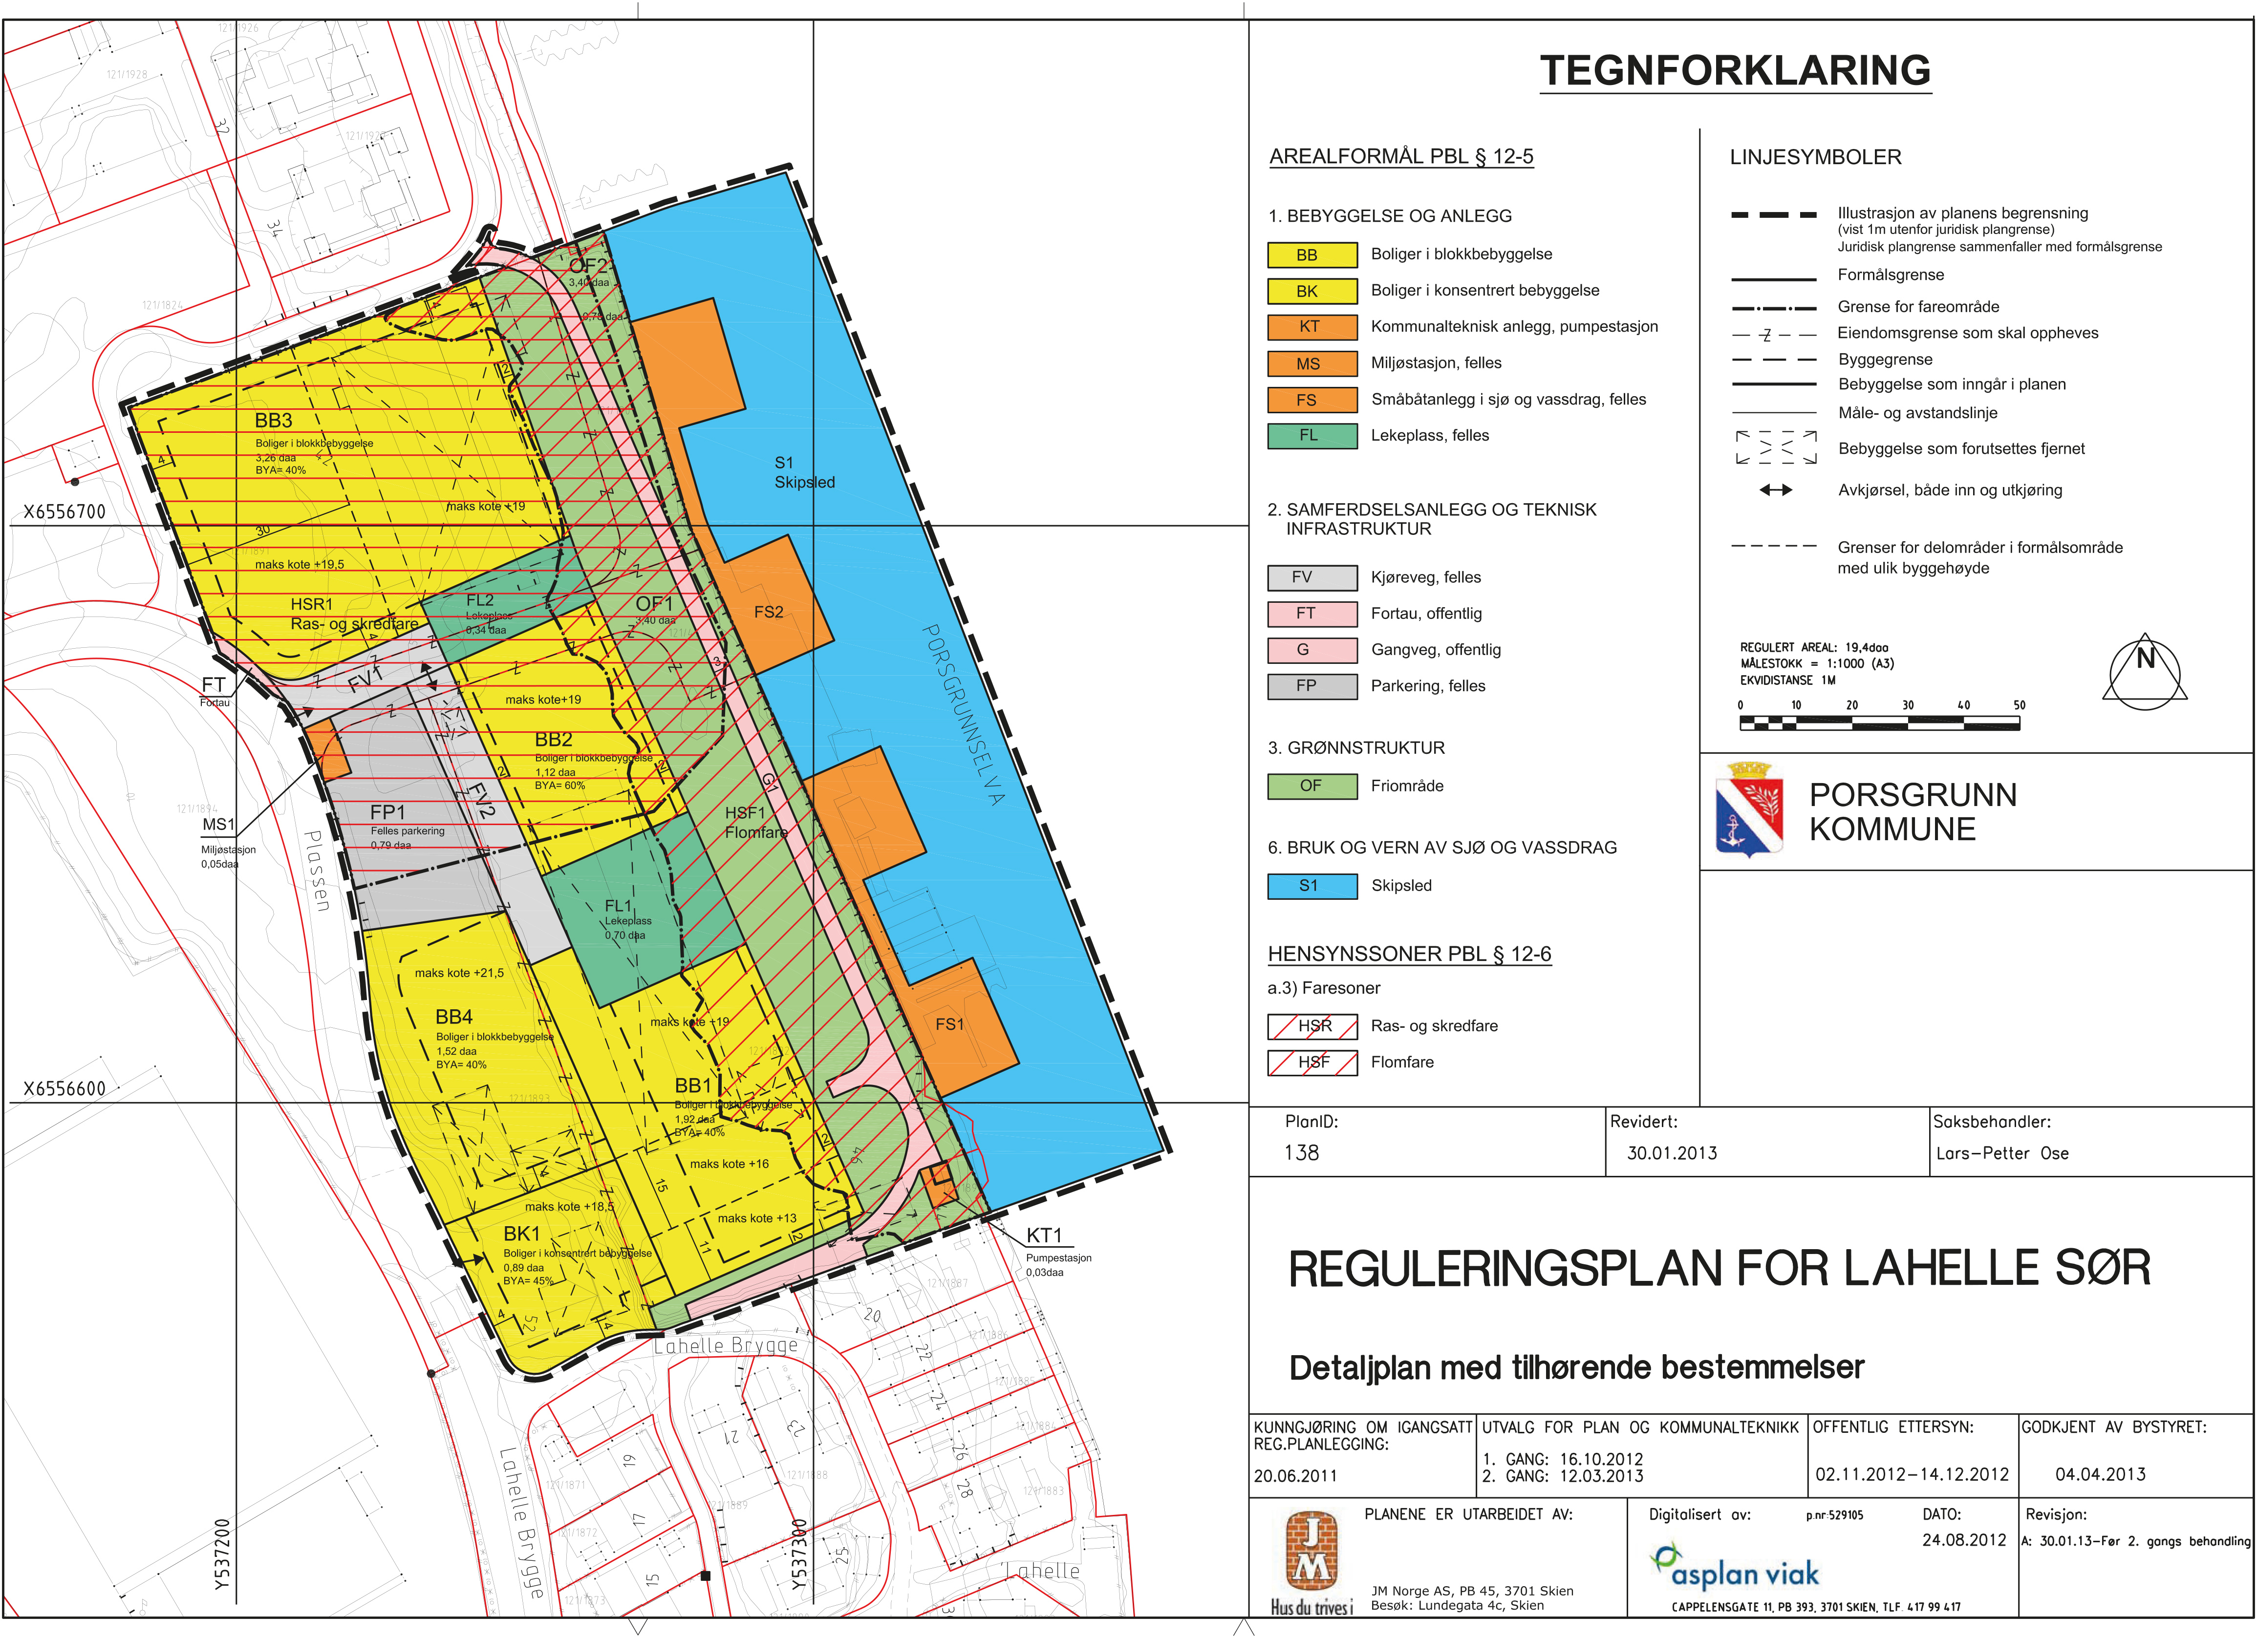
Detailed zoning plan
Detailed zoning plans with associated provisions regulate the use and protection of land, watercourses, sea areas, buildings and the external environment in specific areas in a municipality.
Image source: Porsgrunn kommune
Notes:
Detailed zoning plans with associated provisions regulate the use and protection of land, watercourses, sea areas, buildings and the external environment in specific areas in a municipality. And this example is a initiative from a Private proposer, and decided by the local authority.
Everyone (also private firm og private person) has a right to prepare proposals for detailed zoning plans and have their proposal considered by the municipality. Planning proposals must comply with the main features and limits of overriding plans. If not, it is the developer’s job to assess the consequences of major deviations in relation to such plans.

Slide 11
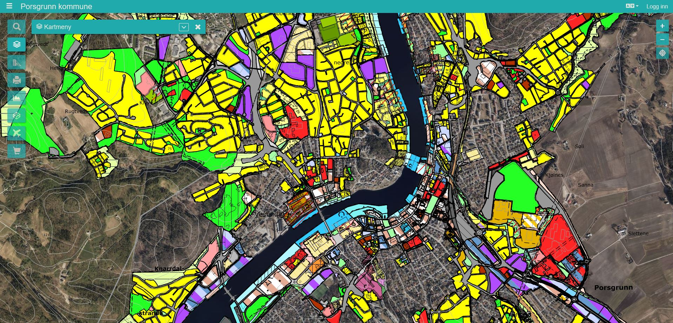
Notes:
Municipality of Porsgrunn uses map system called Geoinnsyn/Webinnsyn which is open for public. The map system contains information about zoning plans, the land-use element of the municipal master plan, properties, historical maps, aerial photos and different thematic maps, f.e. cultural heritage, biological diversity and similar.

Slide 12
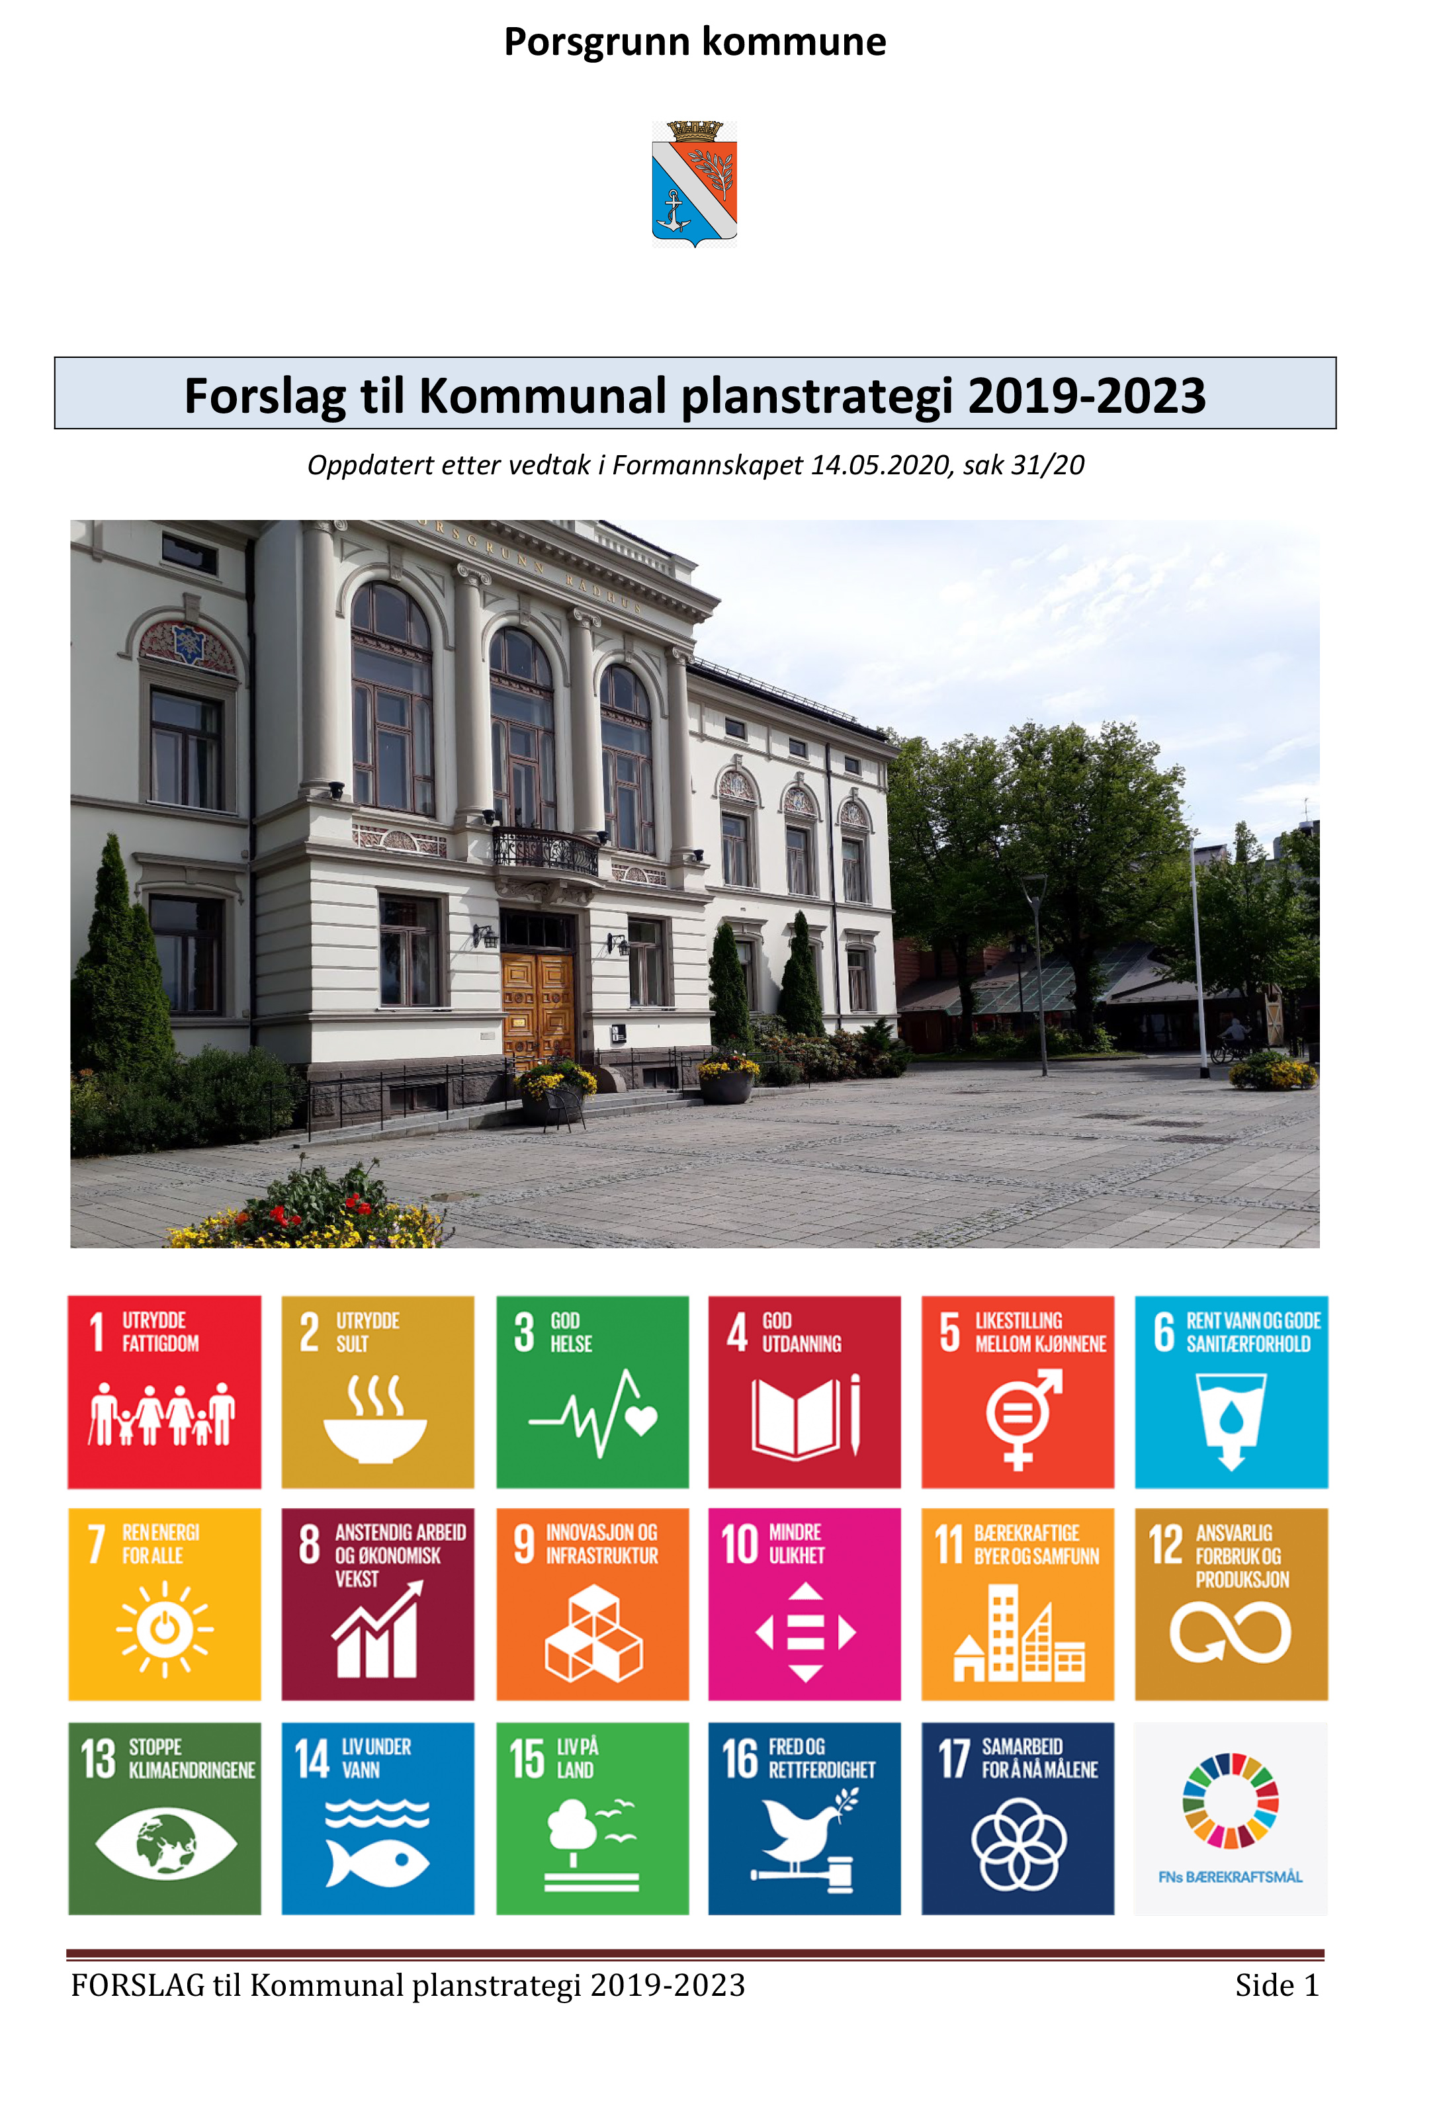
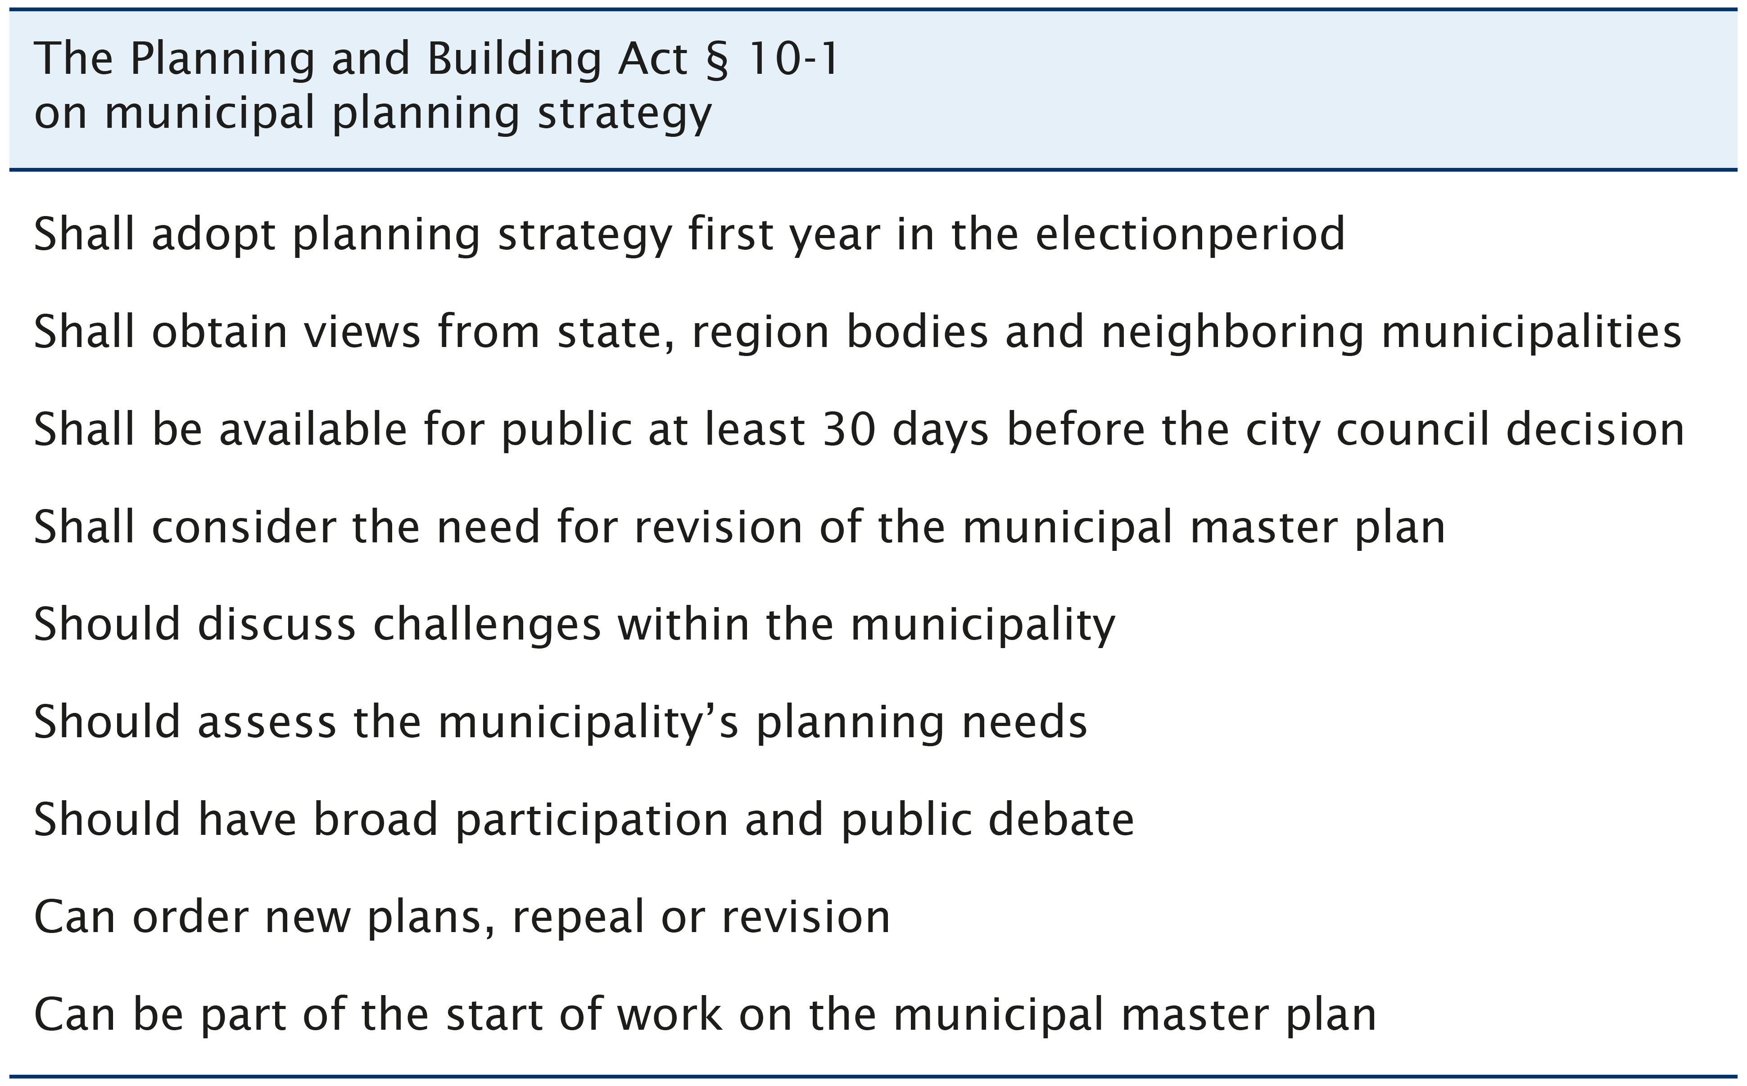
The municipal planning strategy
Image source: Porsgrunn kommune
Notes:
On 3rd of October 2019 a new municipal council was constituted in Porsgrunn. The work with the planning strategy has been organized as a project. On 28th of November 2019 a mandate for the preparation of the municipal planning strategy for the city council period 2019-2023 was approved.
According the law newly elected municipal council shall present its proposal for a municipal planning strategy during the first year of the four-year electoral term.
The municipal planning strategy is not a plan, but a tool to clarify and prioritize municipal planning needs during the election period. This includes strategic choices related to community development, long-term land use, environmental challenges and others.
The purpose of the adopted planning strategy is to clarify which planning tasks the municipality should start up or continue in order to facilitate a desired development. As a basis for the strategy an overview of population’s health has been made and challenges related to public health are discussed in more detail.
The planning strategy is prepared in consultation with neighbouring municipalities and regional authorities. The municipality has a duty to obtain views from these parties. There is also a general recommendation for public participation. In addition, there is a requirement to make the planning strategy available for public, minimum 30 days before city ​​council’s consideration.

Slide 13
The United Nation’s Sustainable Development Goals (SDGs) are integrated in Porsgrunn’s municipal planning strategy
Notes:
The City Council has decided that the UN's sustainability goals will be incorporated in the municipality's management documents and daily operations. Therefore, the UN's sustainability goals and sub-goals have to be incorporated in the municipality's planning, including municipal planning strategy, early in the new city council term.

Slide 14
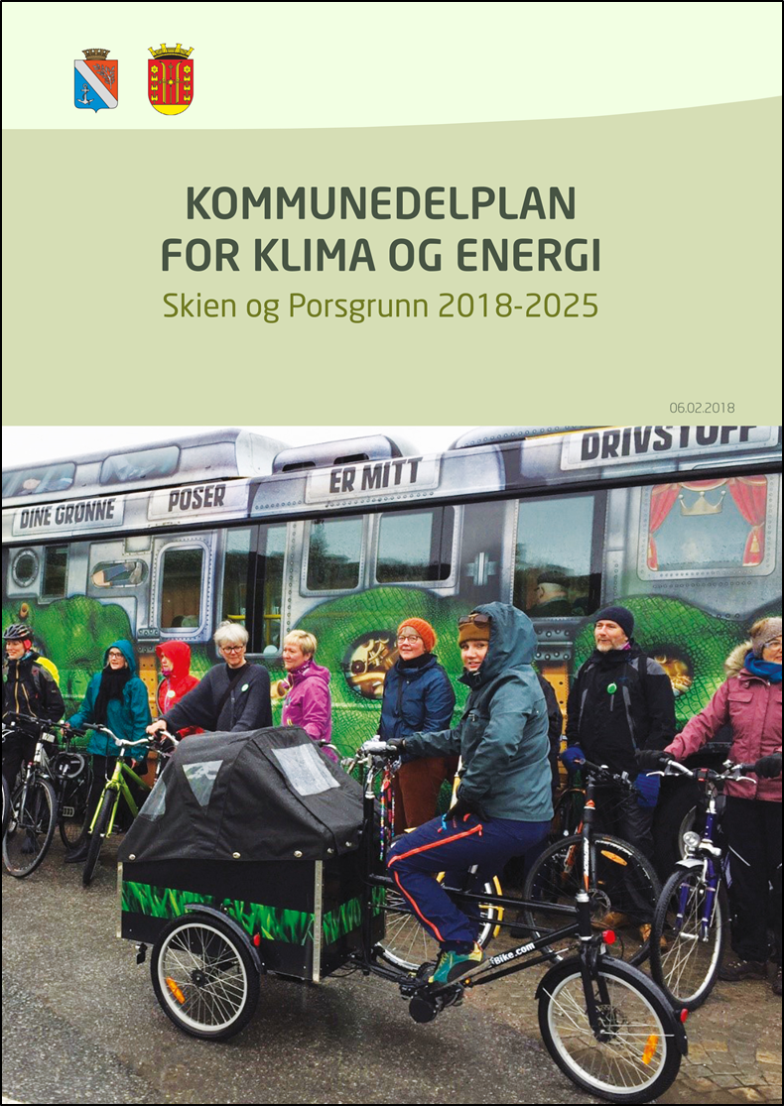
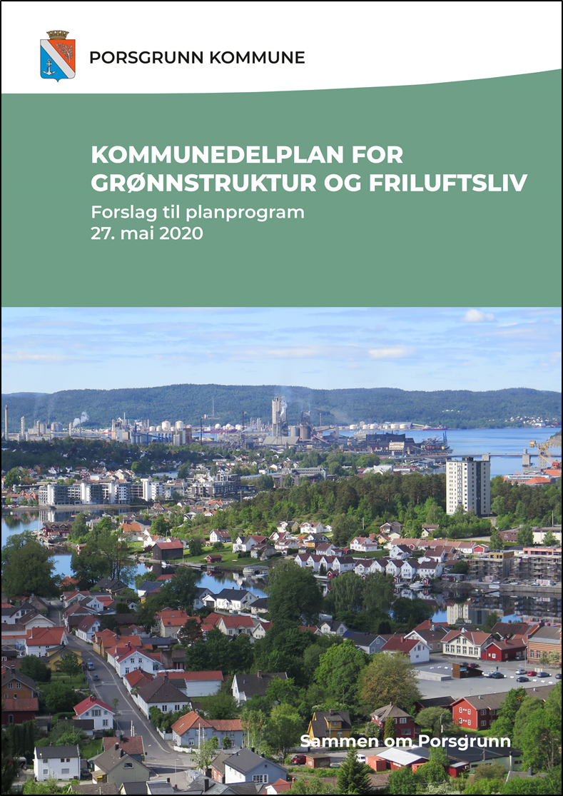
Municipal sub-plan
A municipal sub-plan can be prepared for specific areas or be thematic.
.
The municipal sub-plan is an overall planning document. The plan applies to a larger geographical area and lays down guidelines for further regulation and land use.
Notes:
A municipal sub-plan can be prepared for specific areas, themes or business areas. It may be drawn up if there is a need for more details regarding land use in parts of the municipality.
It can be prepared for a geographical area, f.e. municipal sub-plan for center. Or it can be thematic, f.e. municipal sub-plan for sports and outdoor life.
The municipal sub-plan is an overall planning document. The plan applies to a larger geographical area and lays down guidelines for further regulation and land use.

Slide 15
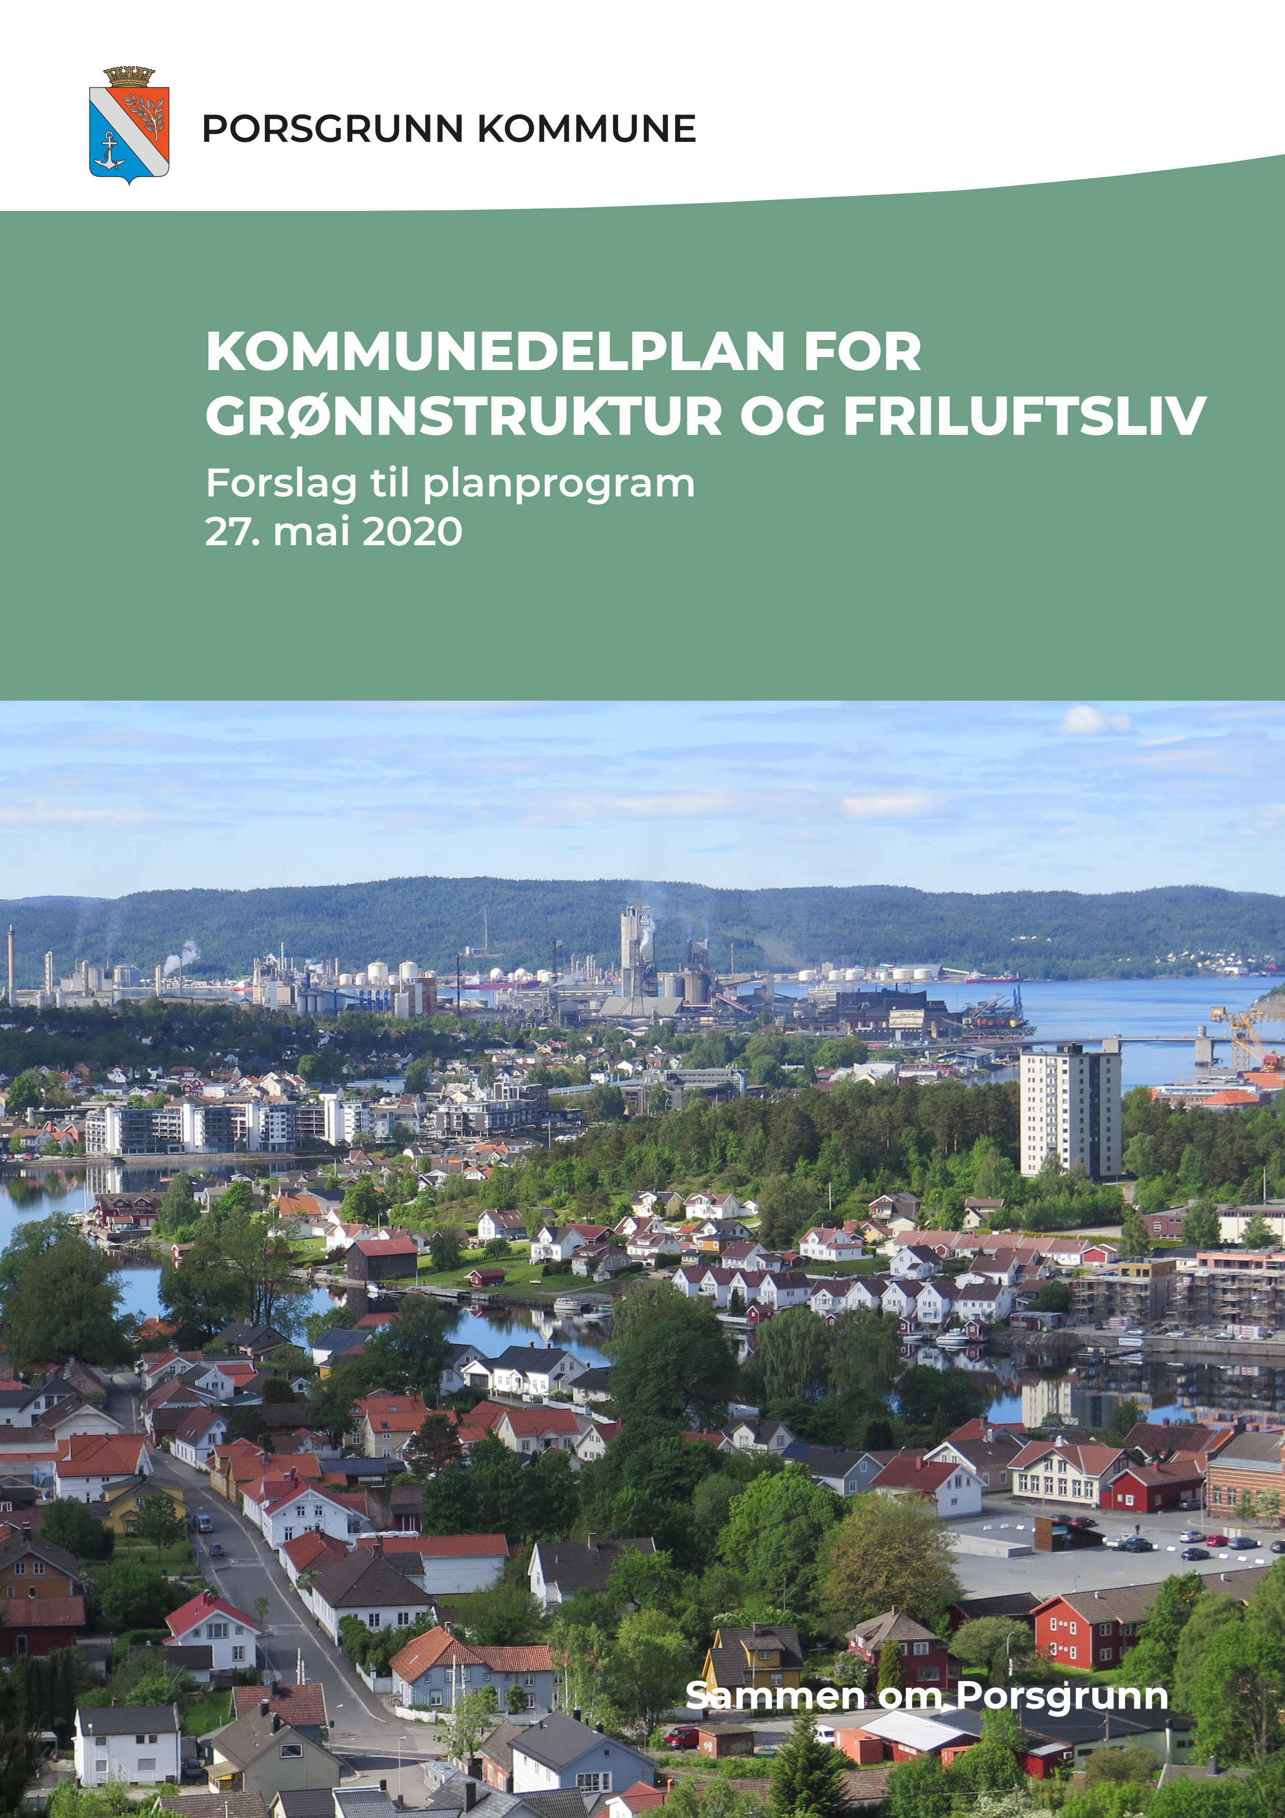
The plan’s purpose
Provides an assessment on quality and variety of the green areas in the municipality.
Provides important information for the municipal master plan (land-use element)
Notes:
The aim of the planning work is to:
- provide an assessment on quality and variety of the green areas in the municipality. It will also assess to what extend is municipality’s green structure is available to the inhabitants.
provide important information for the municipal master plan (land-use element) June 2019 the City Council decided that “the municipal sub-plan for green structure and outdoor life has to be adopted before the next revision of the municipal master plan (land-use part)”.
The municipal sub-plan for green structure and outdoor life will be used for the management and operation of the municipality's green structures and areas for outdoor life, as well as providing guidelines for land use for the next revision of the municipal plan (land-use part). It covers the entire municipality in area.

Slide 16
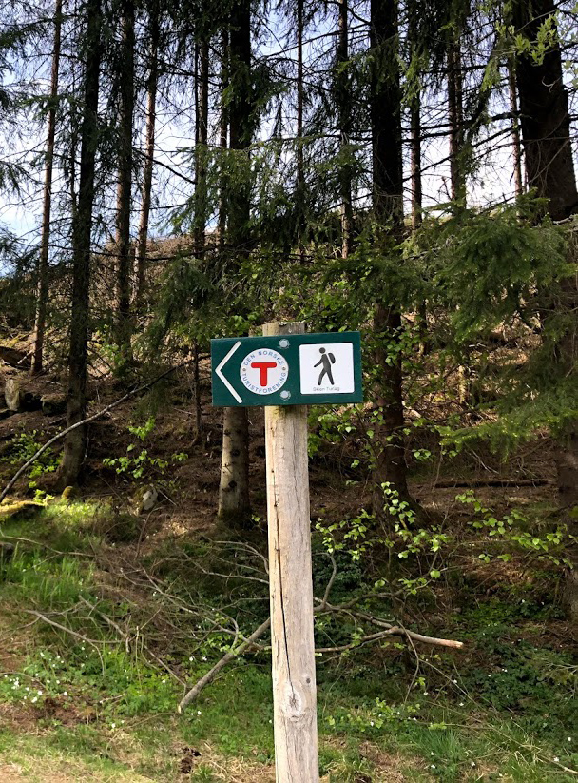
Main principles
Updated information
Different thematic maps
Thematic maps:
Current distance between built environment and the green structure and outdoors areas
Areas within municipality with continuous green connections
The variety of green structure and possibilities for outdoor activities
Image source: Porsgrunn kommune
Notes:
What will the municipal sub-plan for green structure and outdoor life include?
- Updated information about green structure and outdoor life within the municipality
- Different thematic maps within the topic of green structure and outdoor life and activities

Slide 17
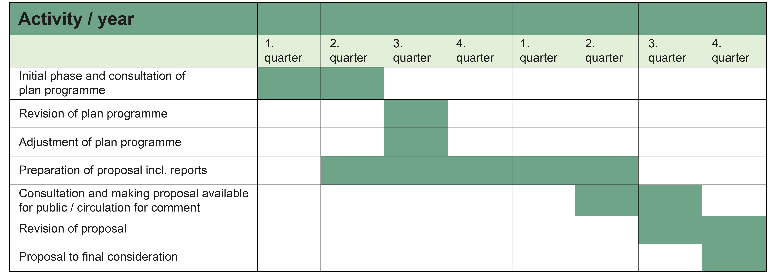
The Process
Notes:
The work with the municipal sub-plan is a complex work that demands time.
Public participation is an important element in this process. The planning department suggests having open office days and information meetings to give inhabitants and associations an opportunity to provide their input and ask questions. Other organizations, government and county authorities will have an opportunity to provide their input on the sub-plan during the consultations.
Necessary information about the planning work is published on the municipality’s website and in at least one local newspaper.
Participation and Covid 19 /Corona – It will be different.

Slide 18
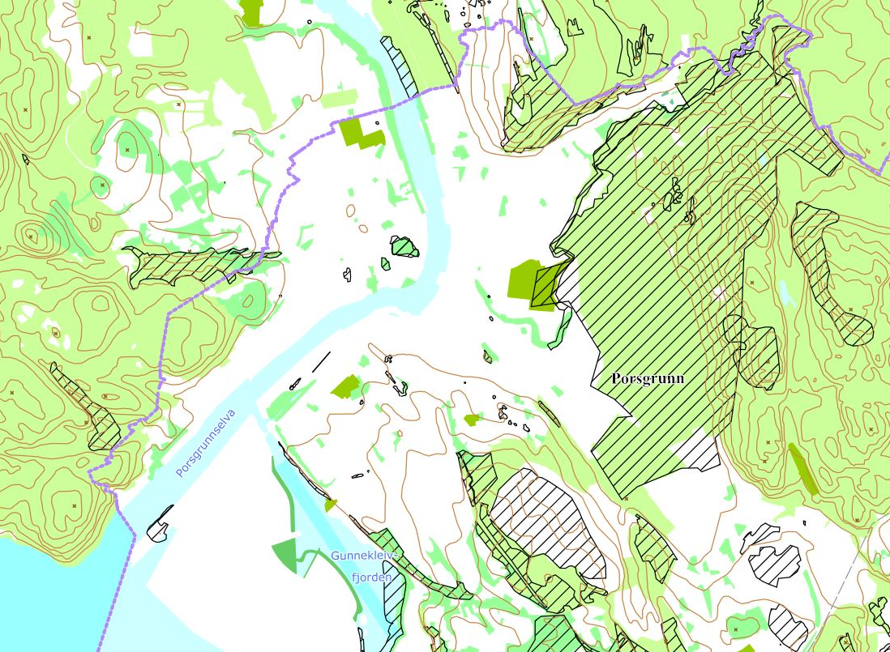
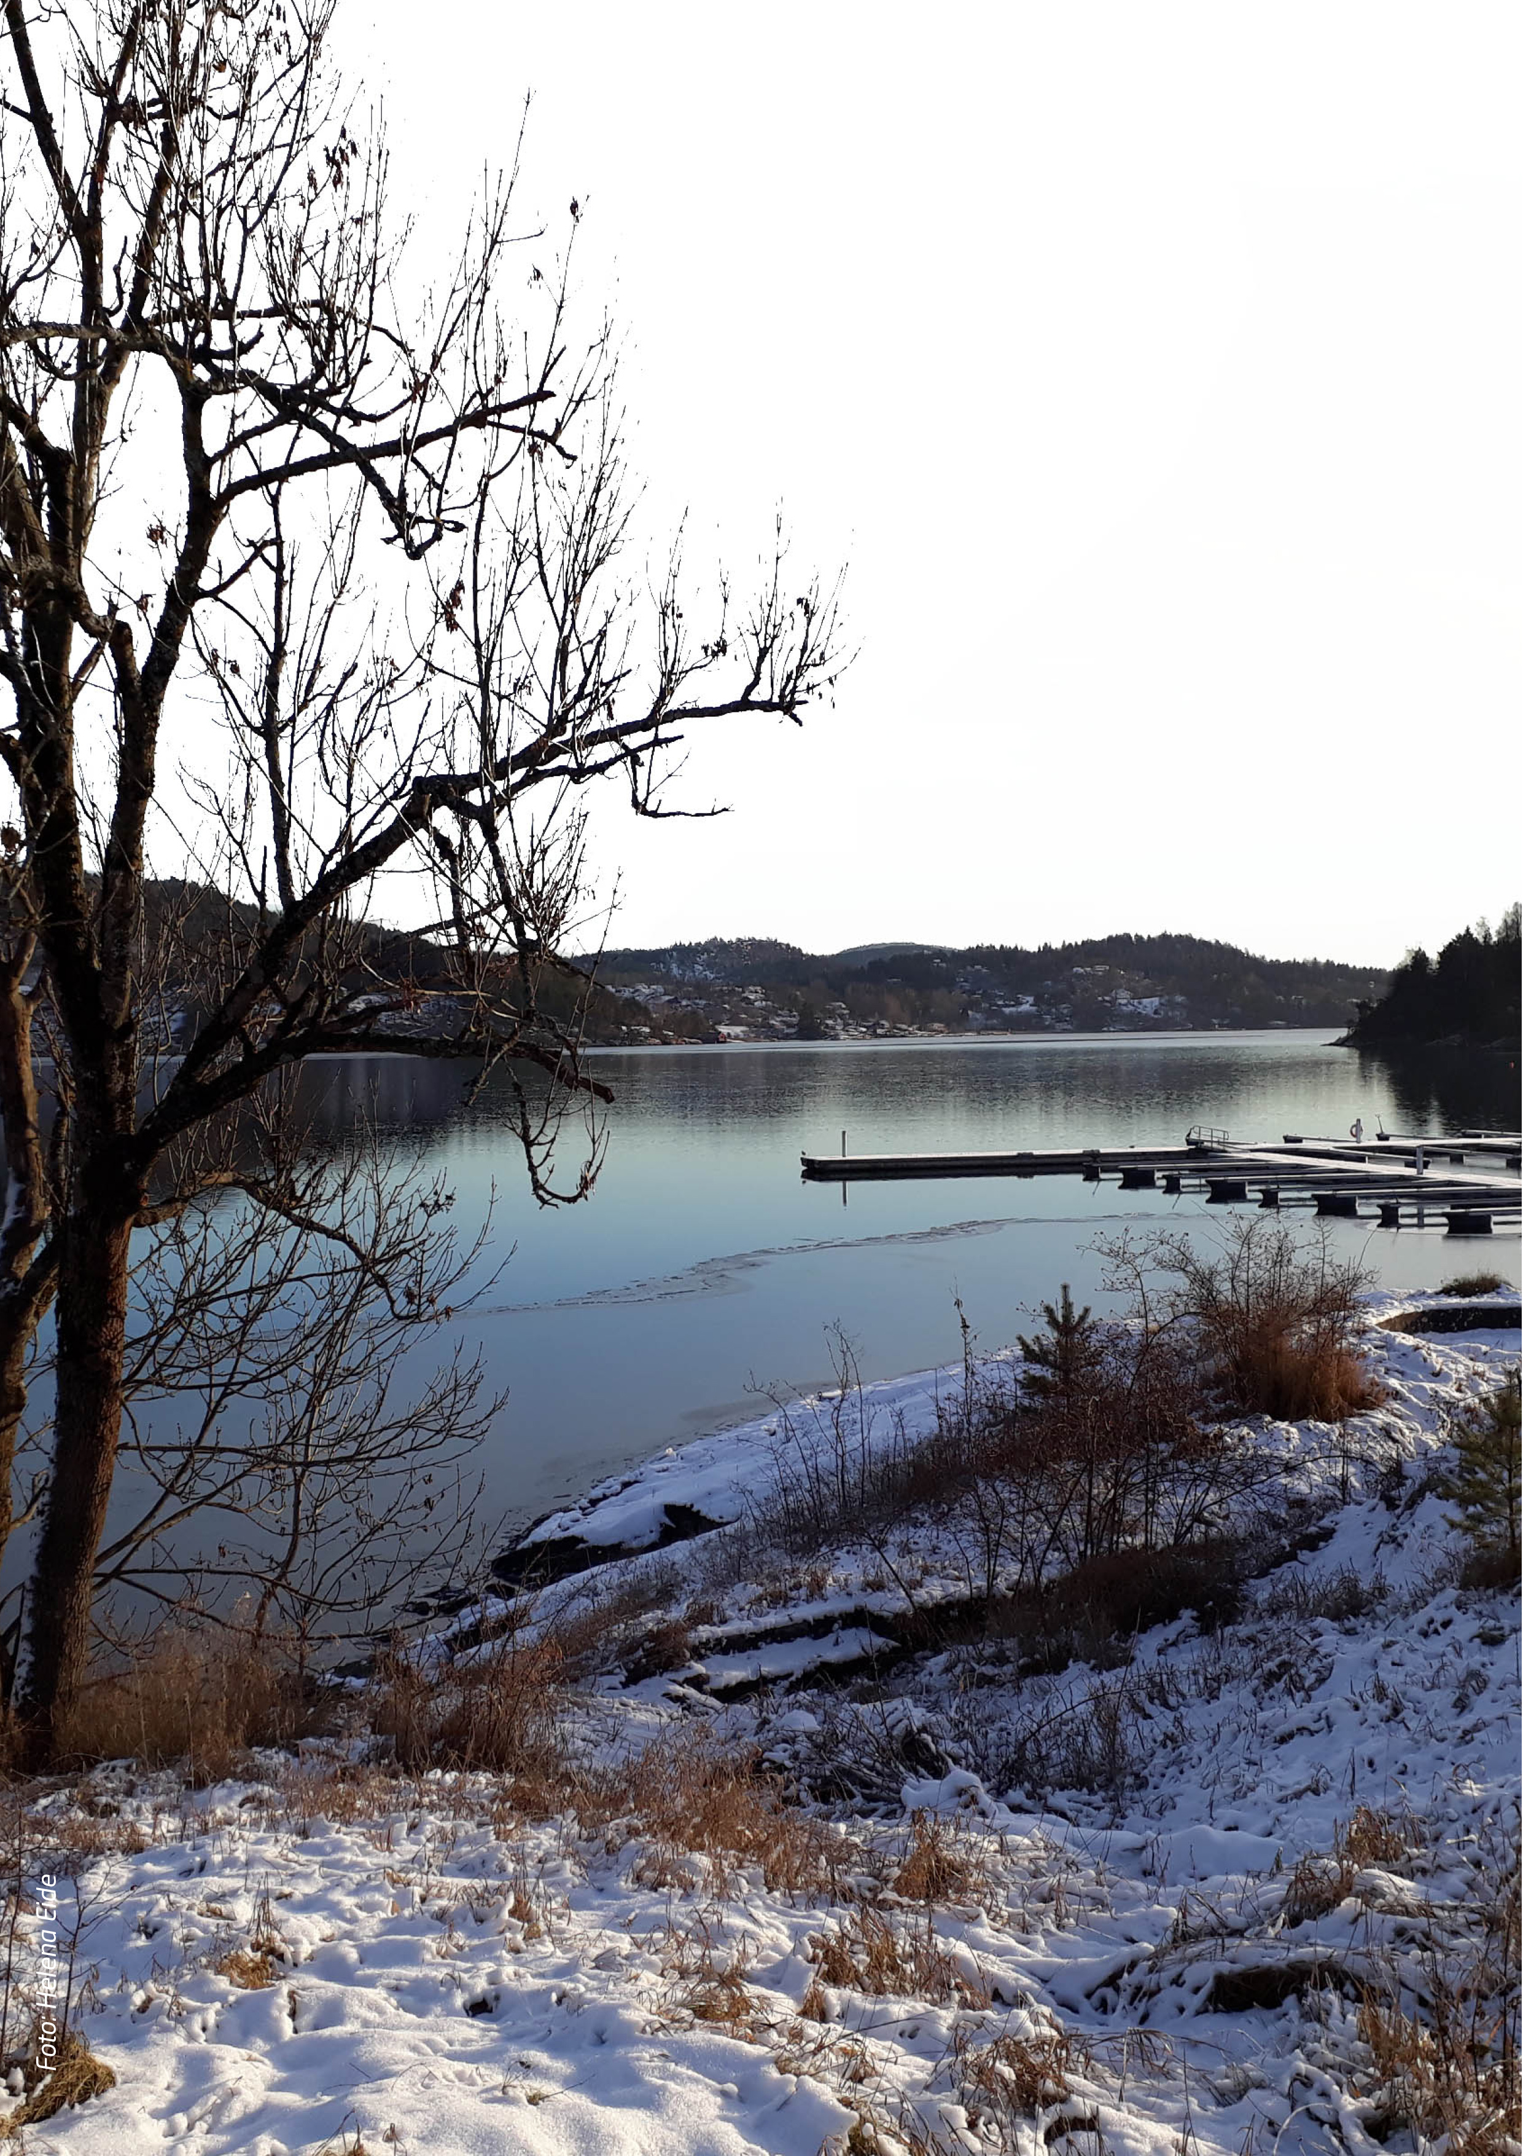
Notes:
Why is it important?
It is desirable that green structure in the city and built environment will have a good connection with the surrounding nature and green areas.
The city's 100-meter forest, municipality’s fjords, the surrounding landscape and the hills close to the city centre are only few examples that define important green qualities which contribute to attractive city development and outdoor life. The combination of urbanity and closeness to recreation and nature contributes to better quality of life and well-being of many.
In order to ensure good public health in Porsgrunn, it is important to try to incorporate green with urban structures. Mapping of green structures close to the city centre will also provide guidelines for building and planning processes.
The green structure is also an important element in climate work. It can be relevant for dissipation of surface water, as in densely urbanised areas heavy rainfalls can lead to problems controlling the surface water. Conscious design of green areas will make cities better prepared to deal with current and future climate change.
In addition attractive walking and cycling paths can increase walking and cycling as transport modes, thus helping to reduce greenhouse gas emissions.

Slide 19
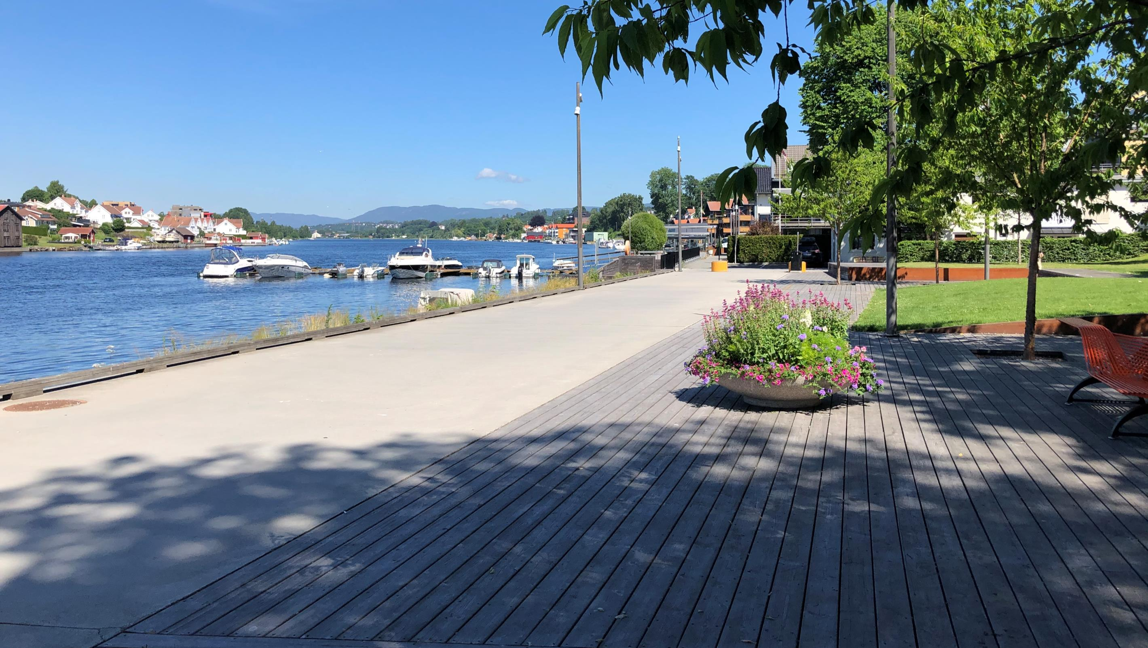
The river promenade is an important part of the green area in the city centre
Foto: Elise Brændaas

Slide 20
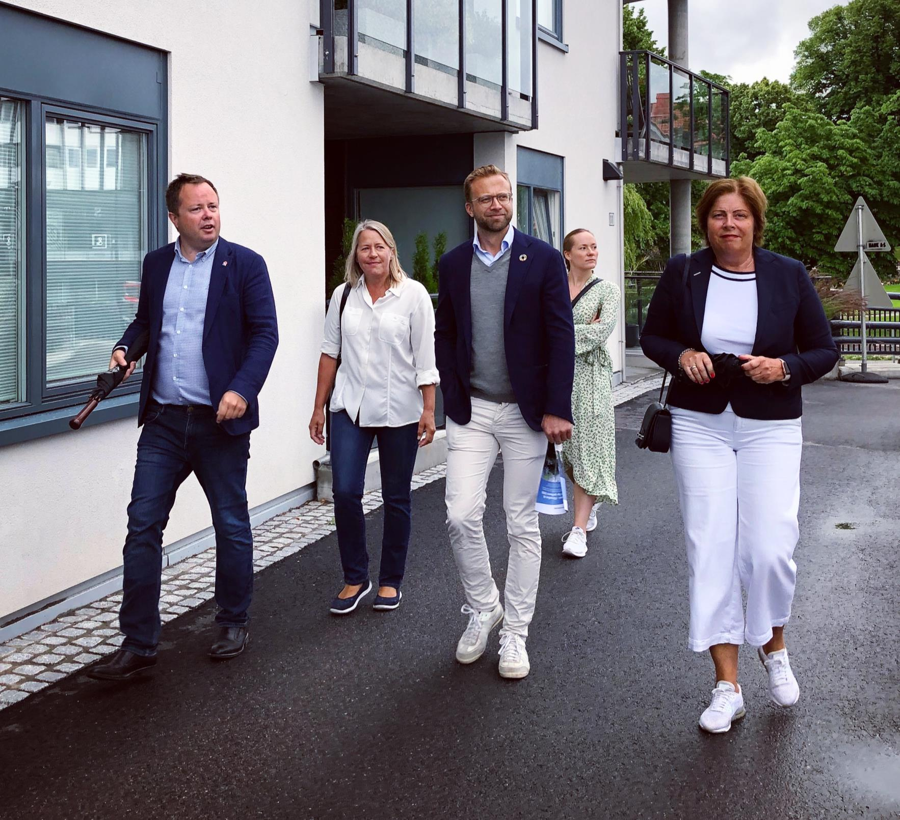
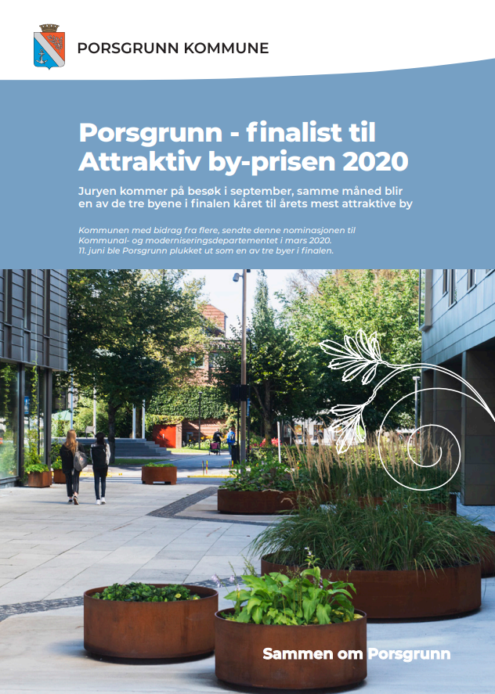
Porsgrunn was one of a finalists for the Attractive City Award 2020. Here, Minister for Local Government and Regional Development, Nikolai Astrup, inspects the city together with mayor Robin Kåss
Foto: Elise Brændaas

Slide 21
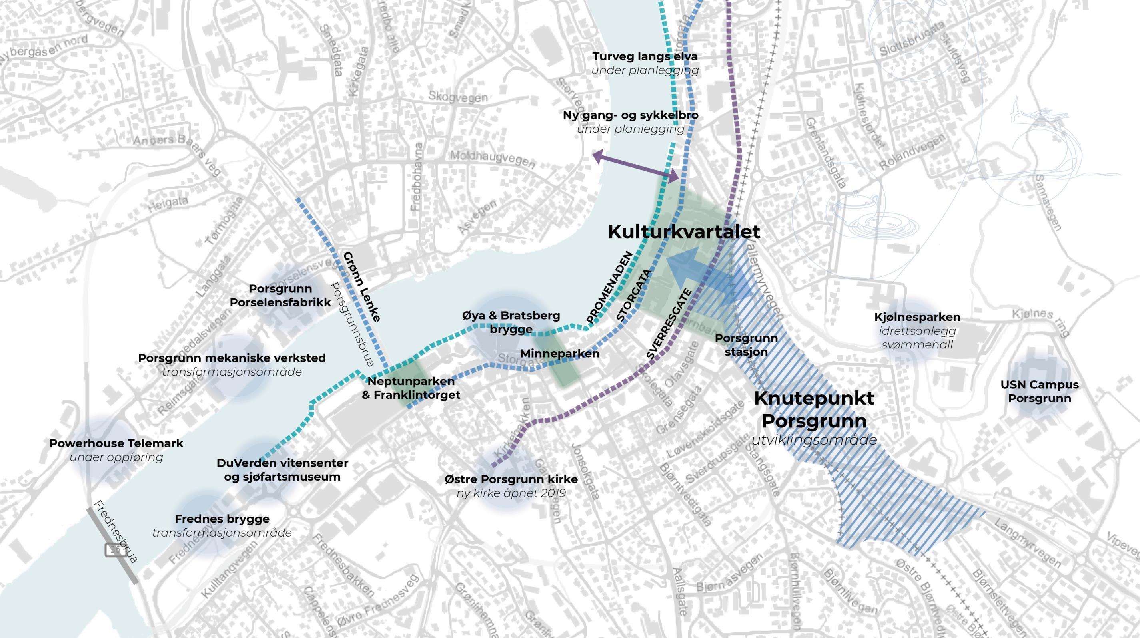
The «Node» («Knutepunktet») and the city centre
New hotel and office buildings on Kammerherreløkka
Major development plans in the area known as «the node» («knutepunktet»)
Ongoing development and transformation processes along the riverbanks
Down Town kjøpesenter
Illustrasjon: Byutvikling

Slide 22
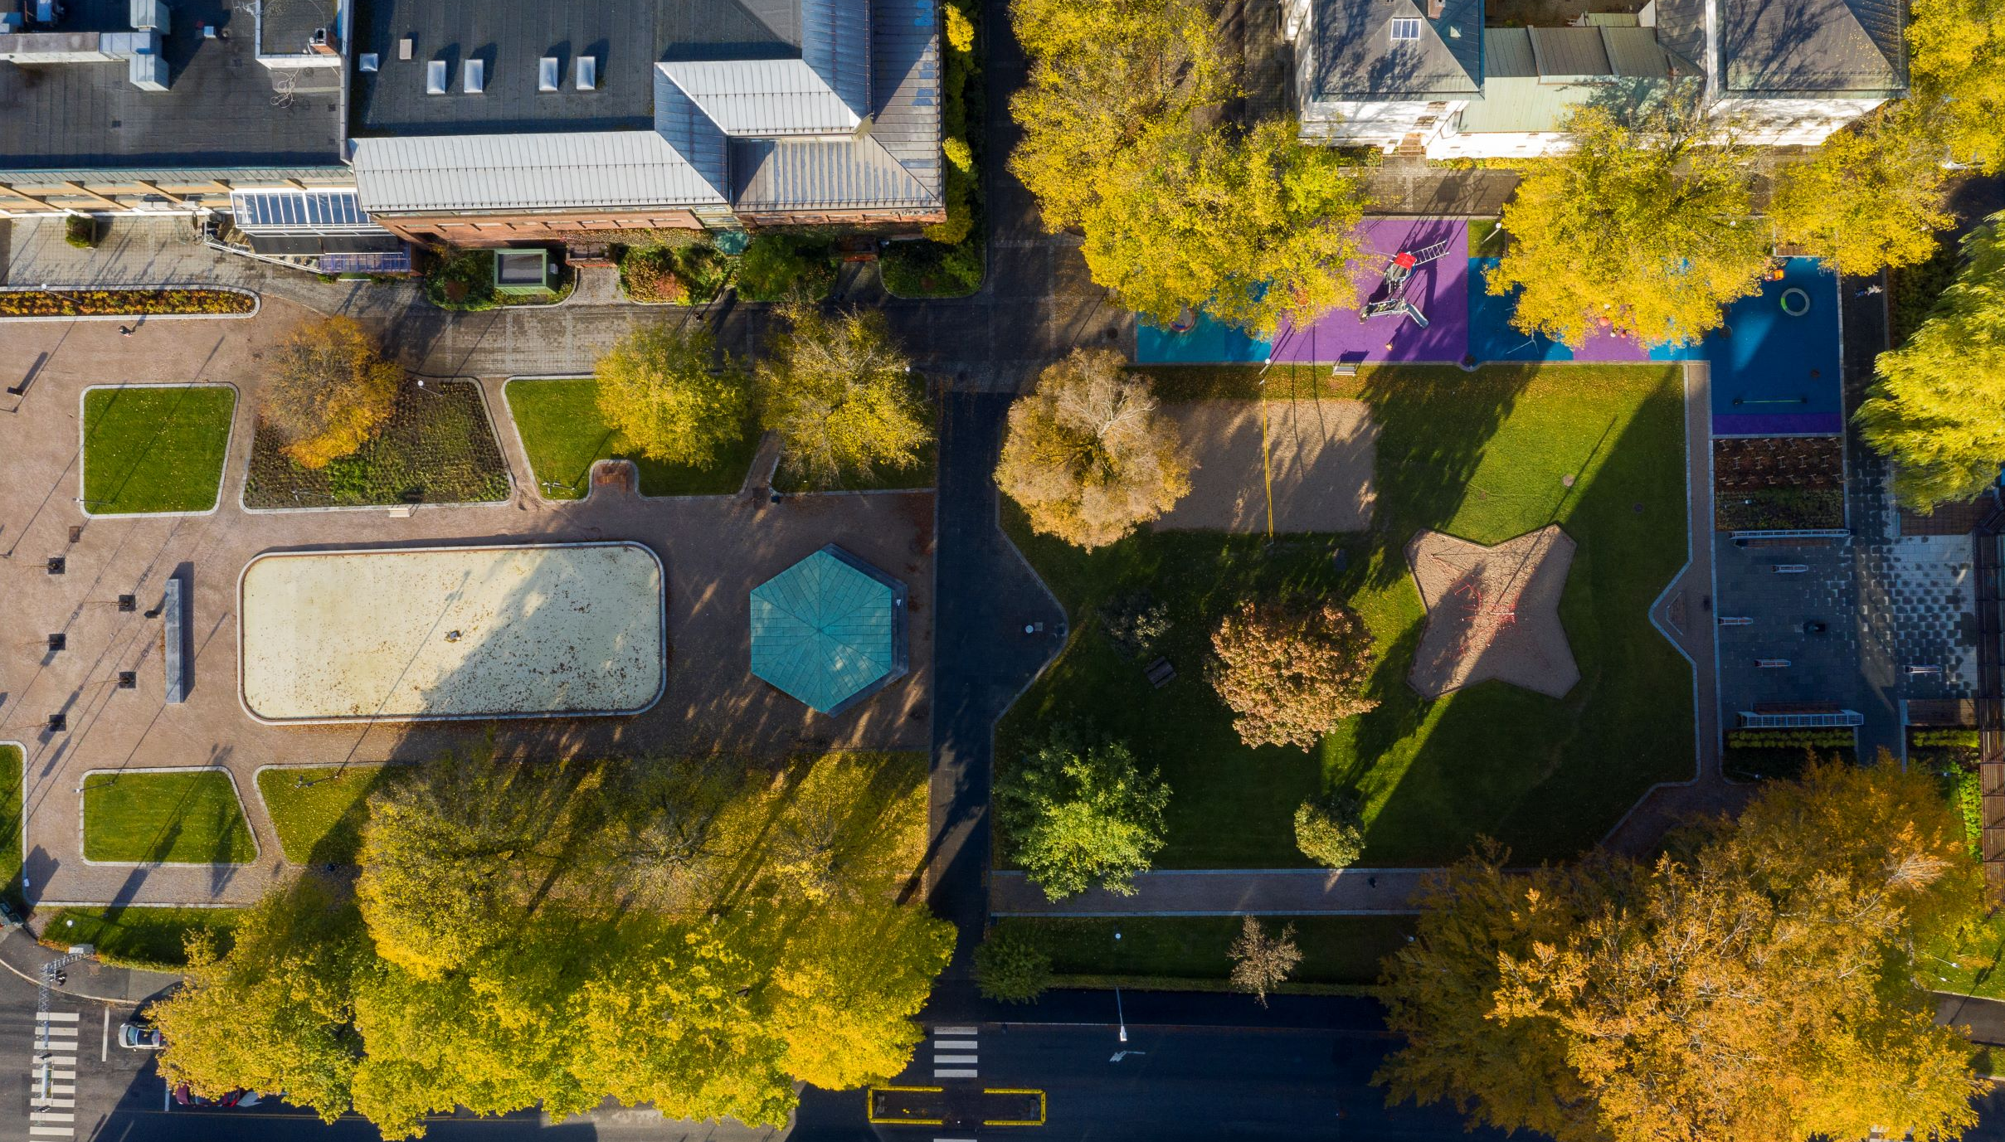
Town Hall Park
Foto: Dag Jenssen

Slide 23
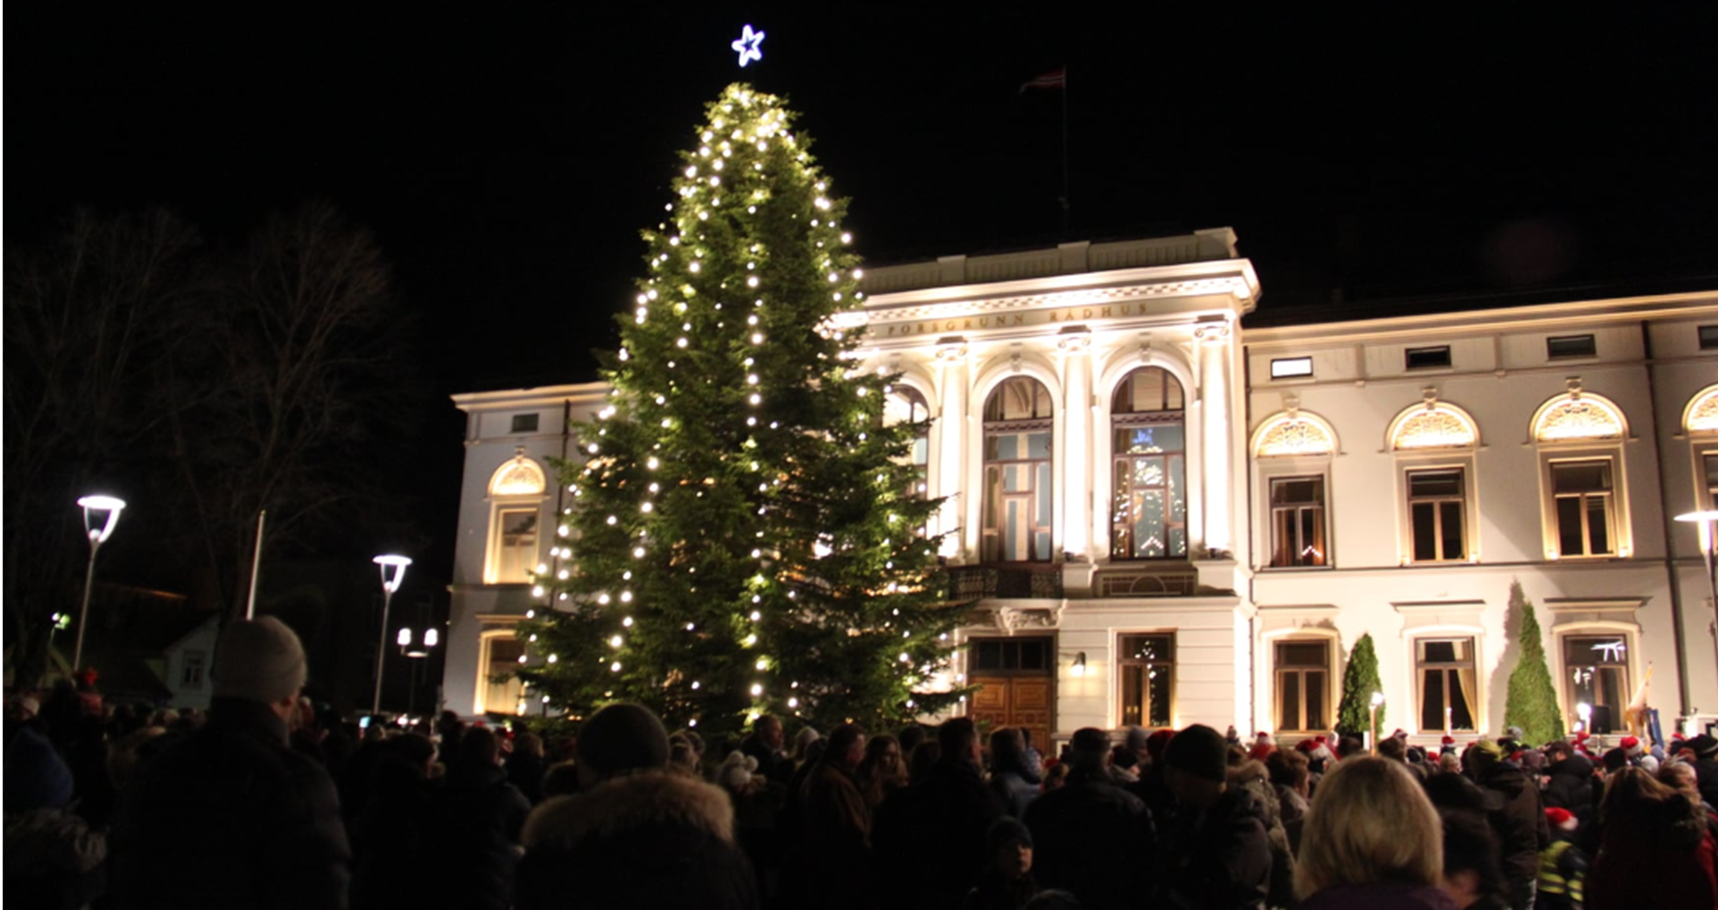
The Cultural Quarter functions as a
communal space throughout the year

Slide 24
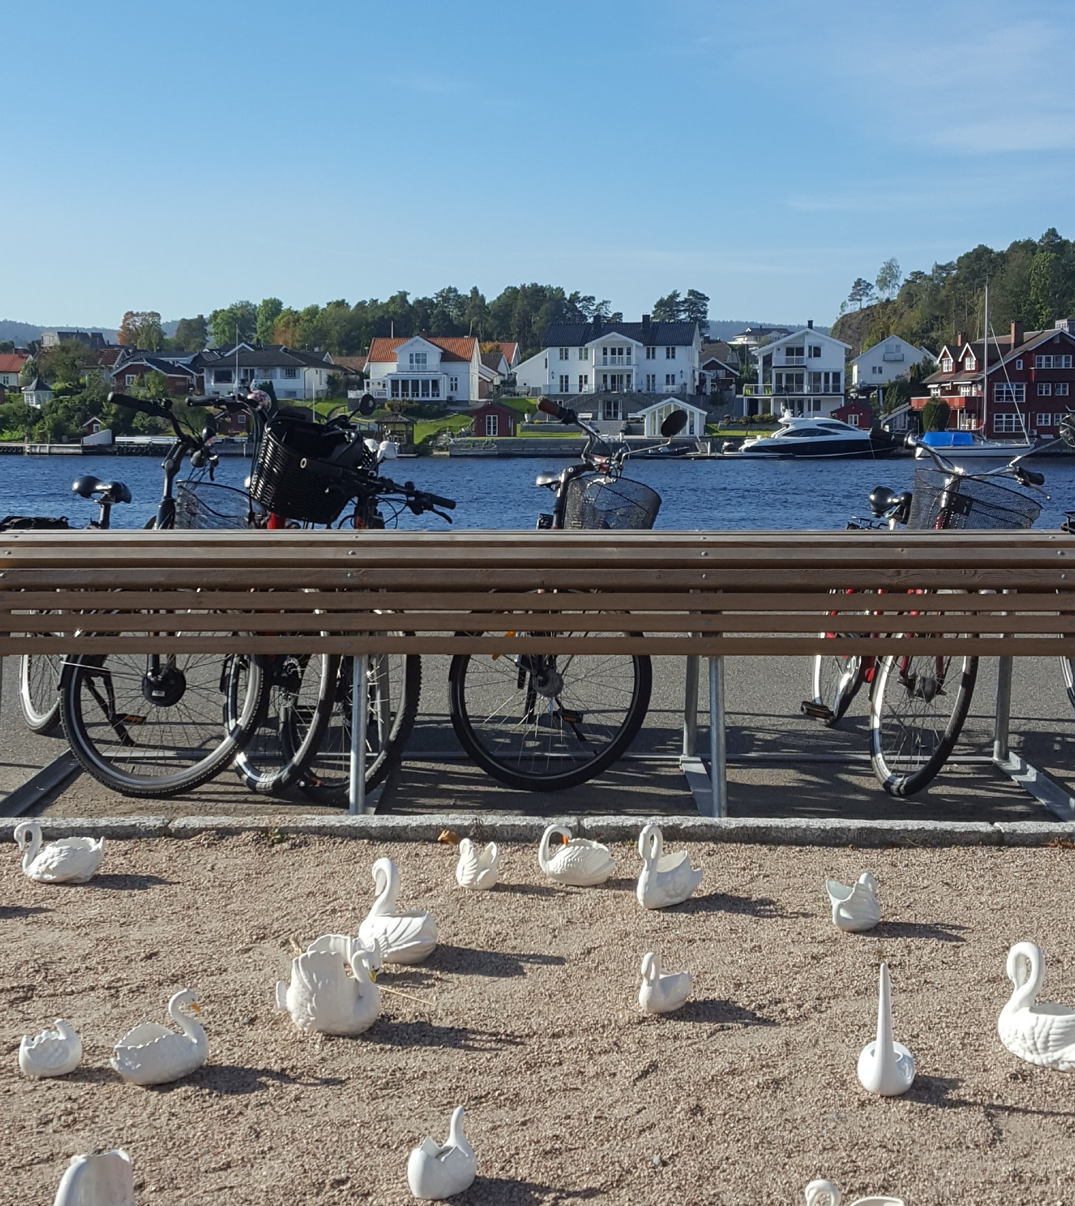
The river is important to the city. And the river promenade is important to the inhabitants.
Foto: Elise Brændaas

Slide 25
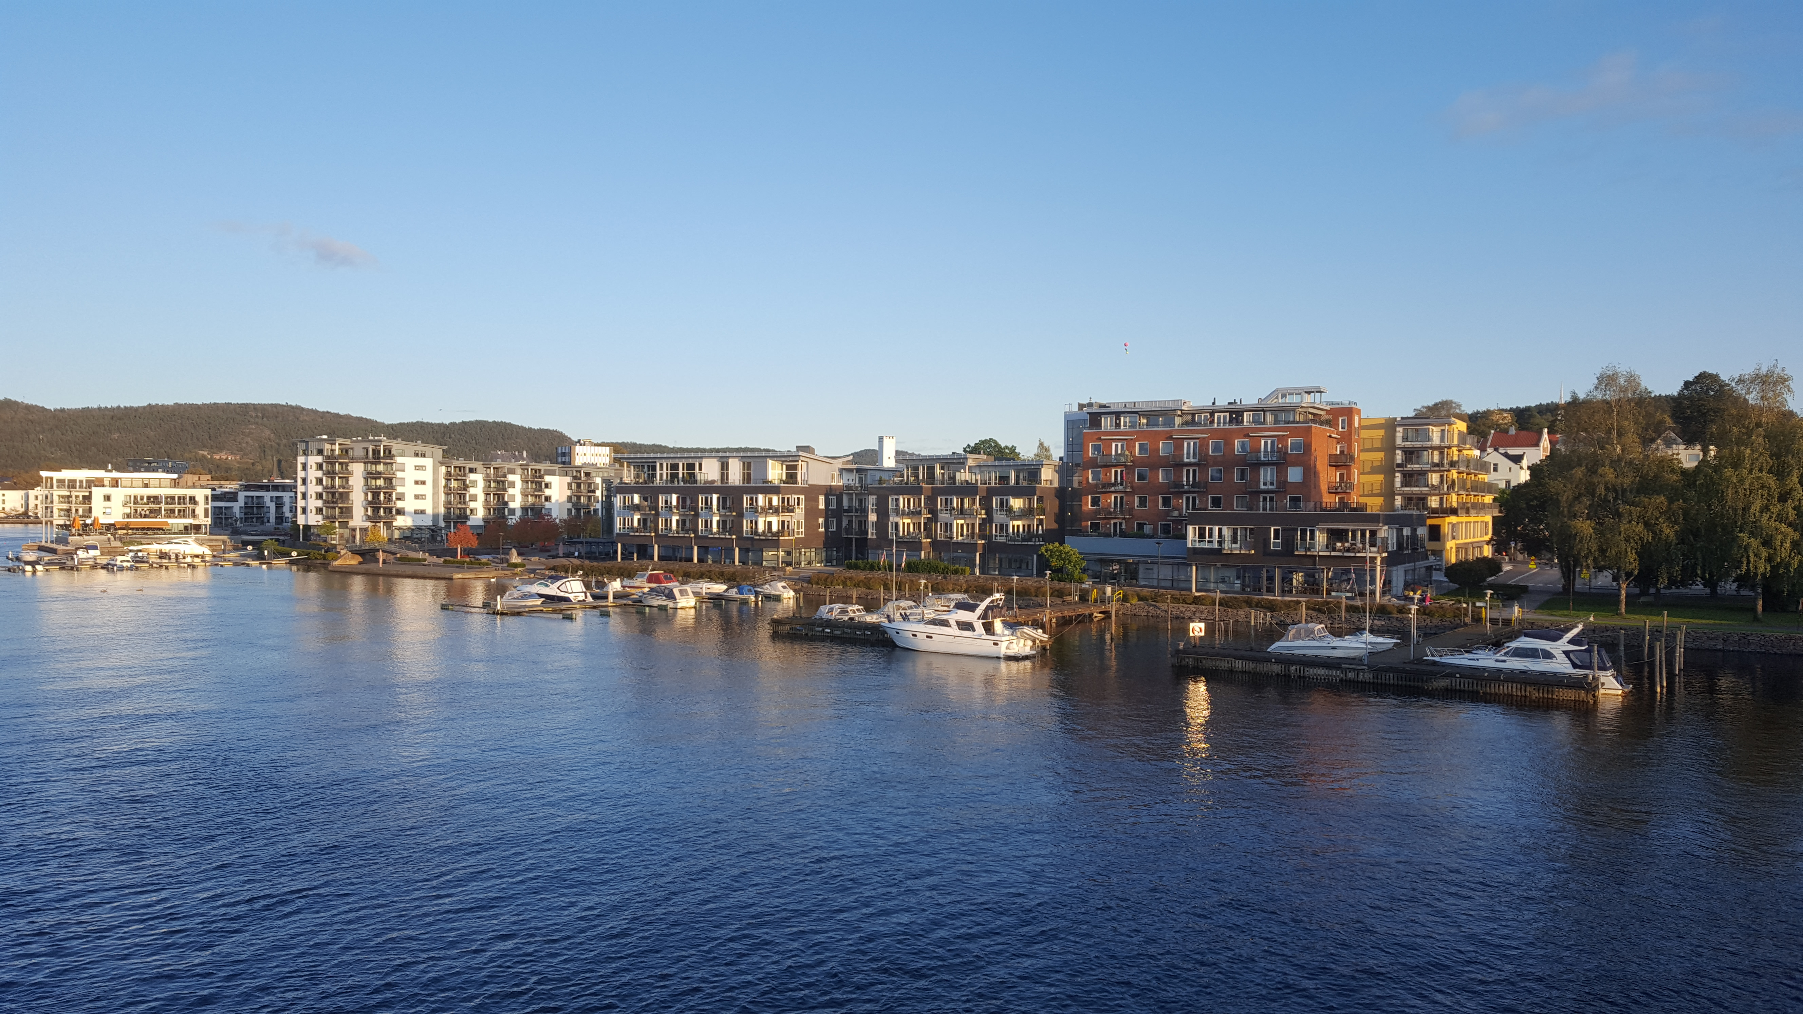
The riverbank is long, and its development has been accomplished in stages
Foto: Elise Brændaas

Slide 26
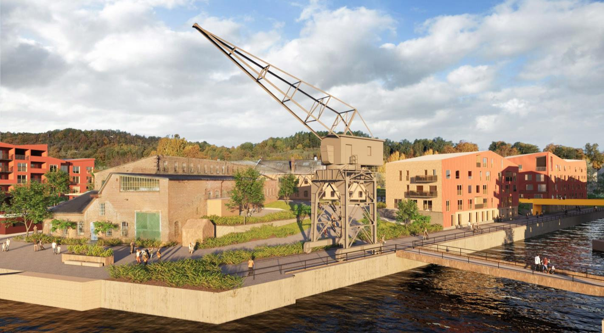
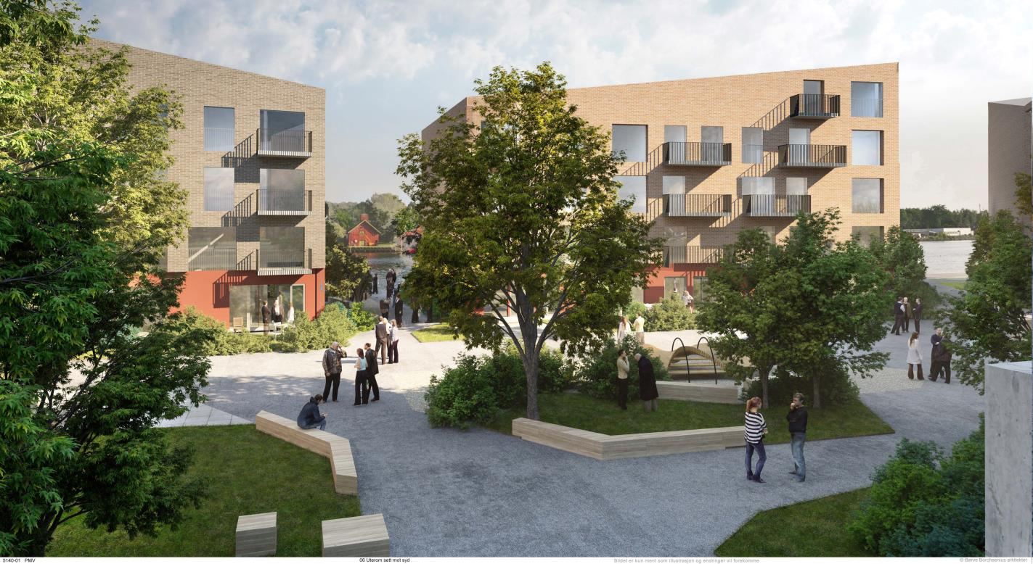
Porsgrunn Mechanical Yard
Former industrial space in attractive, central areas along the river being transformed
Illustrasjoner: Børve Borchsenius Arkitekter AS

