Slide 1
THE BILATERAL ASPECT of projects under the «Local Development» Programme

Slide 2
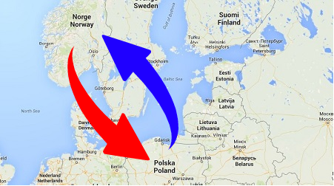
BILATERAL PARTNERSHIPS IN CITY-TO CITY PROJECTS
54 Polish cities are in the final phase of developing a comprehensive development plan – the cities with the 15 best development plans will receive 3-10 million euro to finance the implementation of selected parts of the development plan
It is a bilateral objective that each of the 15 cities receiving financial support shall have a Norwegian or Icelandic municipality as project partner
Every development plan will be accompanied by a document in which Polish priorities and expectations vis-à-vis a future Norwegian or Icelandic partner are formulated
All 54 cities are required to dedicate a minimum amount of 150 000 euro to cover the costs of the bilateral cooperation with a Norwegian or Icelandic municipality

Slide 3
After the selection of 15 cities to receive funding:
KS will attempt to find a matching Norwegian partner to each of the selected Polish cities
KS will organize a webinar for Norwegian municipalities in the autumn of 2020 to promote the possibility of partnership with a Polish city
KS will also liaison with the Icelandic Association of Local Authorities in order to make contact with interested Icelandic municipalities
If a suitable Norwegian or Icelandic partner cannot be found, the amount dedicated to the bilateral partnership will be returned to the Project Operator
Partnerships will continue throughout the implementation period – that is, until the 1st quarter of 2024

Slide 4
Some examples of NO/IS involvement include
Work in cooperation to develop a common product (a new technology, a strategy paper, a performance or a study);
Advisor in a certain area of expertise;
Exchange knowledge with professionals in a certain field;
Provide training to share knowledge, or take part in training to increase knowledge;
Facilitate meetings and visits (workshops, study visits, internship);
Cooperation on the organisation of workshops or conferences.

Slide 5
Planning the partnership project M2M
Most importantly, agree on your roles in the proposed project, the contribution to the project (deliverables) and the division of the budget between NO /IS and PL municipality.
Think carefully about NO/IS expected costs and use of time in the project. The project budget should cover the hours NO/IS partner intend to spend on working on the project as well as any costs they have directly related to their involvement in the project, such as travel, accommodation, translation costs, audits etc.
Keep in mind that there are substantial differences in cost levels in the donor and beneficiary countries. It might be necessary to alert the project promoter to this when you are drawing up the project budget.
Set aside sufficient budget for administration and reporting, as this will form part of NO/IS involvement in the project.

